Slide 1
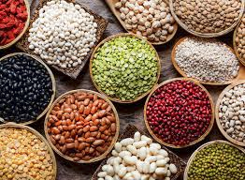
What is a seed?
How can we learn more about them?

Slide 2
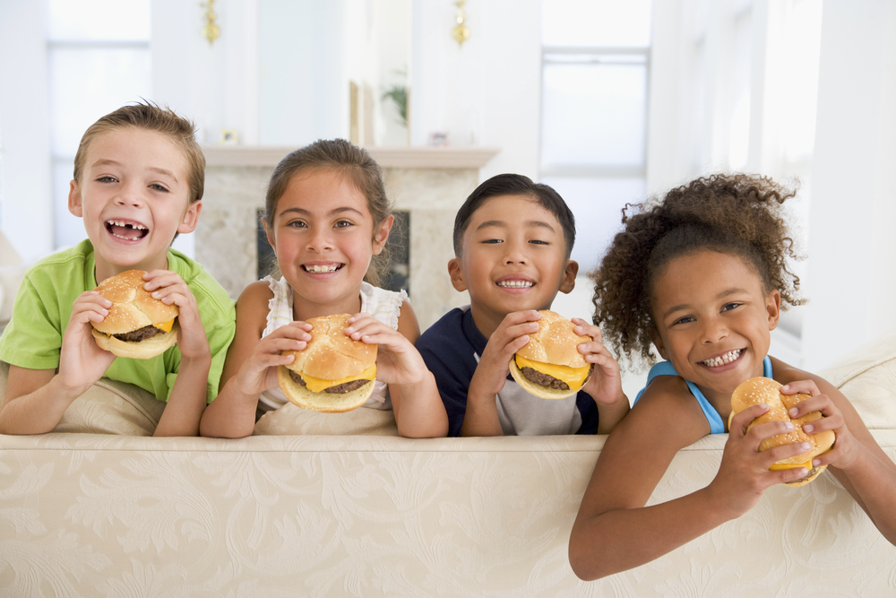
Can you name some seeds that you eat?
What are some of the favorite seeds that you eat?
Hint: I see that there are 2 seeds the kids on the right are eating...

Slide 3
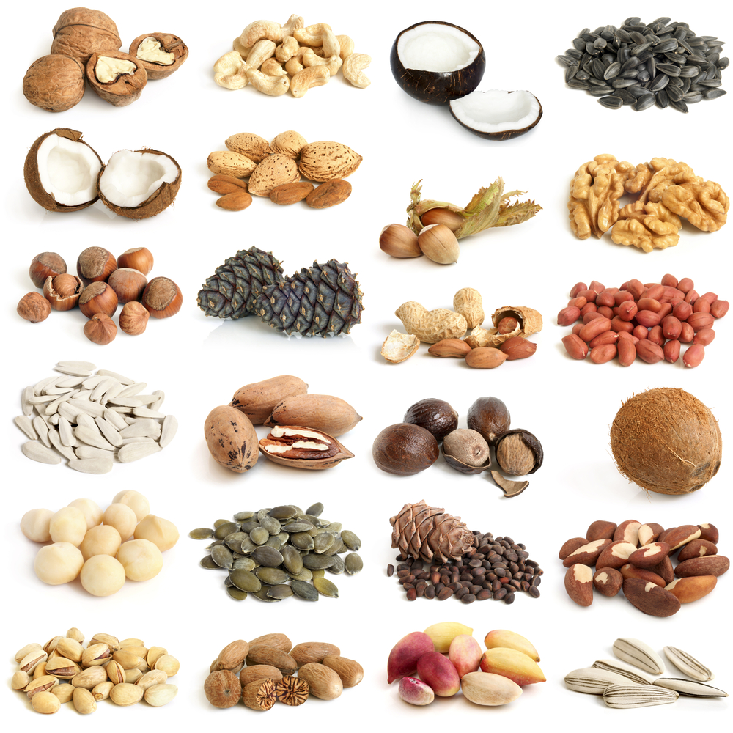
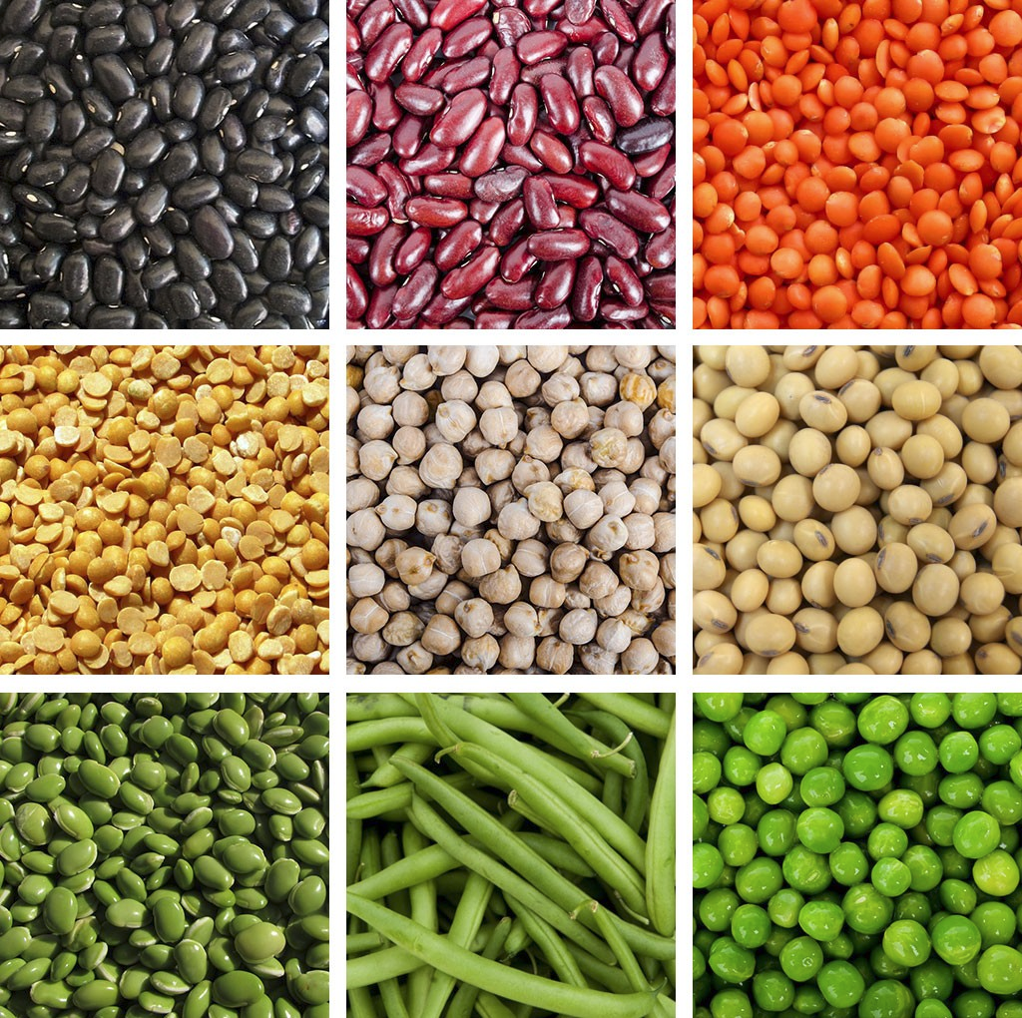
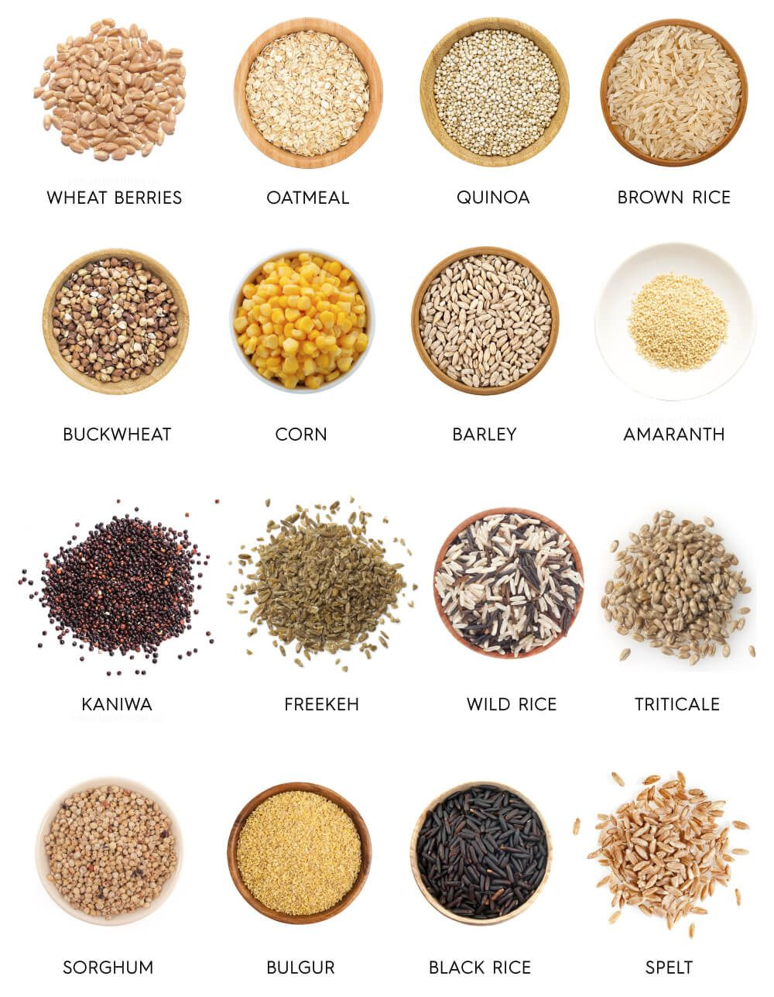
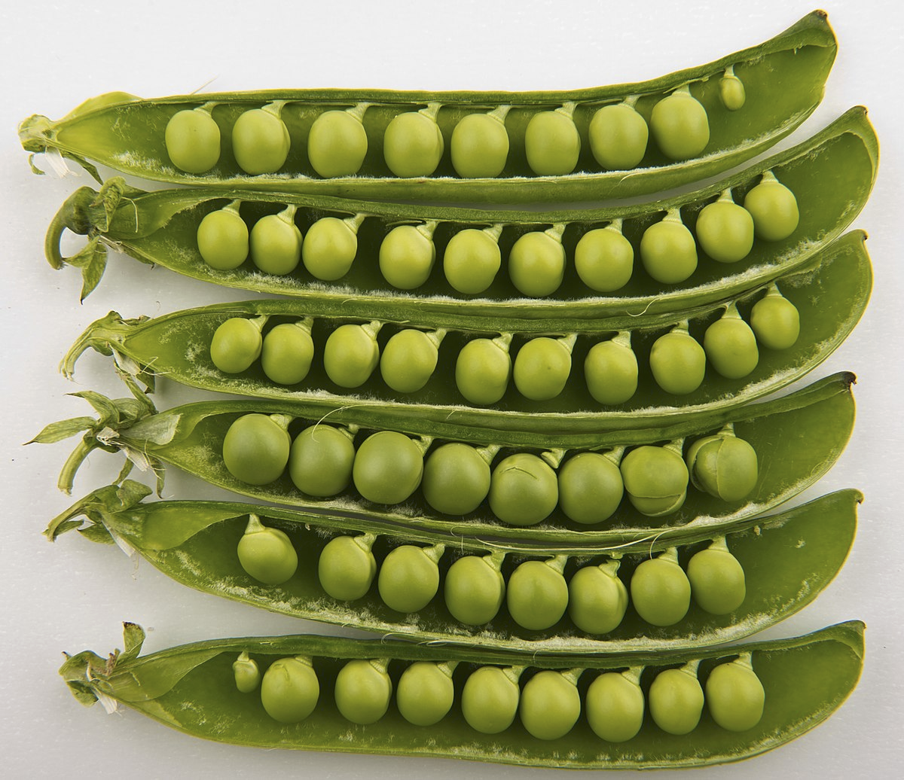

Slide 4
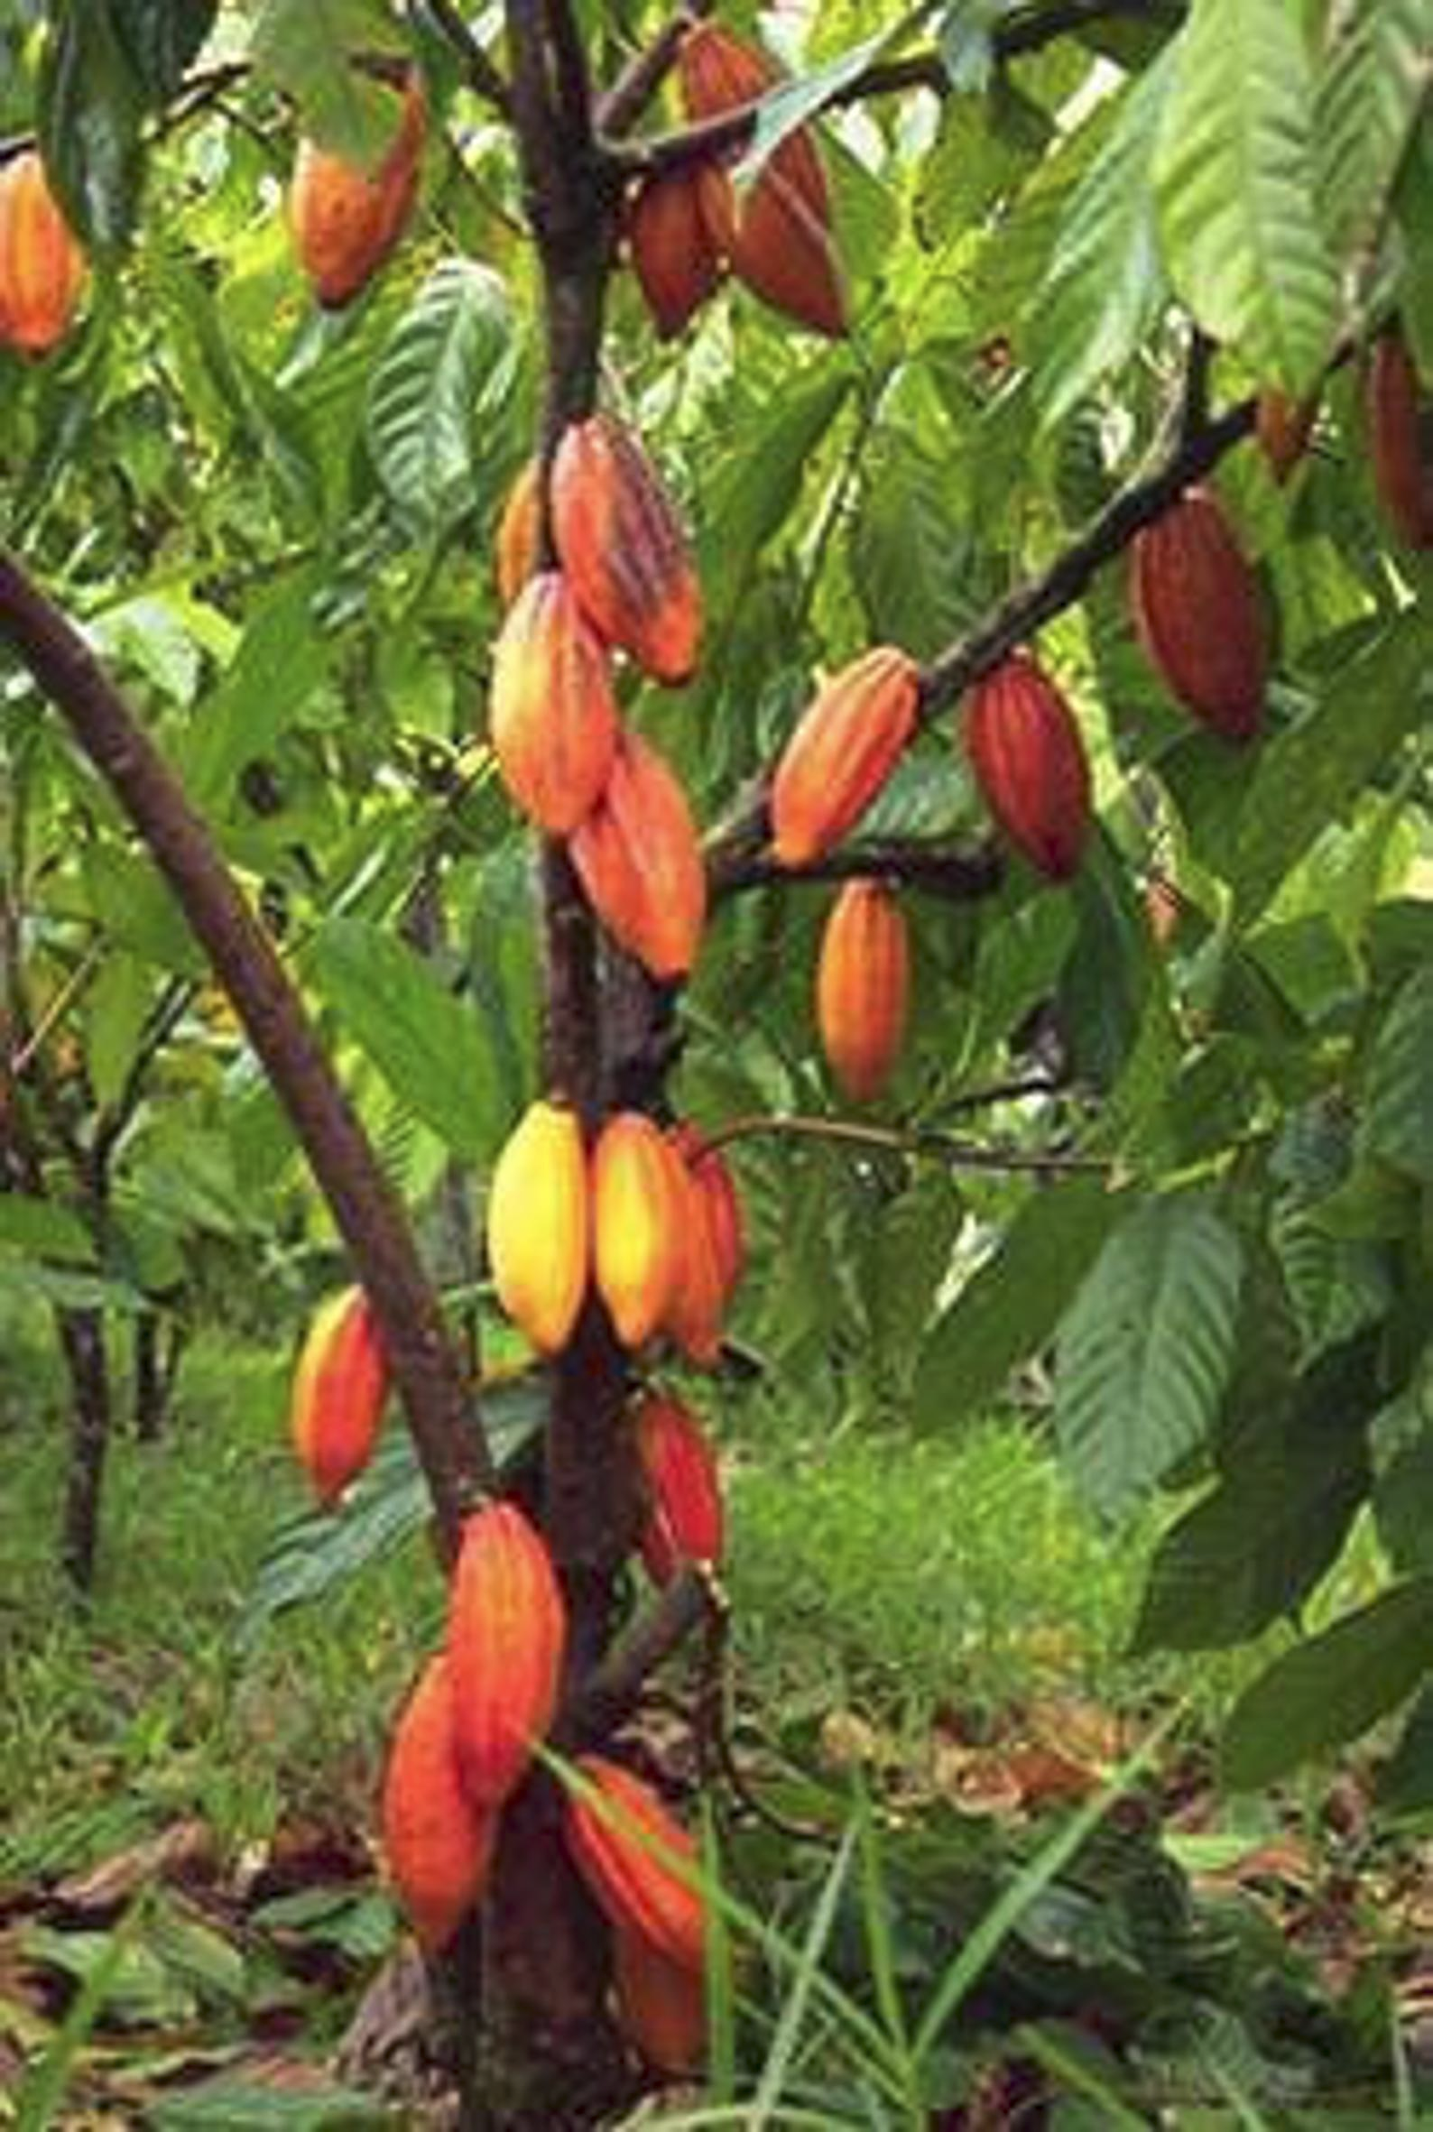
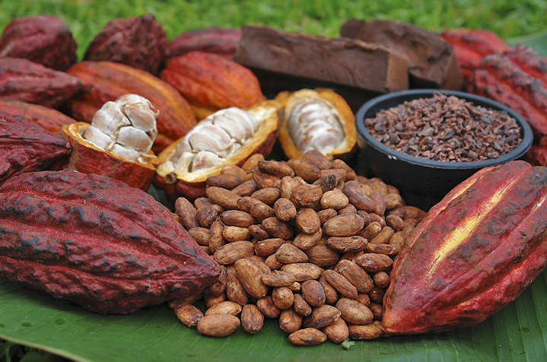
My favorite edible seed is...
CHOCOLATE!!!

Slide 5
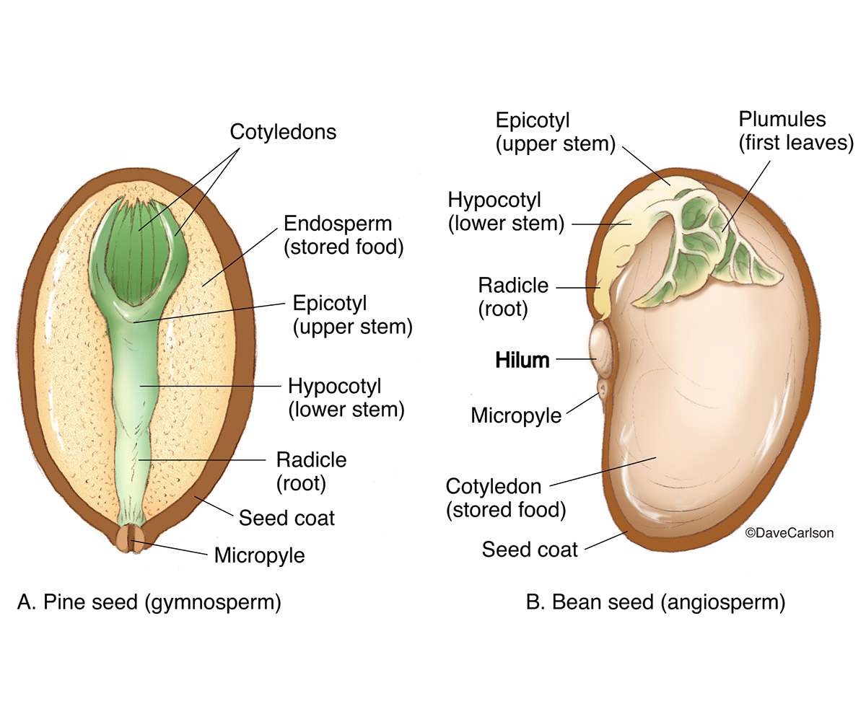
What is a seed?
Seeds are the way that plants reproduce
They contain everything that is needed to grow a new plant
Inside of each seed is energy for the new plant to get started, a root, and the first leaves

Slide 6
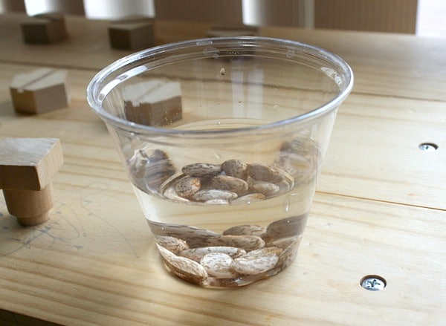
Today we are going to dissect a bean seed to see what is inside
To get started make sure you have:
Soaked beans
Dry bean
A paper towel or plate
Notebook
Pencil and colored pencils
Optional:
Hand lens
Tweezers
Ruler

Slide 7
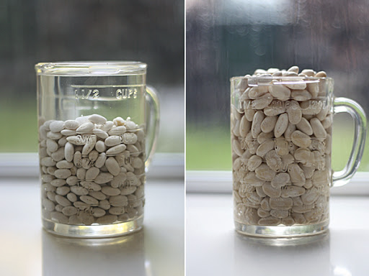
Step 1: Compare and Contrast
Look at your dry bean and your bean that soaked in water.
How has the soaked bean changed?
How is it still the same?
How do they feel? Which weighs more?
How do they smell?
Record your observations in your journal.

Slide 8
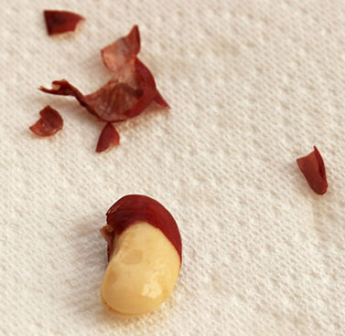
Step 2: Remove the seed coat
Look closely at the bean. There is a tough exterior on the bean. This is the bean coat.
Pull off the coat carefully.
What do you see?
Why do you think a seed has a seed coat? (Think about why humans wear coats.)

Slide 9
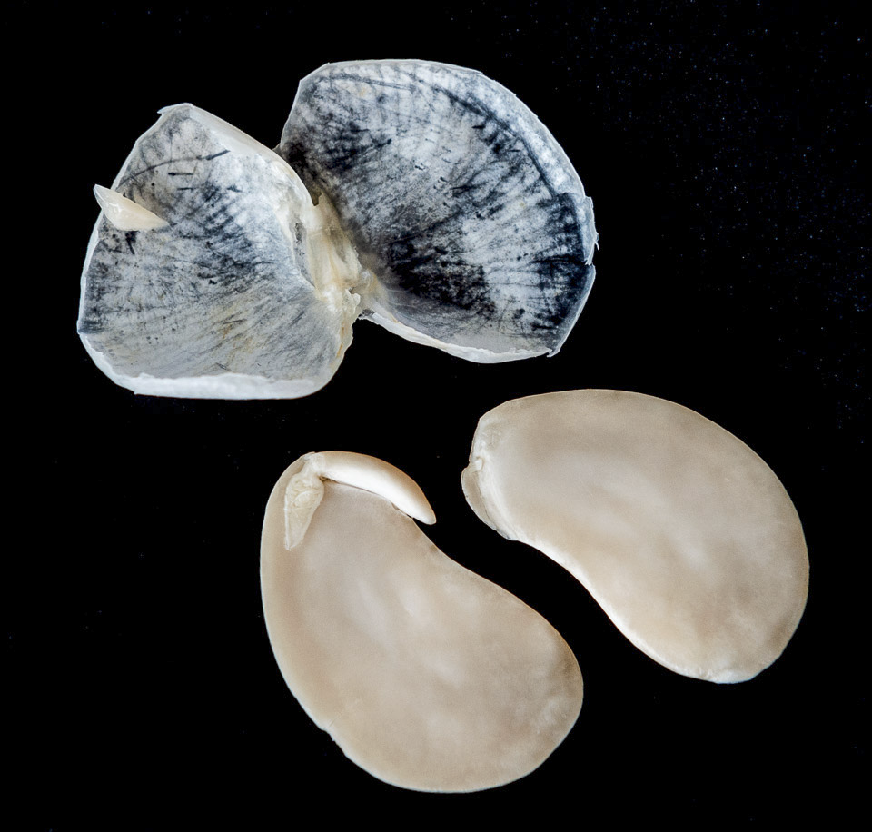
Step 3: Open the bean
Pull the two halves of the bean carefully apart.
As you pull it apart, look inside.
Notice how the bean feels.
How does it smell?

Slide 10
Step 4: Find the Root Radicle
The radicle is the part of the seed that will grow into the first root
It is usually the first part of the plant to grow from the seed.
It will become long, and thin. It pushes into the dirt as the rest of the plant grows up.

Slide 11
Step 5: Find the cotyledon and first true leaves
Cotyledon
Cotyledon are the first part of the plant to sprout above ground. They look like leaves, but actually they are the part of the seed that provides food to the growing plant.
The first true leaves or plumule are inside of the cotyledon. They open after the plant has emerged from the soil.
First leaves

Slide 12
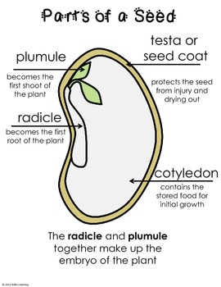
Step 6: Record Data in your Notebook
Lay out all of the parts of the seed
Draw each part in your notebook
Label the part of the plant
Makes sure you include:
Seed coat
Radicle - root
Cotyledon - large sides of beans
Plumule - first sprout with leaves

Slide 13
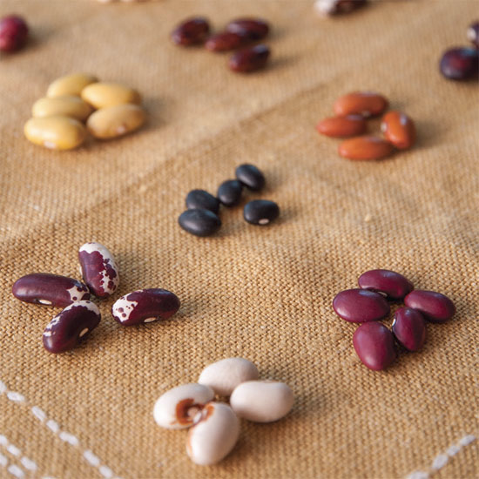
Reflection
Did all of our beans look the same?
How were they similar?
How were they different?

Slide 14
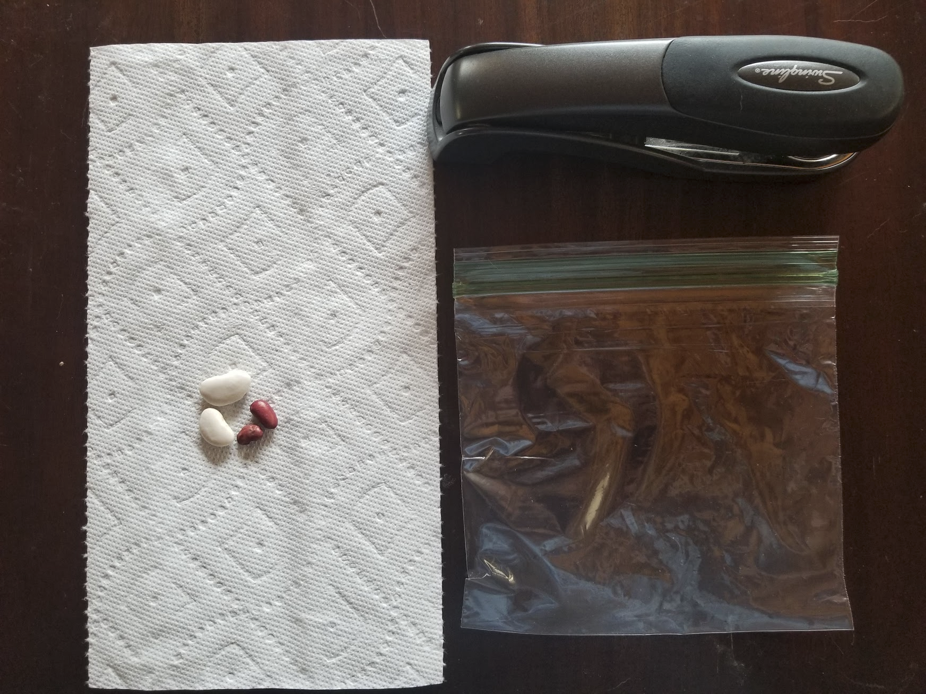
Your Bean Sprouting Experiment
What do you need?
3-6 dry beans
Paper towel
Plastic bag
Stapler (or tape)
Tape
Sunny window

Slide 15
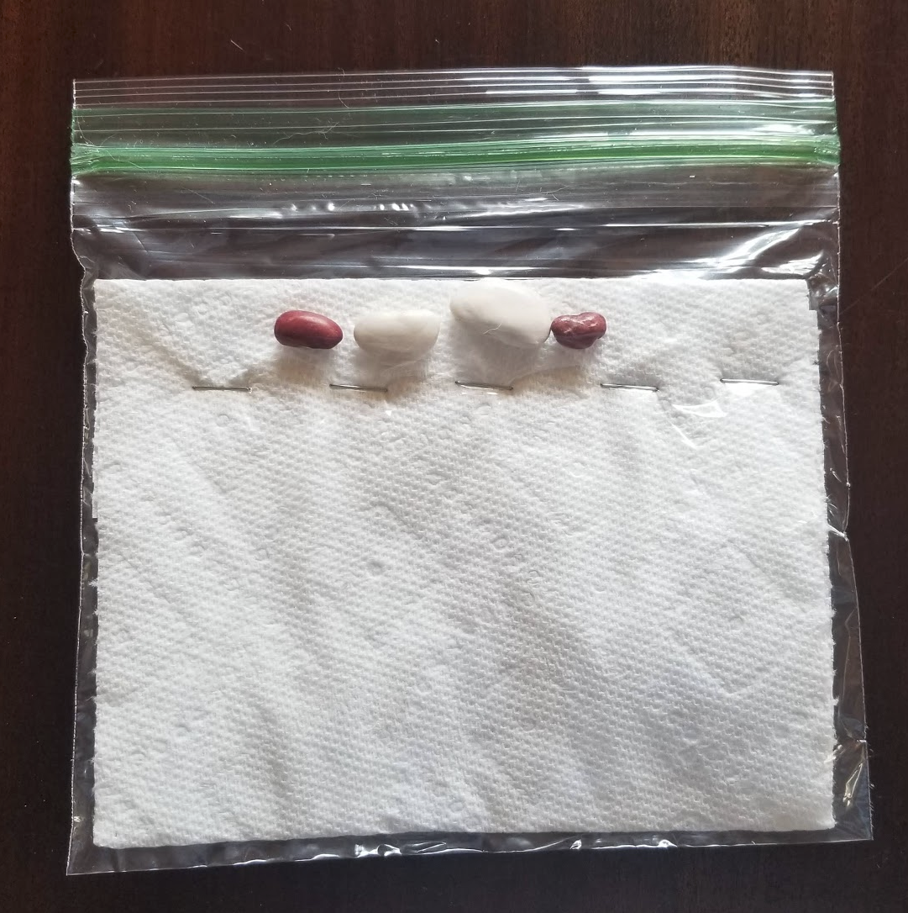
How to set up the experiment
Fold the paper towel so it fits in the bag
Staple across the bag, so the beans can’t fall into the bottom of the bag and the paper towel is held in place
Place the beans above the staples
In your journal record what the beans look like, the date, and any other information

Slide 16
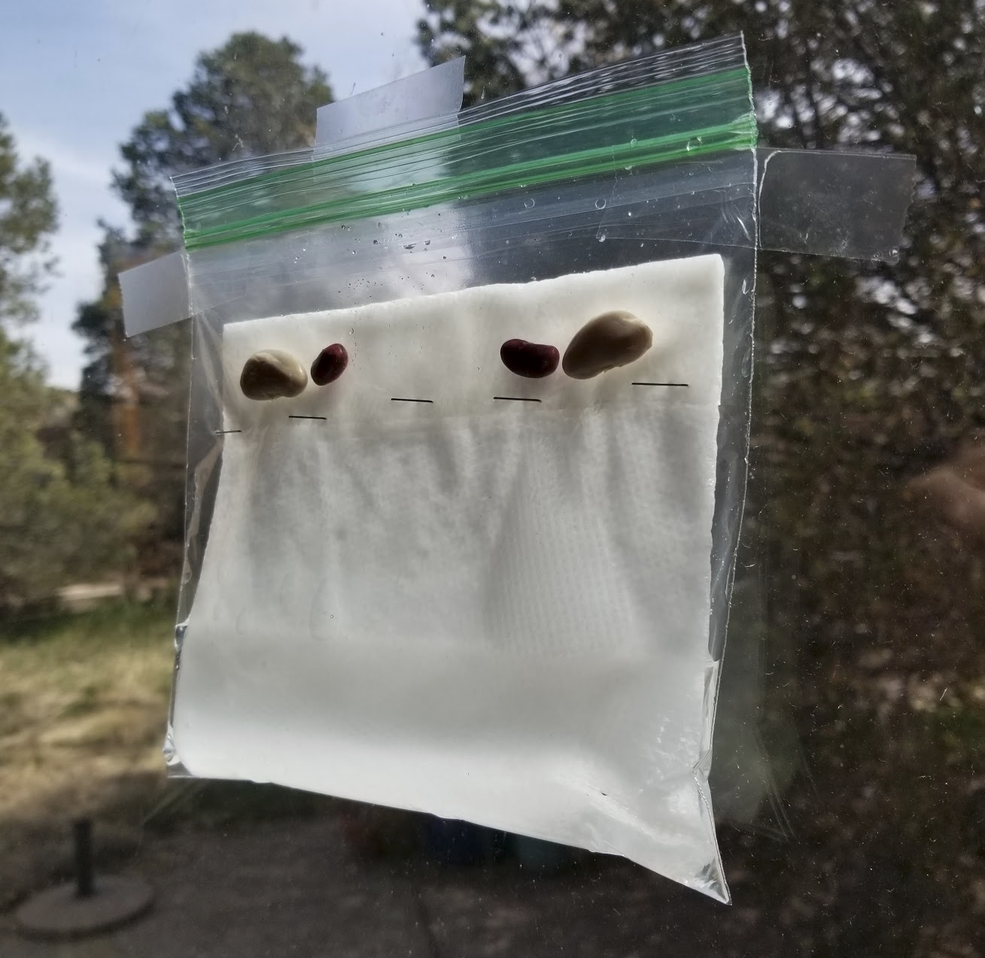
How to set up the experiment
Tape the bag in a sunny window
Add water to the bottom of the bag

Slide 17
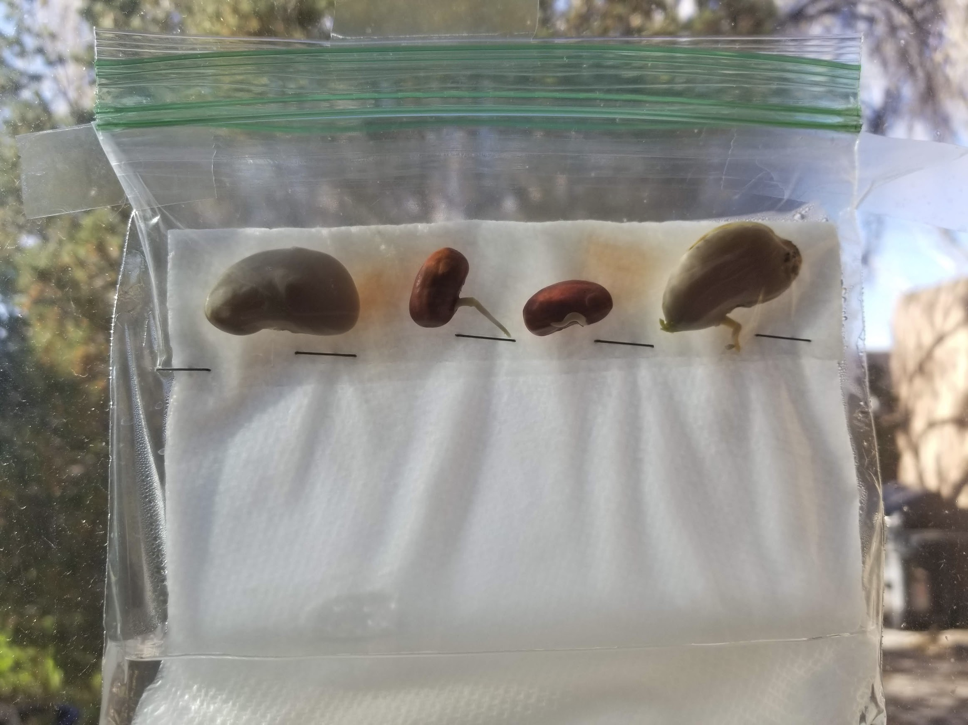
Visit your bean bag very day
Add water as it evaporates.
Record what you see happen every day.
Make sure you also record the date with your observation.
Draw and label the daily growth.
If you have a ruler at home, measure the length of the roots and stems as they grow.

