Slide 1
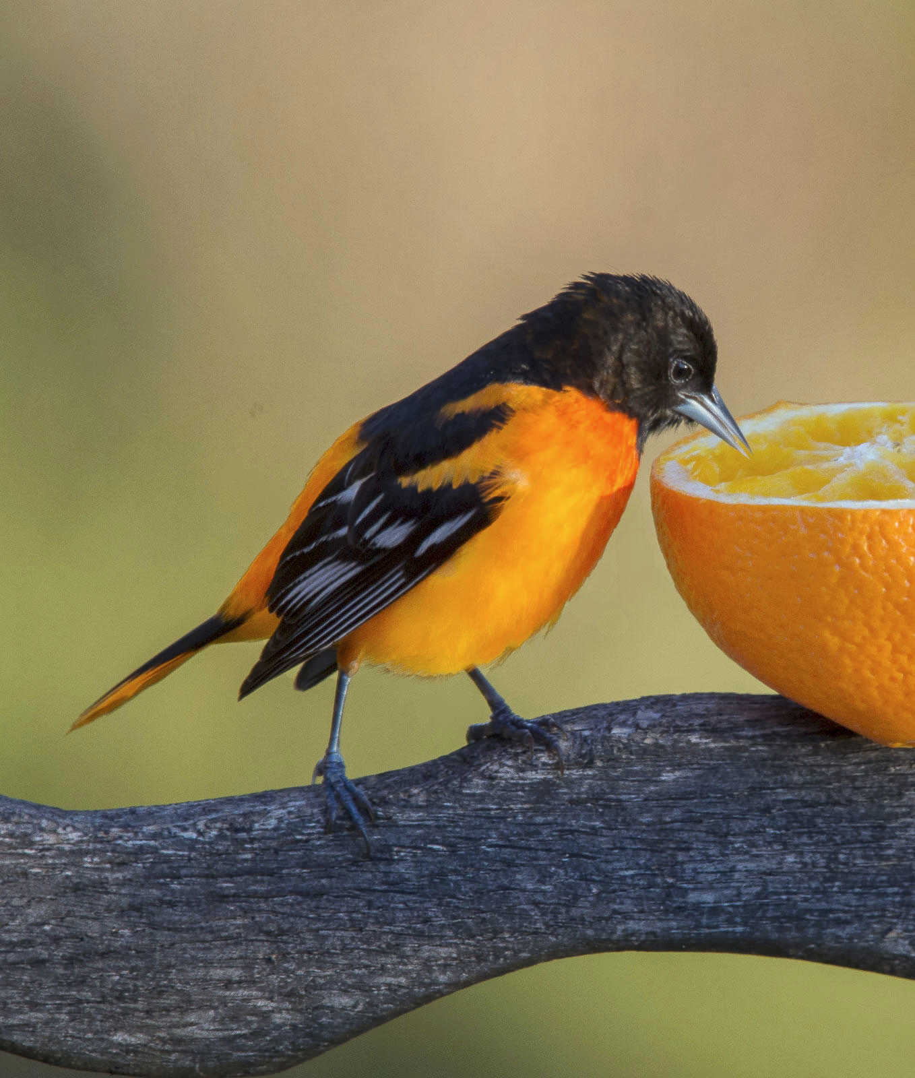
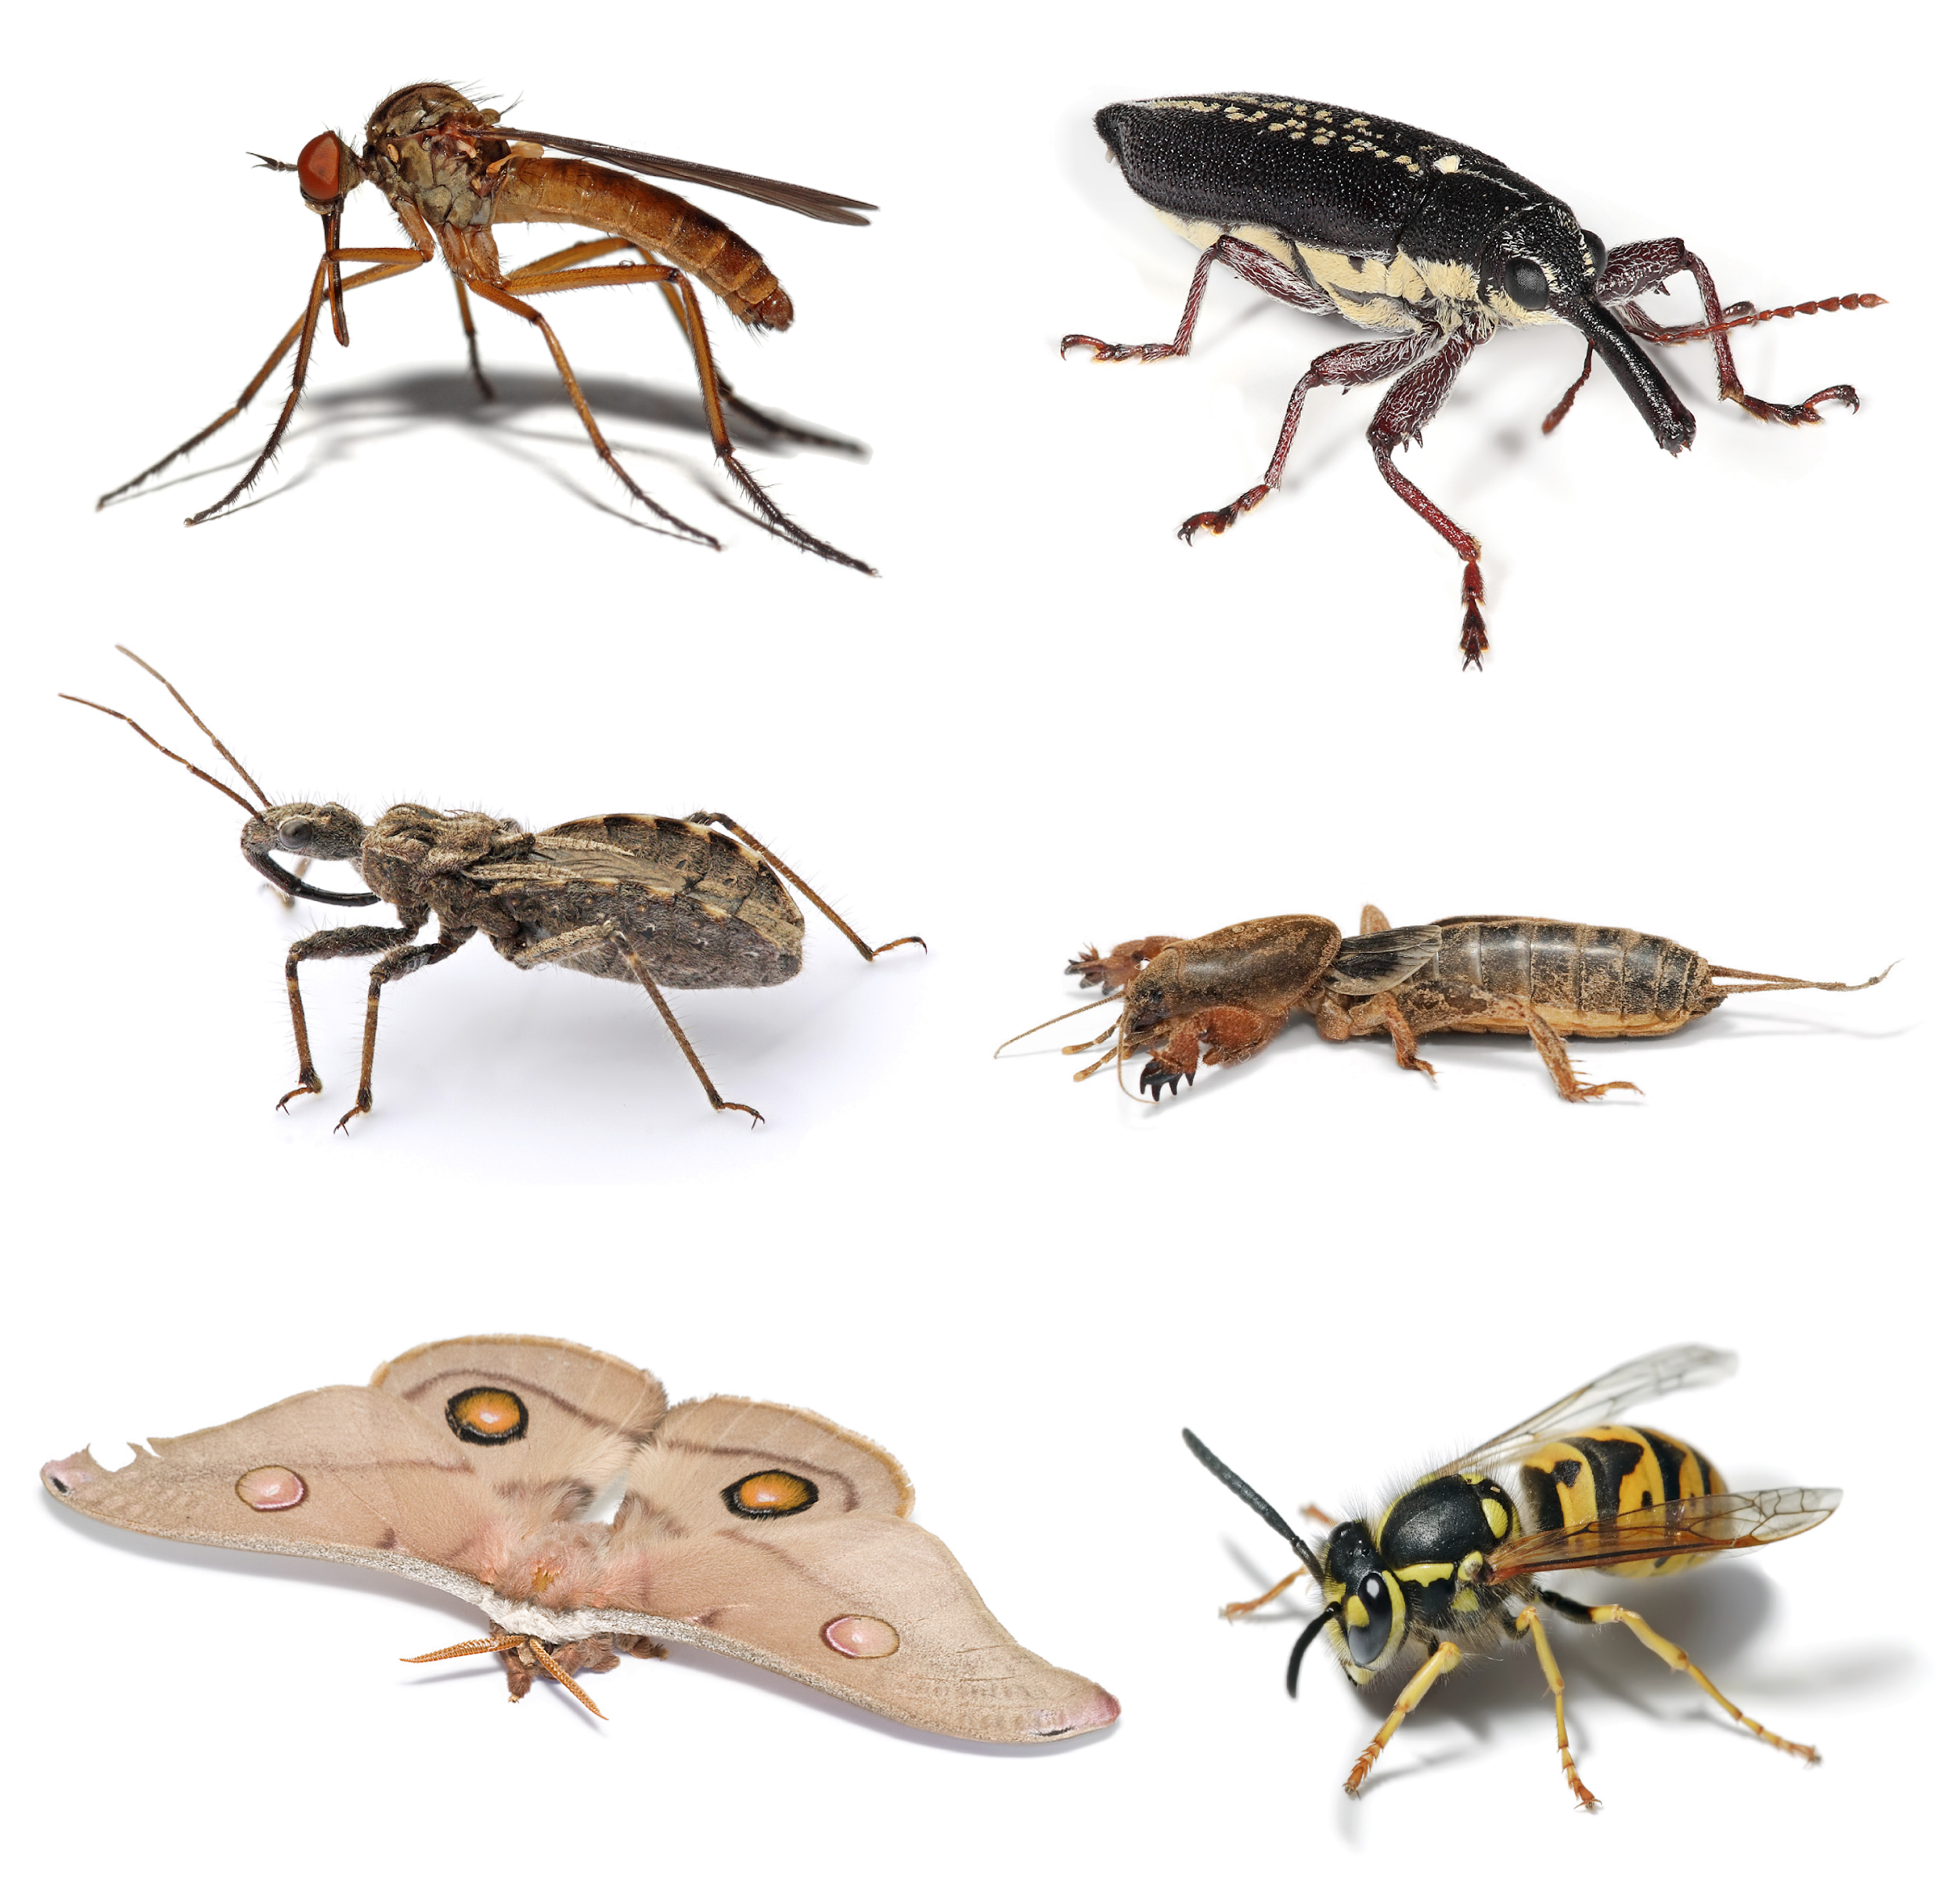
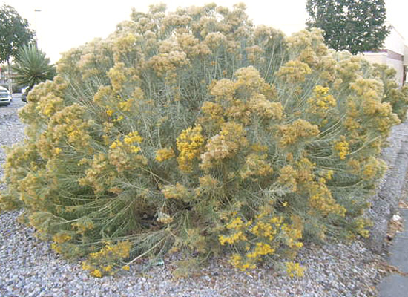

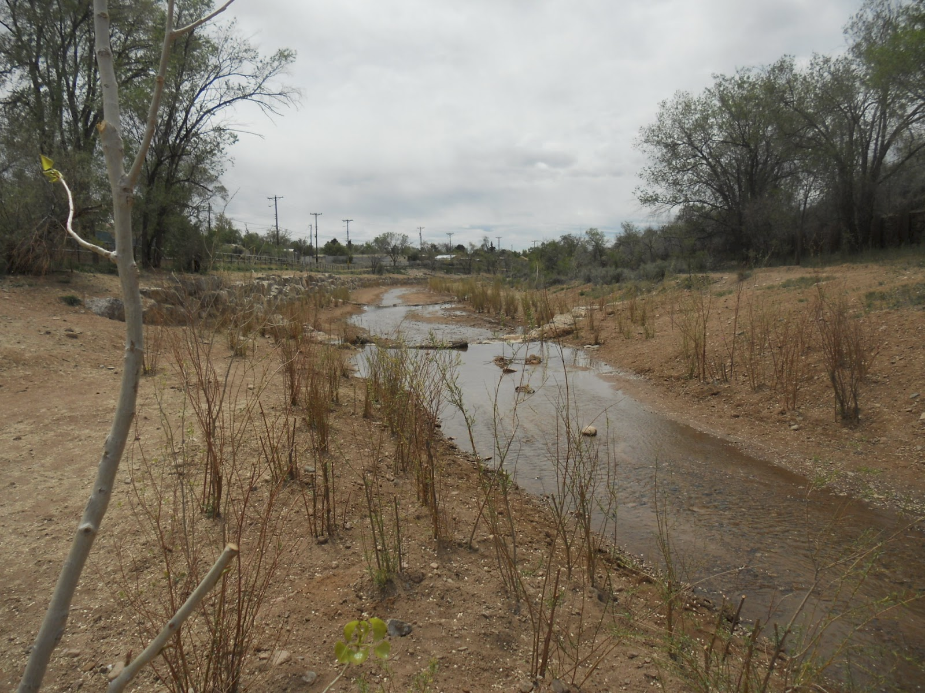
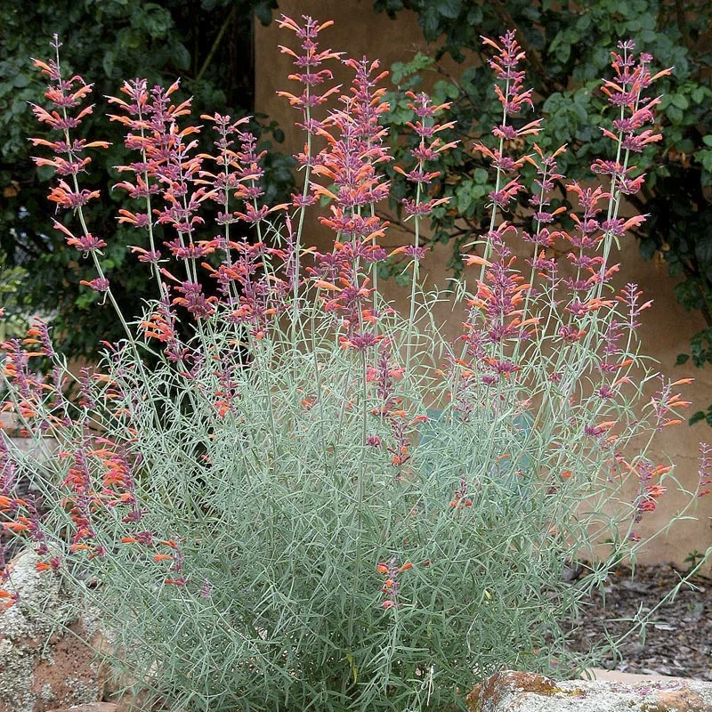
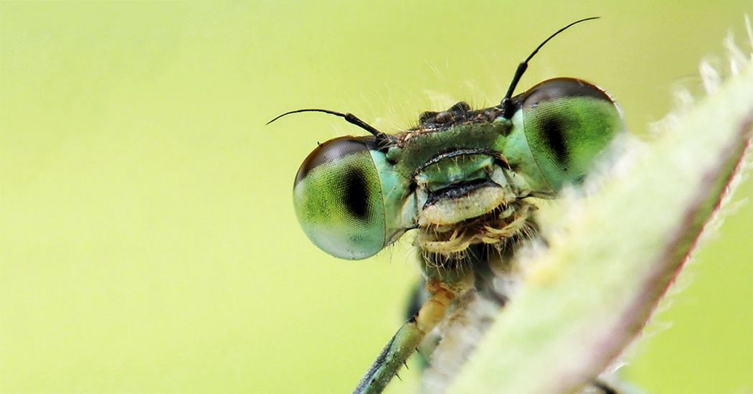

Family Scavenger Hunt
What can you find?

Slide 2
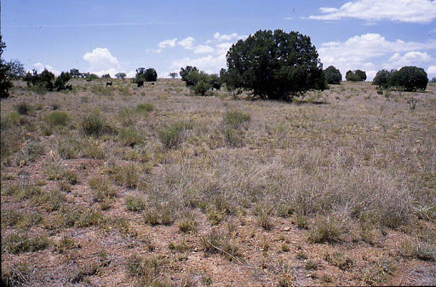
You are going to have to look closely…
What can you find?
The world is filled with amazing plants, animals, insects, and more!
We created a challenge for you and your families to find around town, in your neighborhood.
There are three hunts, one for insects, one for plants, and one for birds.

Slide 3

Classification:
All living things are put in groups by scientists
Even this dog!
This is called classification.
How would a scientist classify this dog?

Slide 4
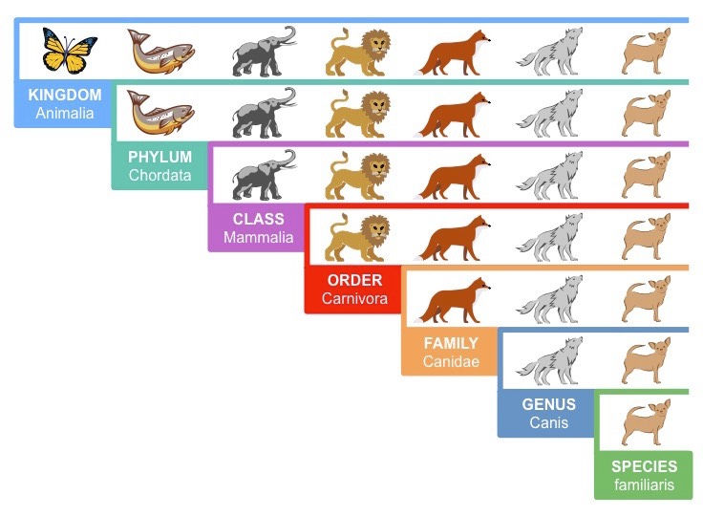
Classification:

Slide 5
Classification:

Slide 6
Classification:

Slide 7
Classification:

Slide 8
Classification:

Slide 9
Classification:

Slide 10
Classification:

Slide 11
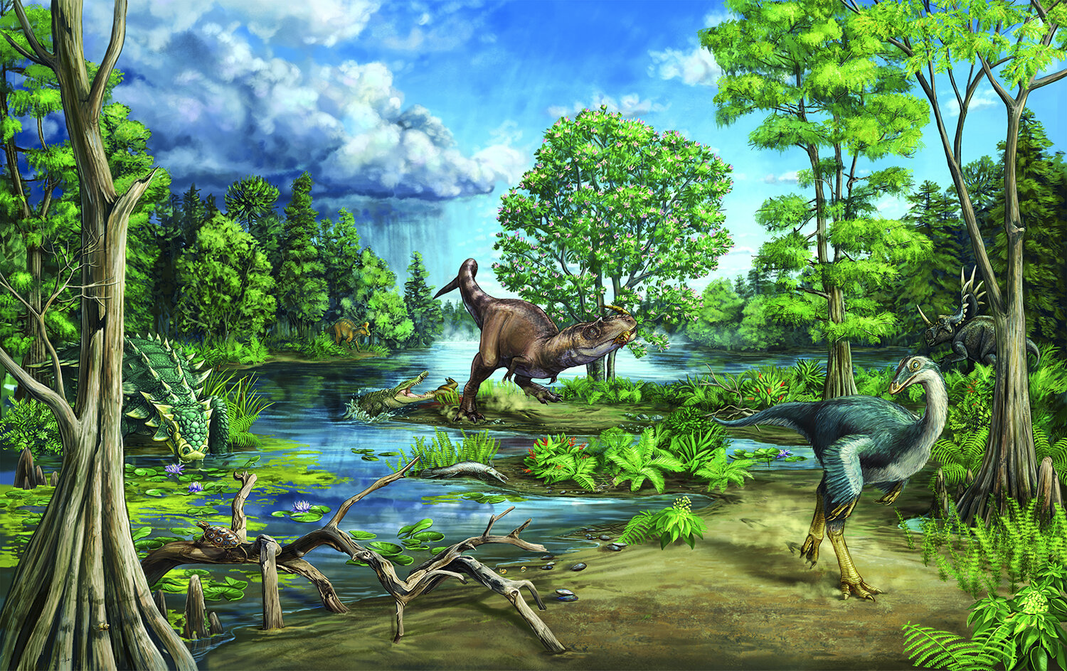
You are going to find a few different types of living things...
Insects
Trees
Shrubs
Grasses
Cacti
Forbs
Birds
Dinosaurs? Just kidding

Slide 12
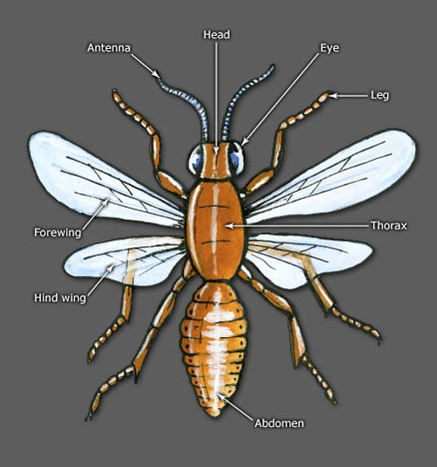
What is an insect?
All insects have some things in common
6 legs
3 body parts
2 antenna
Some insects also have
Wings
Multiple eyes
Stingers
And more!

Slide 13
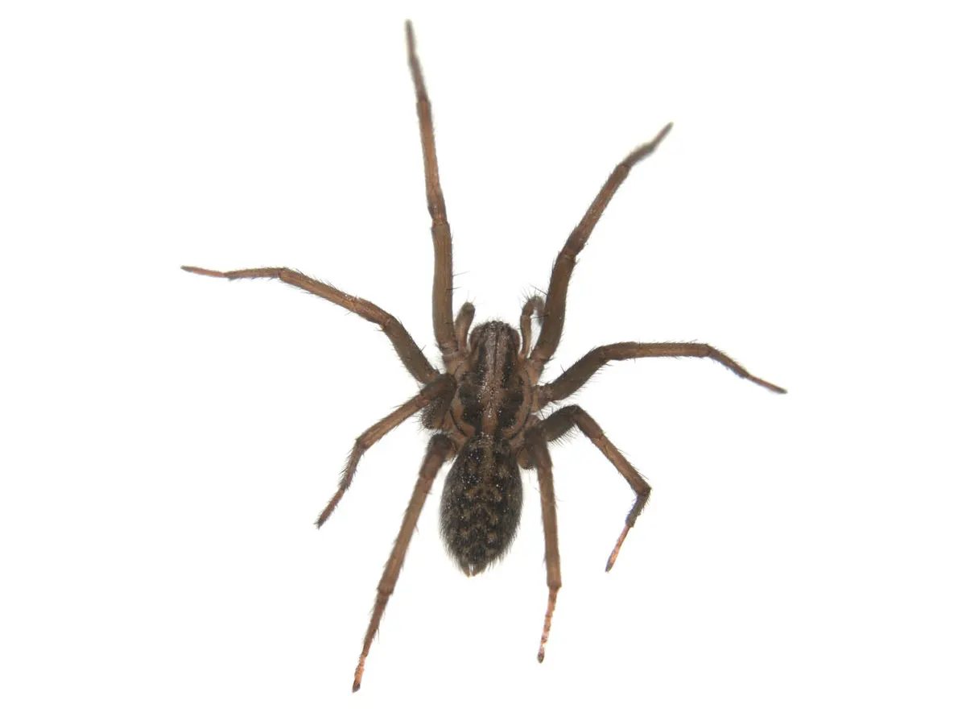
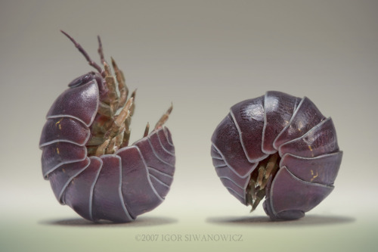
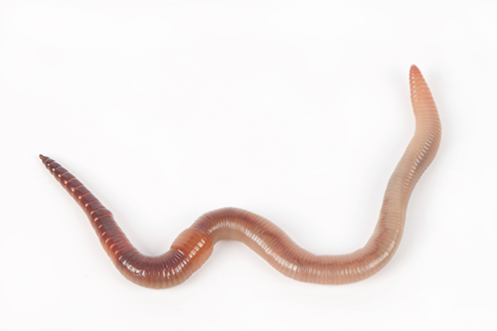
Some creatures look like insects, but they aren’t
Spiders have 8 legs and 2 body parts
Rolly pollies have a lot more legs!
Earthworms don’t have any
legs at all.

Slide 14
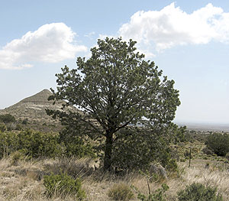
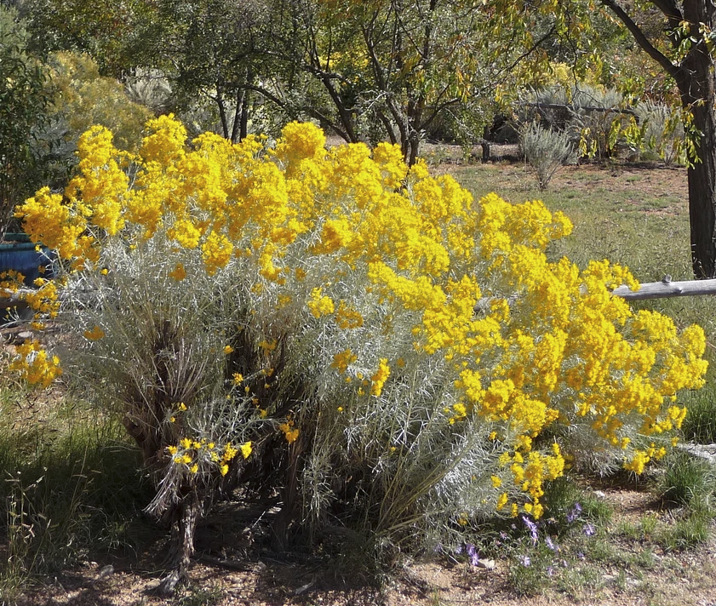
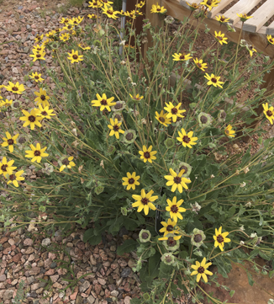
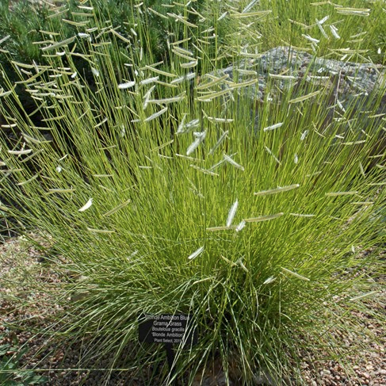
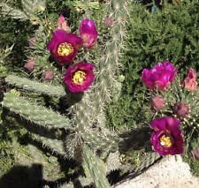
Review of plant classification
Tree - taller than 15 ft, usually one woody stem | Shrub - has multiple woody stems. Shorter than a tree | Forb - dies back in the winter and grows again from roots in spring | Grass - long, thin leaves. Die back in the winter and some grow back. | Cactus - fleshy stems hold water for dry periods. Covered in spines.

Slide 15
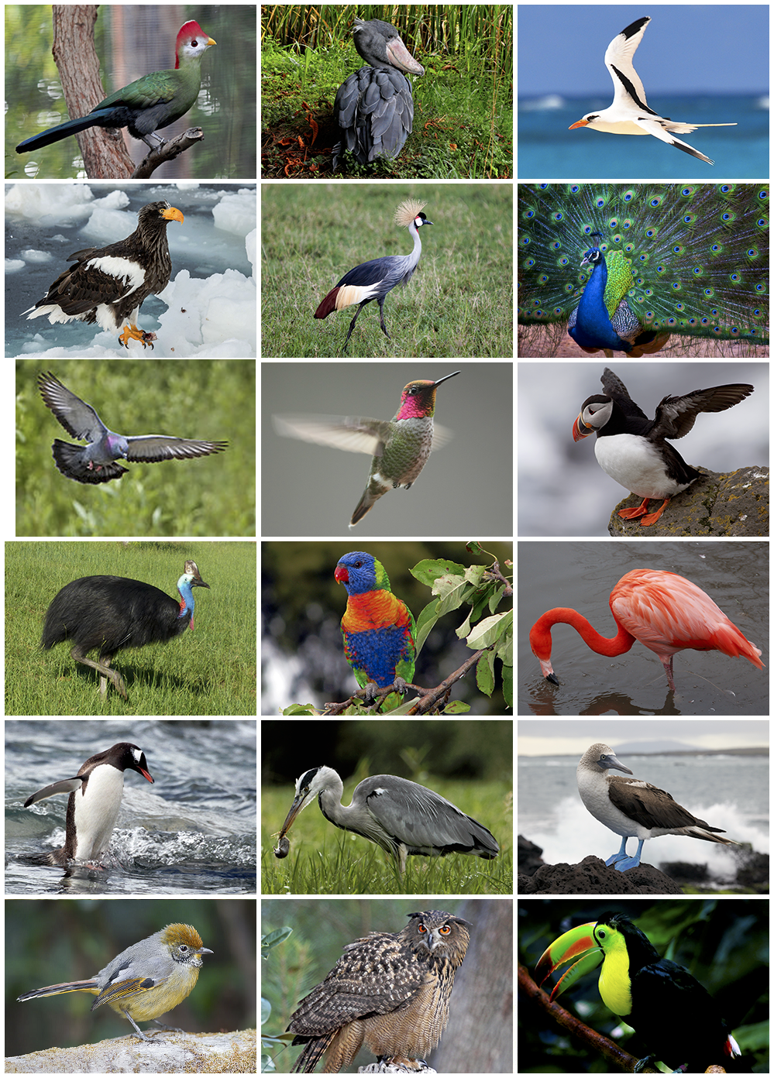
Birds
All birds have a few things in common:
Beaks
Feathers (they are the only living organism that has them!)
Wings
2 feet
But they live all over the world in many different habitats!

Slide 16

Your challenge…
With your family or other adults go for a walk and see what you can find from the scavenger hunt pages.
Use the trail map and try different trails. Do you find different plants and animals on different trails?
How many of the plants and animals can you find in a week?
It is ok if you don’t find everything. Some are hard to spot!

