Slide 1
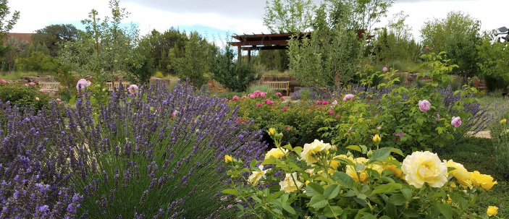
Adopt a Plant
Which one is your favorite?

Slide 2
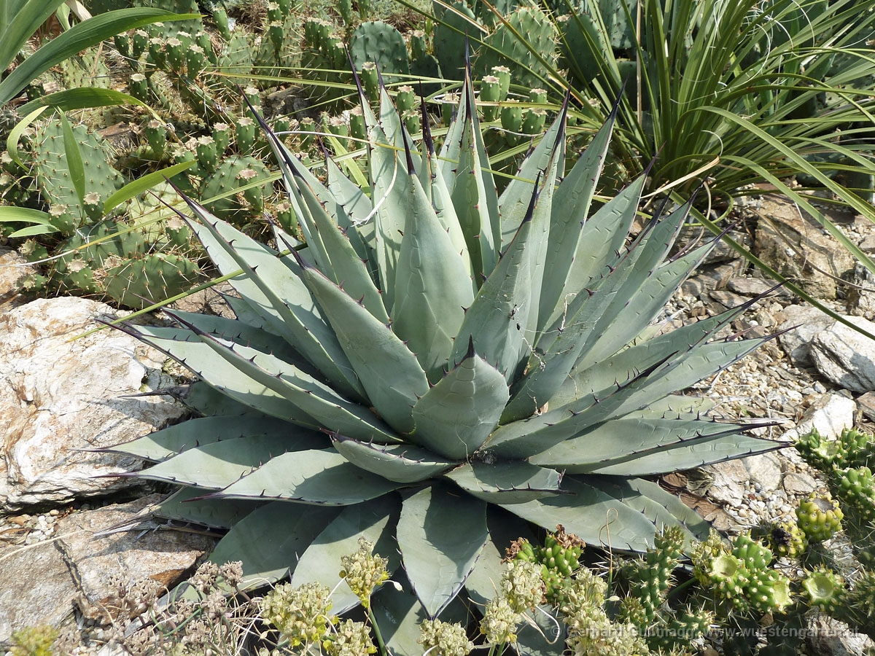
Today you get to adopt a plant!
You will go outside and choose a plant you want to learn more about.
Your plant can be tiny or GIANT.
You can choose a flower, a tree, a weed, a cactus, a clump of grass, or any other plant that you find interesting.

Slide 3
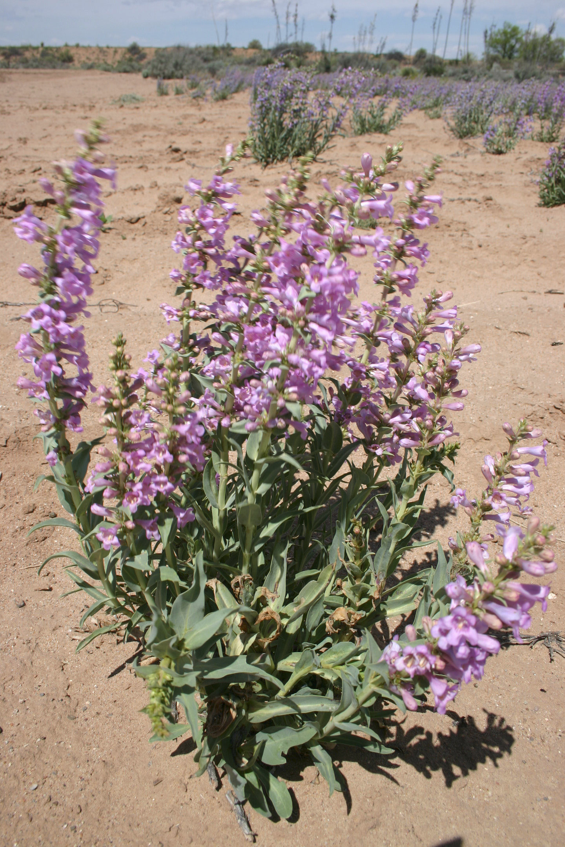
You are going to start by getting to know your plant...
What does your plant look like? Draw it and make notes.
What types of soil are around your plant? If you need to, go back and do a new soil test.
How does your plant get water?
How much sun does your plant get?
What type of microclimate is it in?
Make sure you include date, time, weather, etc!

Slide 4
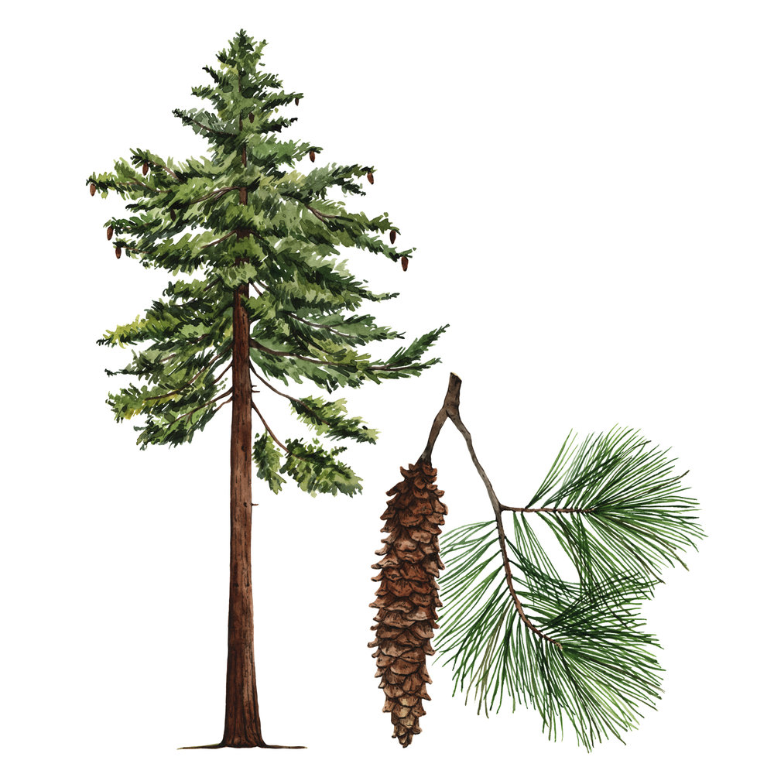
You will be doing a botanical drawing
Botany is the scientific study of plants
Botanical means it is about plants
Botanical drawings are scientific drawings of plants
The drawings should be accurate and detailed
The drawings should include pictures of the whole plant as well as detailed parts of the plant

Slide 5
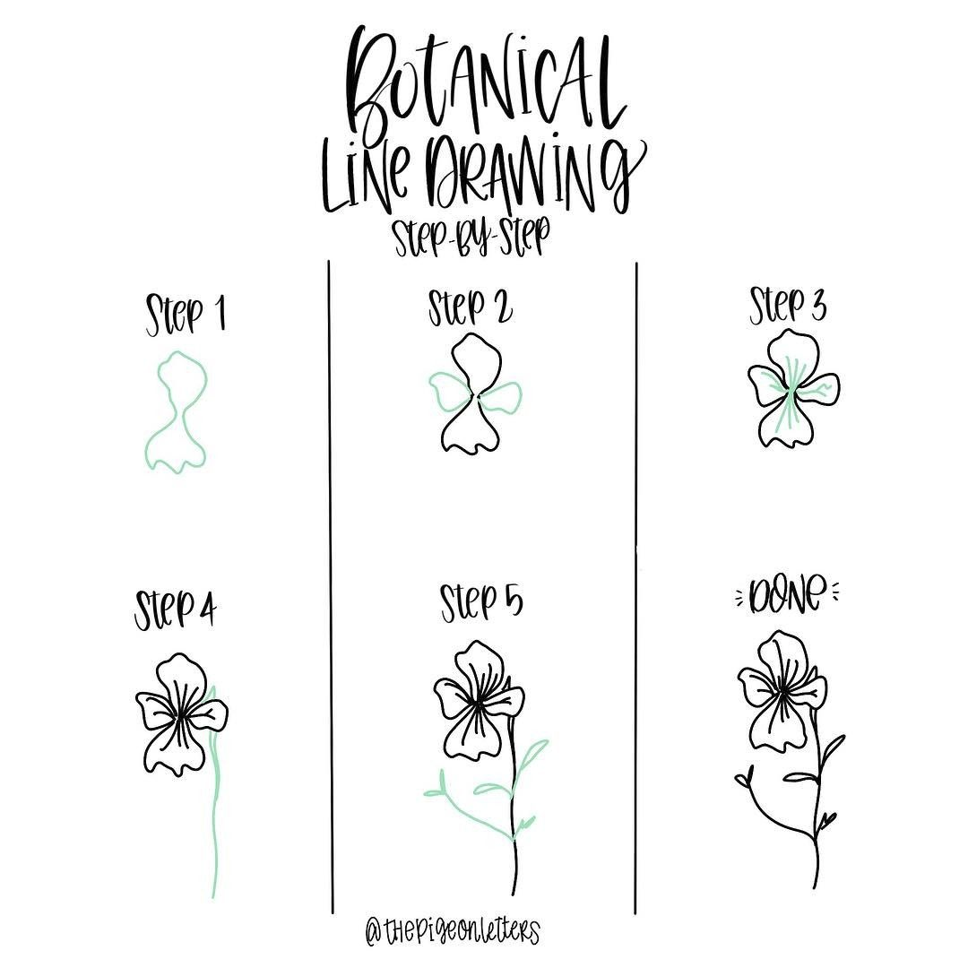
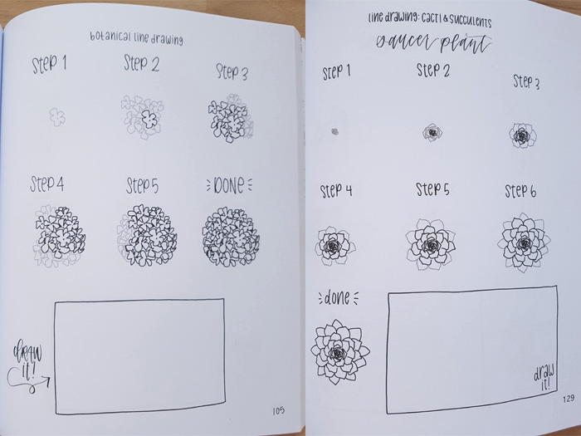
Start with simple shapes then get more detailed...

Slide 6
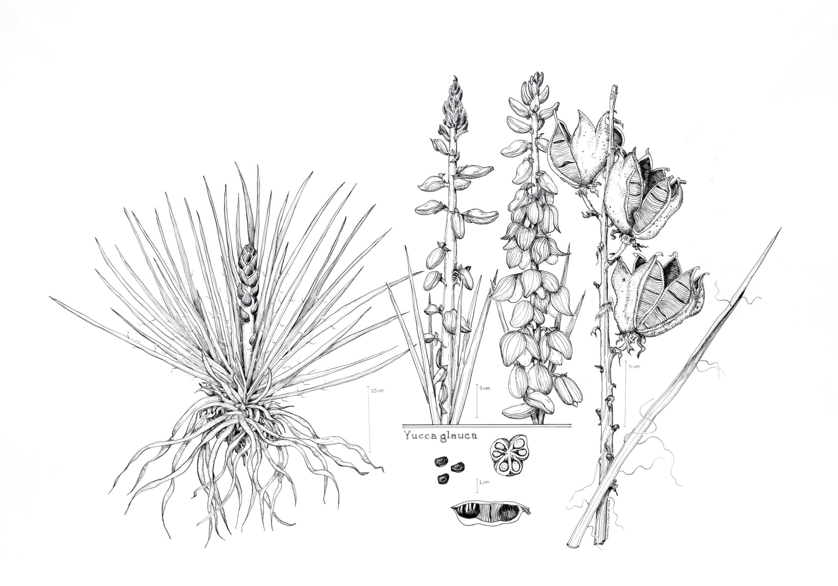
More examples of botanical drawing

Slide 7
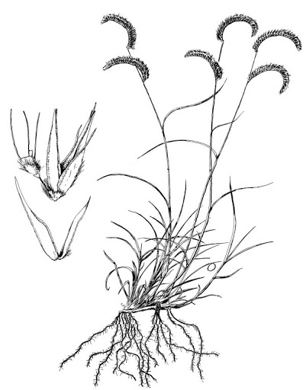
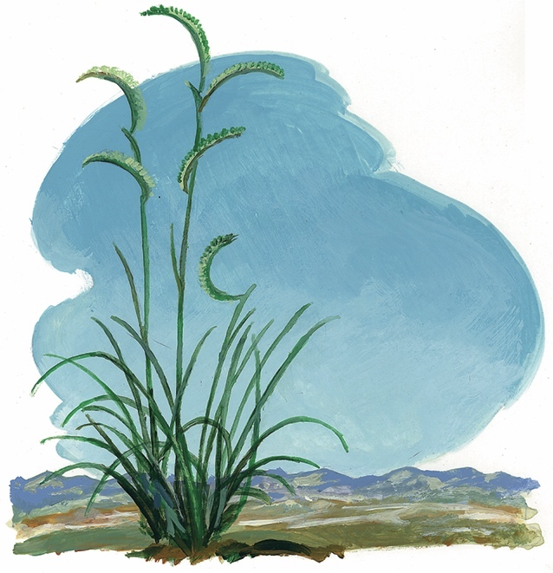

Slide 8
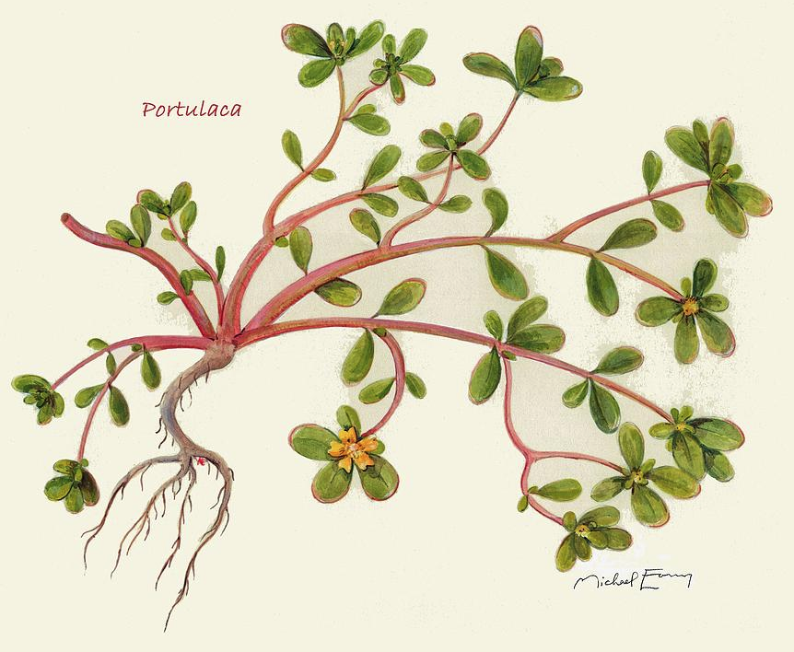

Slide 9
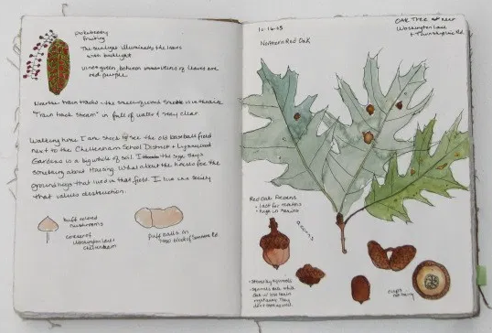
Here are some examples of botanical gardens in nature journals

Slide 10
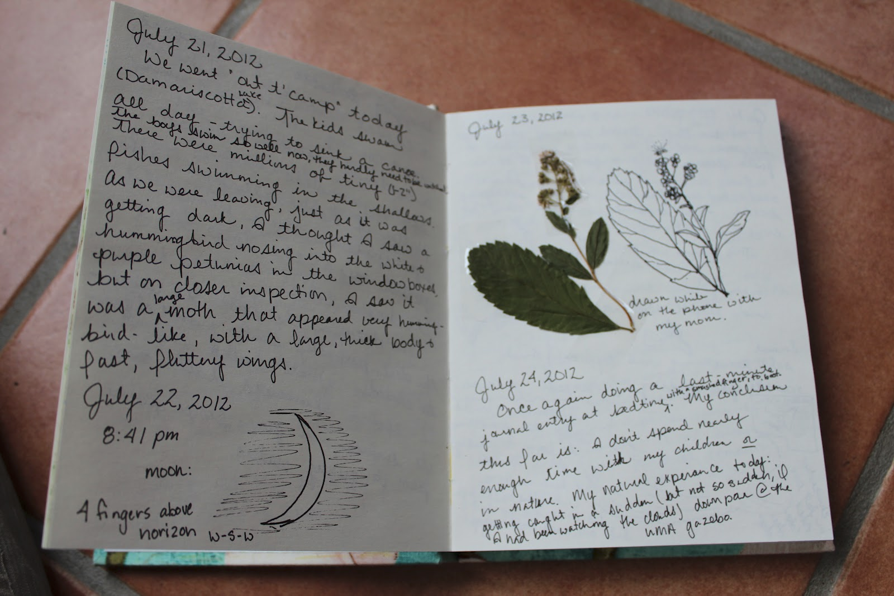
If it works with your plant, take a leaf and flower and press it in your journal

Slide 11
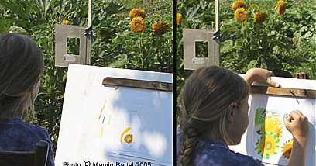
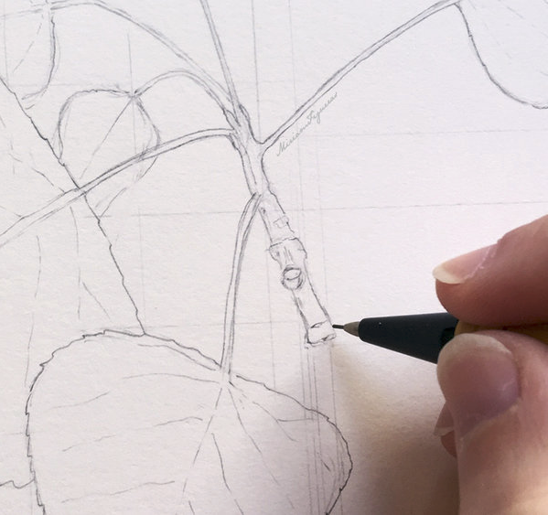
Look closely at color and shape!

