Slide 1
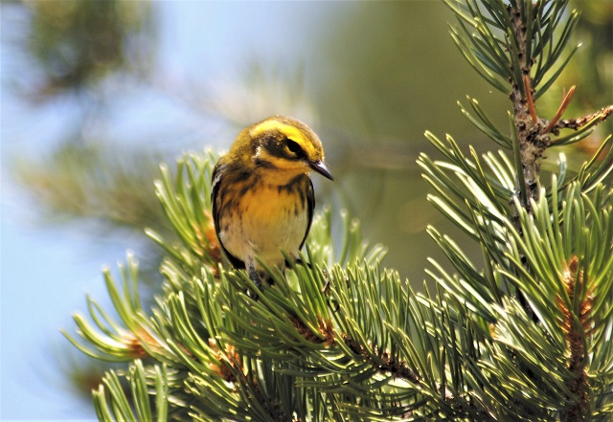
Habitat Exploration
What lives all around you?

Slide 2
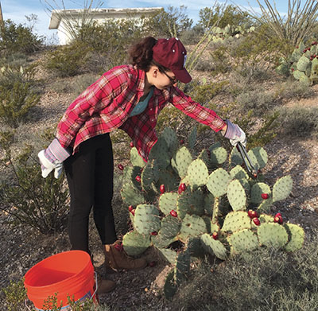
What is a habitat?
A habitat is a place where a living organism makes its home. A habitat meets all the environmental conditions an organism needs to survive.
For an animal, that means everything it needs to find and gather food, select a mate, and successfully reproduce.
For a plant, a good habitat must provide the right combination of light, air, water, and soil.

Slide 3
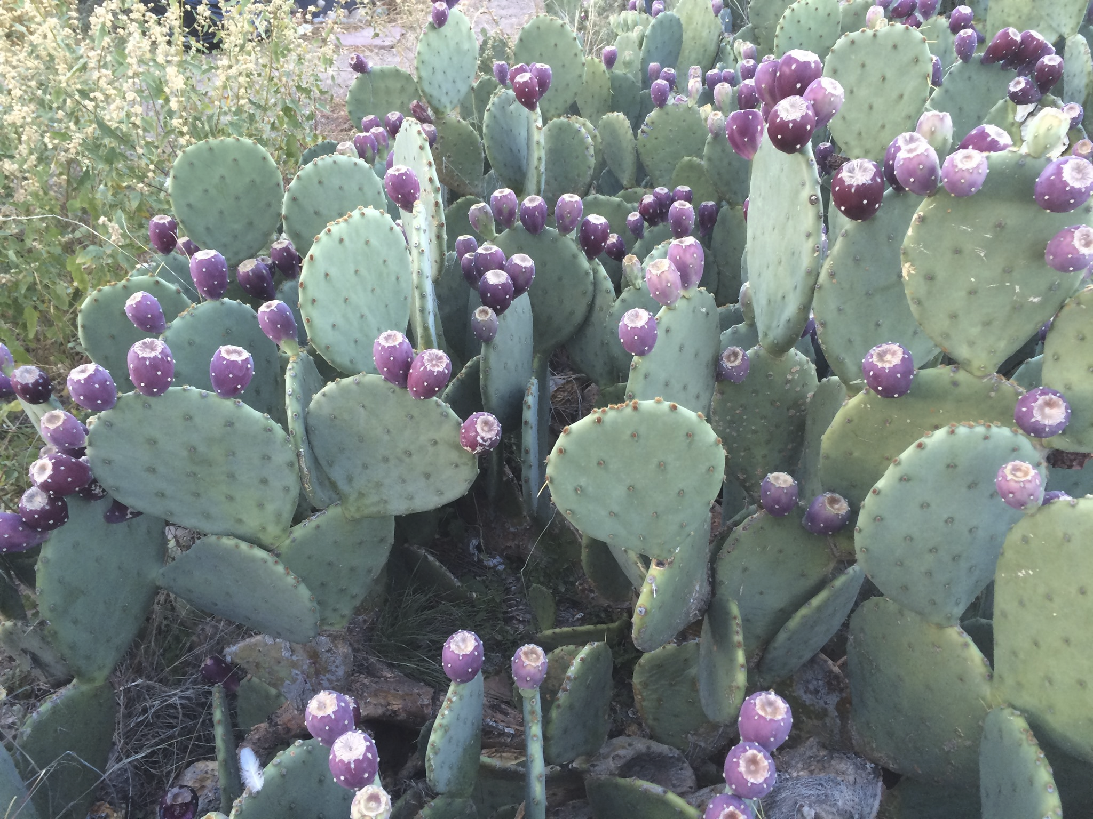
Habitat Example
The prickly pear cactus, which is adapted for sandy soil, dry climates, and bright sunlight, grows well in dry places in New Mexico.

Slide 4
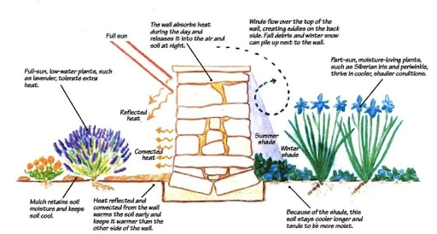
Microclimates in your neighborhood
What is a microclimate?
Micro = small or tiny
Climate = temperature + precipitation
So a microclimate is a small area that has a different temperature or amount of water than the area around it
A south facing wall will be hotter than a north facing wall

Slide 5
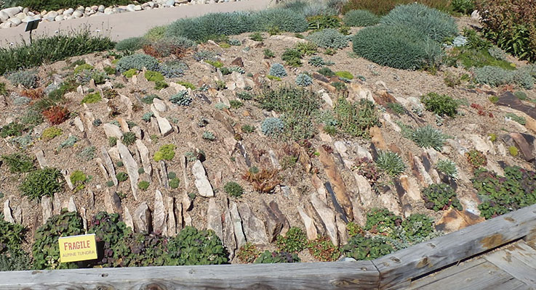
Examples of microclimates
This rocky hill has two sides, one faces north and the side closer to us faces south.
The south side is warmer and drier because of the sun. It has smaller plants.
The north side stays cooler and a little wetter and has larger plants.

Slide 6
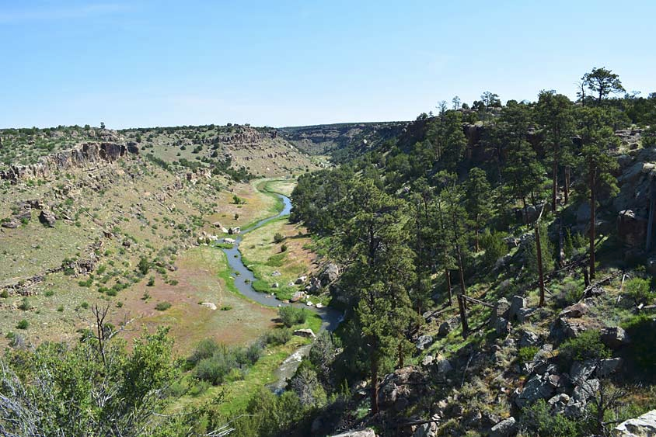
Can you guess which side of this canyon in Colorado faces north and which faces south?

Slide 7
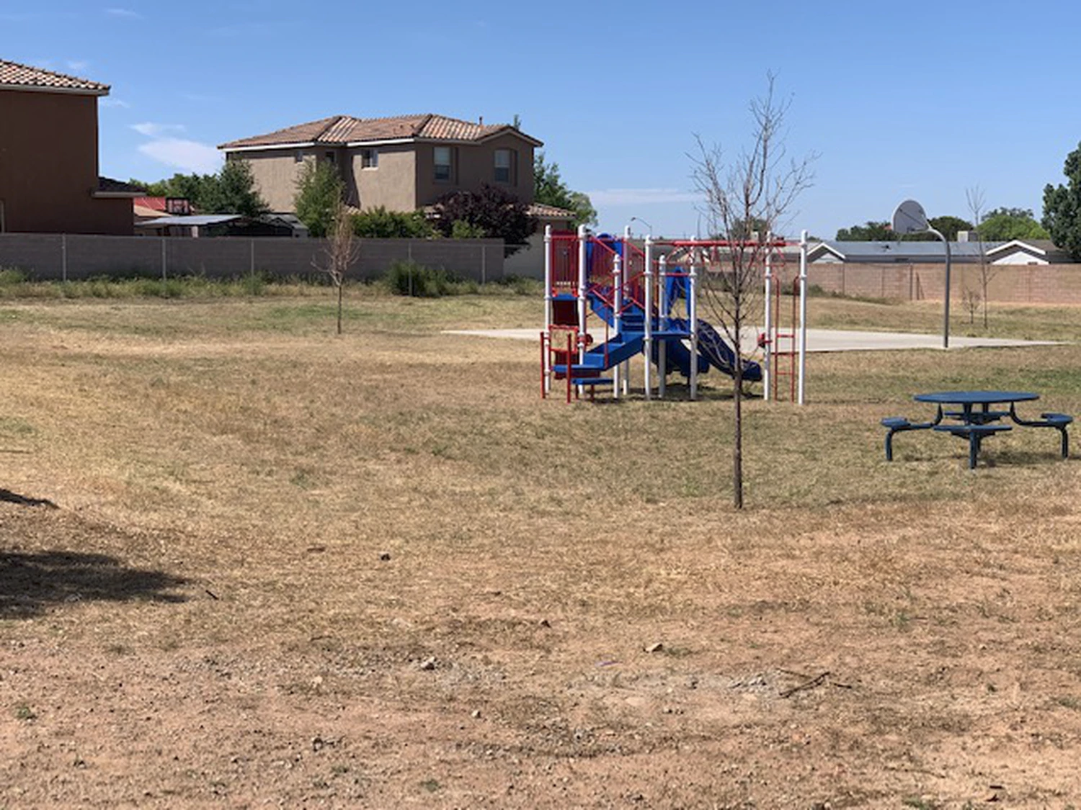
Microclimates around your neighborhood
Go back to the map you drew
Look for
Areas on the north side and south side of walls and buildings
Areas near canales or where rain collects
Places that are shaded by trees
Areas that have a lot of plants
Sections that have no plants or few plants
Choose 3 different spaces to investigate

Slide 8
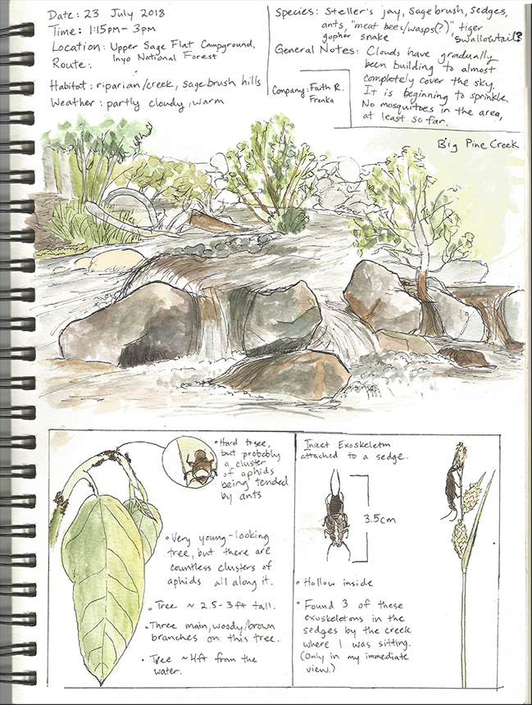
In your journals...
Draw 3 different microclimate habitats.
Include the way the soil feels and looks. Is it warm or cool? Wet or dry?
What plants are growing there. Draw them.
If you see any animals, including birds and insects.
Include anything else you think is important to notice.

