Slide 1
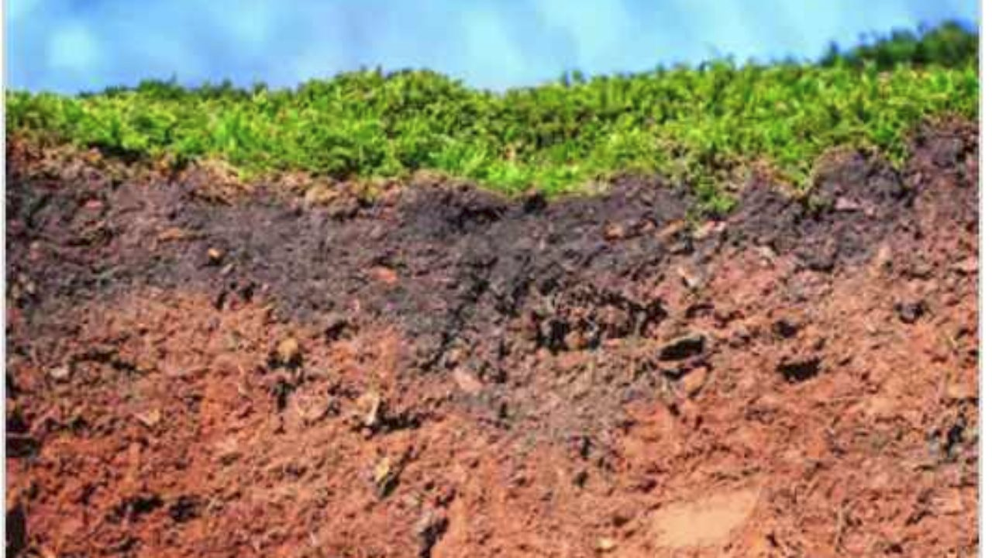
Soil Exploration
What is under your feet?

Slide 2
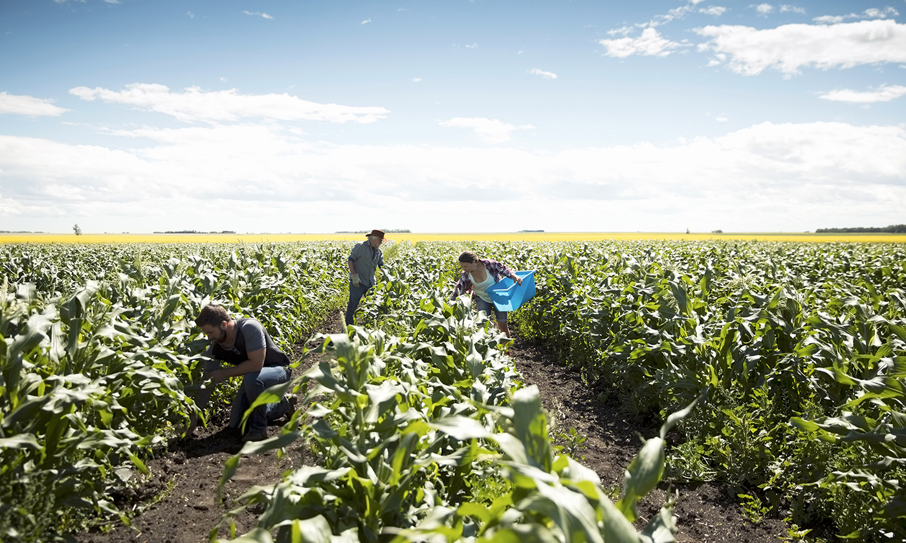
Why should you care about soil?

Slide 3
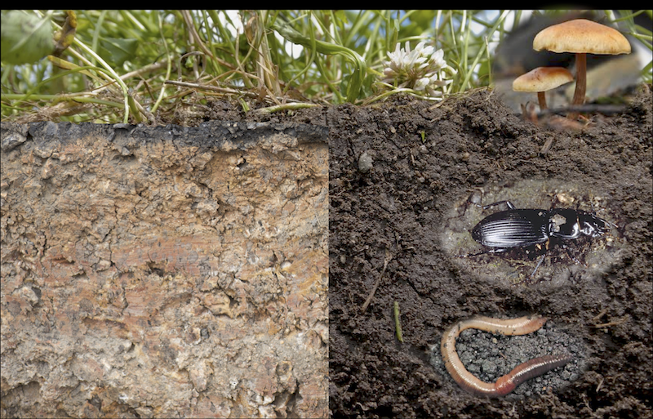
Is all soil the same? How can we tell?

Slide 4
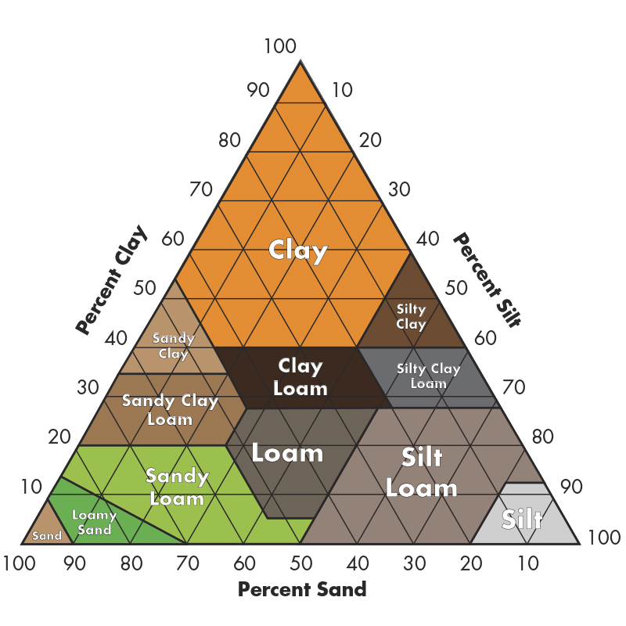
Types of Soil
Clay
Silt
Sand
Loam
And mixes of all the above…!

Slide 5
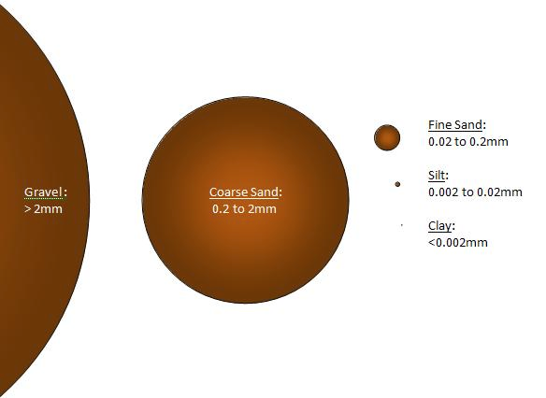
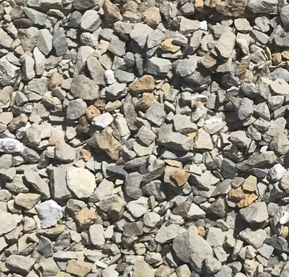
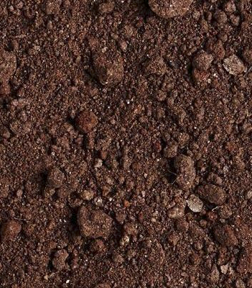
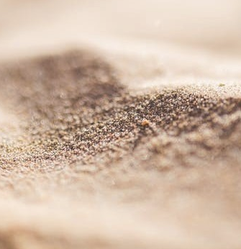
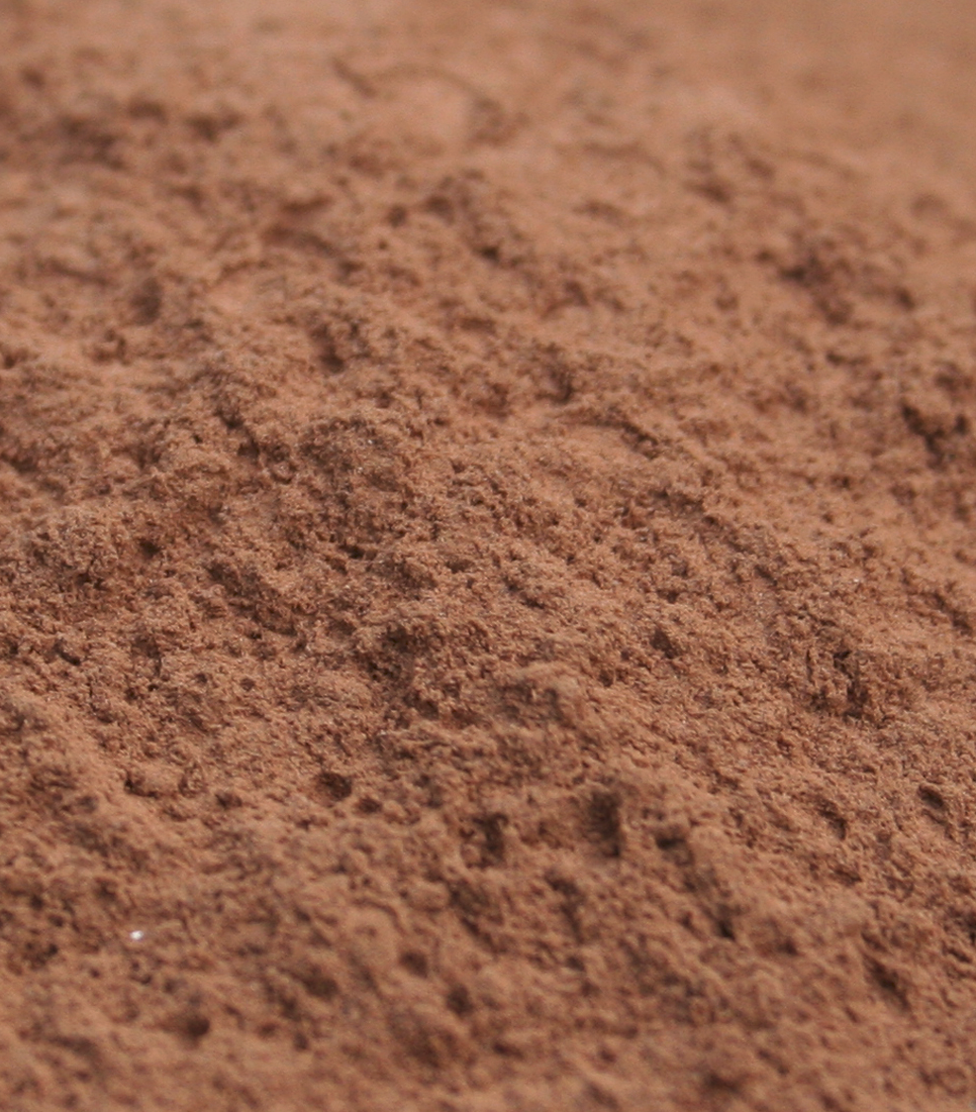
Soil texture is related to the size of the soil particles and how much organic matter is in the soil.
Gravel
Sand
Silt
Clay

Slide 6
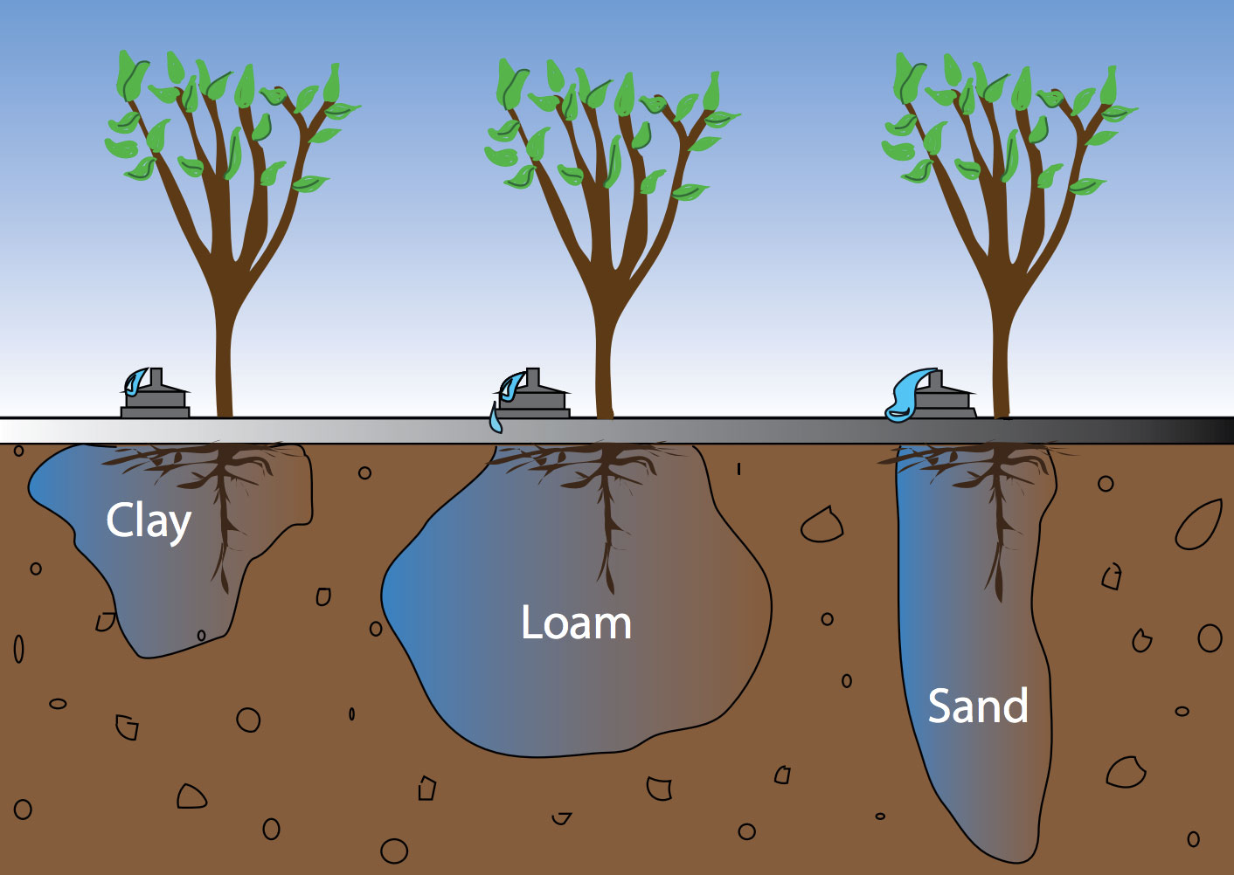
Why does soil texture matter?
Think of Goldilocks and the 3 Bears...
Too small: Clay soils - Hold water, but are easily compacted and will not let roots breathe
Too BIG: Sandy soils - Allow for air pockets in the soil, but the water flows through and does not allow plant to absorb the water into roots
Just Right: Loam and Silt soils - have the right soil texture. Roots can breathe, but water is also stored in the soil.

Slide 7
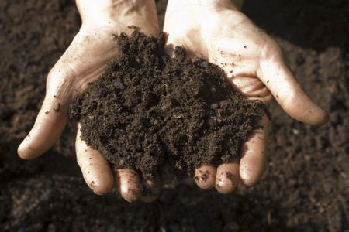
How do you know? Do an easy soil test!
We are going to learn to do 2 tests
The Squeeze Test
The Shake Test

Slide 8
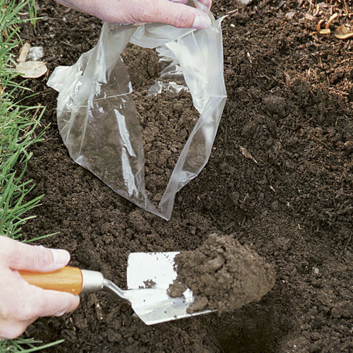
Step 1: Collect Soil Samples
Go to 2-3 places in your yard and collect about 1 cup of soil from each location.
Label each bag
Record details about where you collected each sample in your journal
Include: location, plants, water, and anything else you think it would be good to know.

Slide 9
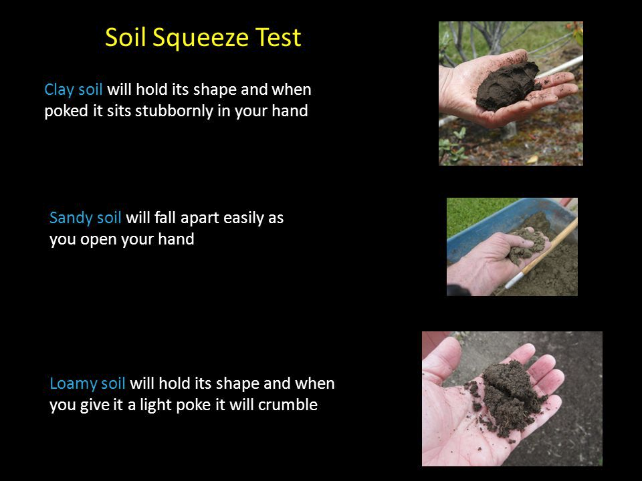

Slide 10
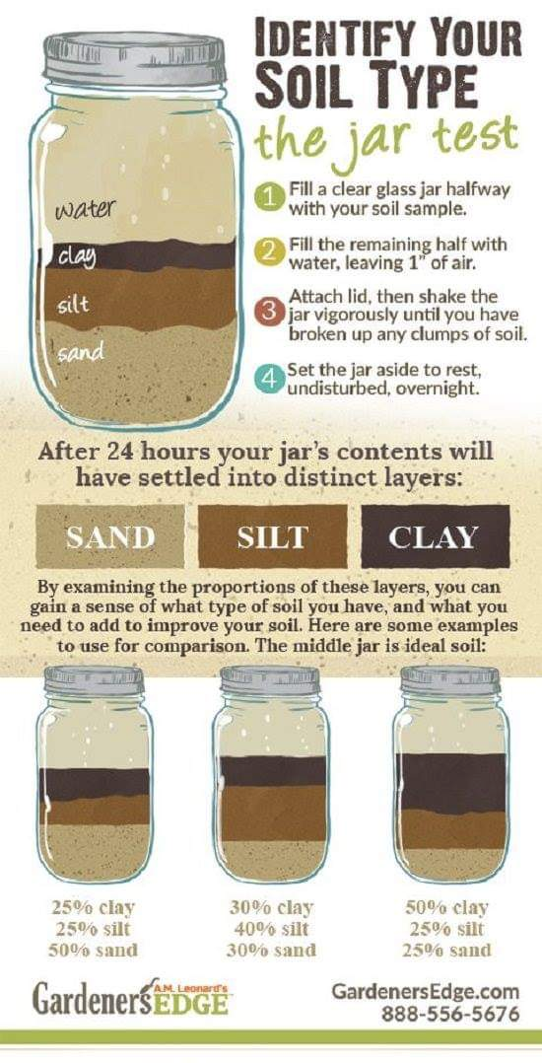
The Jar Shake Test

Slide 11
The Shake Test

Slide 12
Sandy Soils
Sand and pebbles are the heaviest and will drop out of the water first, usually within a minute.
These larger grains will be at the bottom of the jar. Then there will be a layer of silt that takes about 10 minutes to drop from the water.
Finally, at the top are the smallest particles of clay.
You often find this soil in a desert.

Slide 13
Silt Soils
Silt or Loam soils are the easiest to use to grow flowers and vegetables. They have more silt than either clay or sand.
The silt is good at holding water, but also allows air pockets that let the roots breathe.

Slide 14
Clay Soils
Clay particles take as long as 24 hours to drop out of the water.
Clay soils are thick, heavy soils with little air.
They are good at holding water, but many plants have trouble growing in too much clay.
Gardeners add compost to clay soils to create more aeration.

Slide 15
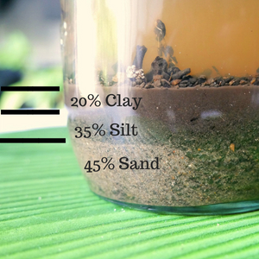
You will need to look carefully at your bottles and estimate the percentages.
You can use a ruler and draw lines on the jar or just use your eyes
Remember the percentages need to add up to 100%
Draw the jars and estimated percentages in your notebook

Slide 16
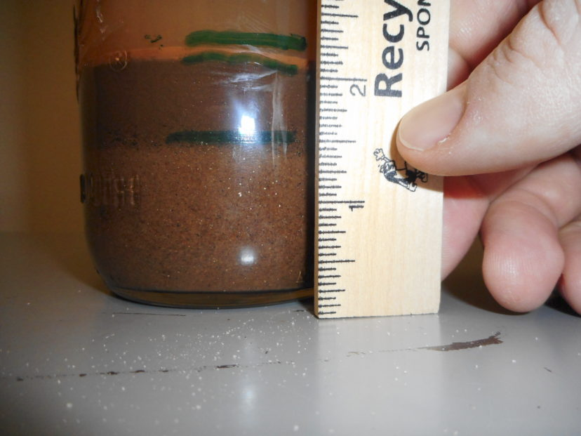
We look forward to learning what types of soil you have at home!
What type of soil do you think this person has?

Slide 17
We look forward to learning what types of soil you have at home!
What type of soil do you think this person has?
It is a sandy soil!
I would estimate that it is about 60% sand, 30% silt, and 10% clay.

