Slide 1
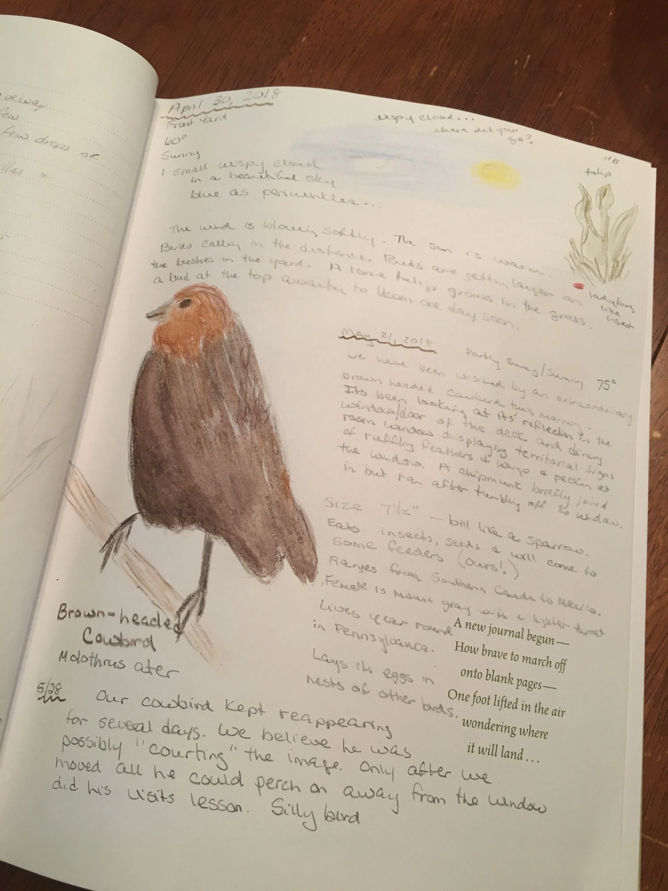
Nature Journals
Learn about where you live directly from what lives all around you!

Slide 2
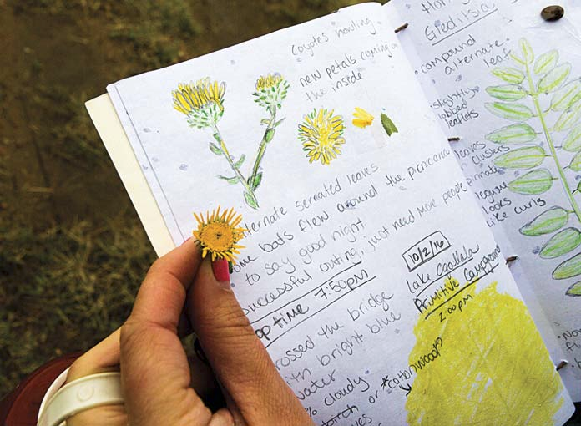
Every Nature Journal entry should include:
Date
Time
Location
Weather
What you notice
  See
  Smell
  Feel
  Hear
Drawing
Writing

Slide 3
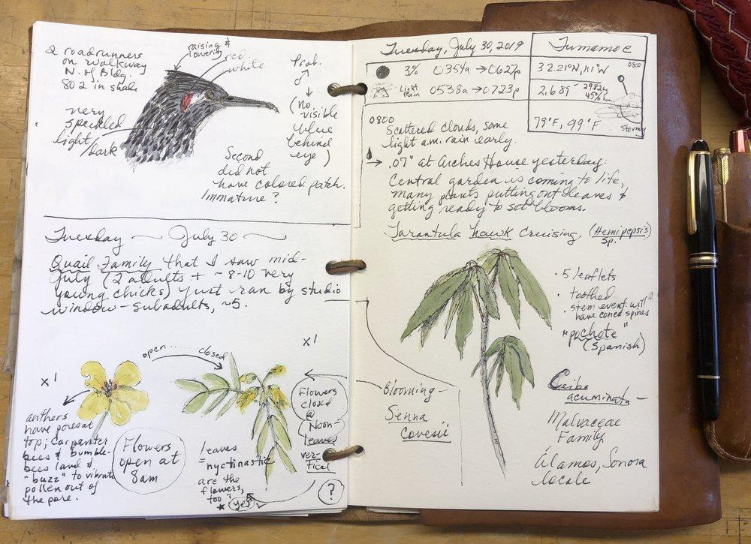
Prompts
I notice...
I wonder...
This reminds me of...
I think maybe...
ABCD-L!
Accurate
Big
Clear
Detailed
Label

Slide 4
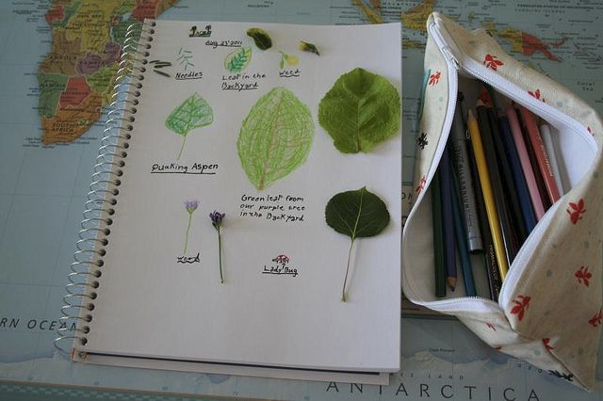
Tips for drawing…
It doesn’t need to be perfect!
When you draw…
Start with shapes
Then think about color
Mix media - watercolor, marker, colored pencil, pencil, pen look great together
Add detail
Try more than once
Have fun!

Slide 5
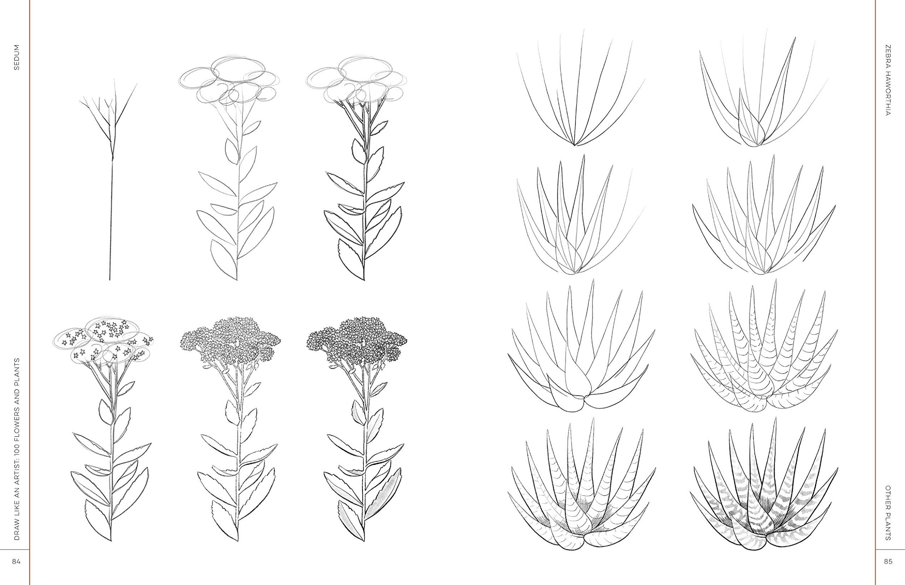

Slide 7
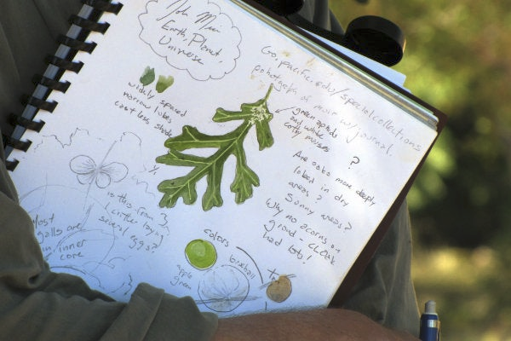
Examples of Journal Entries

Slide 8
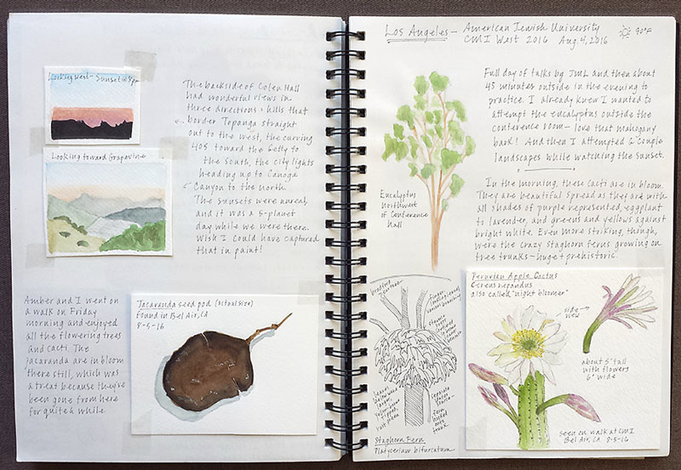

Slide 9
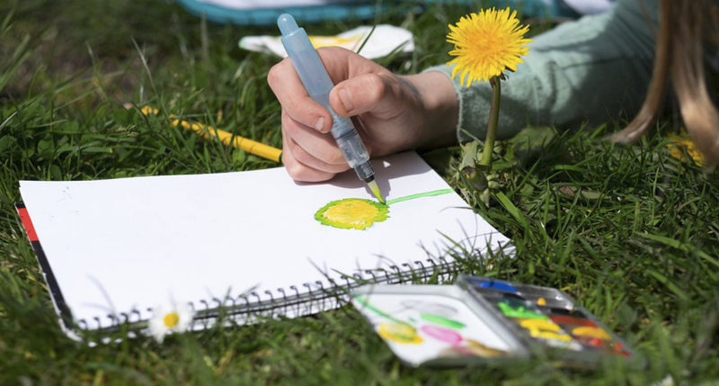

Slide 10
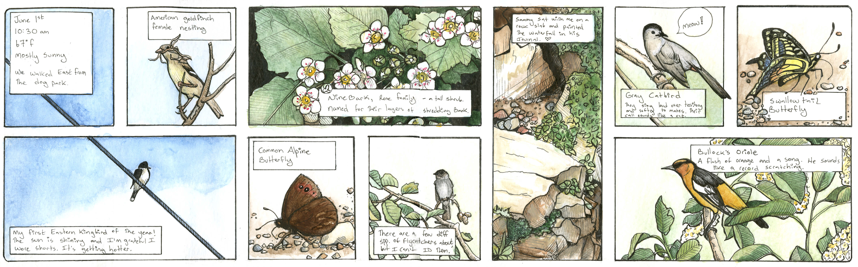

Slide 11
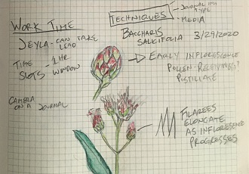
When you journal...
Spend at least 20 minutes in one place
Look closely
Don’t rush
Include detail in your drawing and writing
Enjoy being with nature!

Slide 12
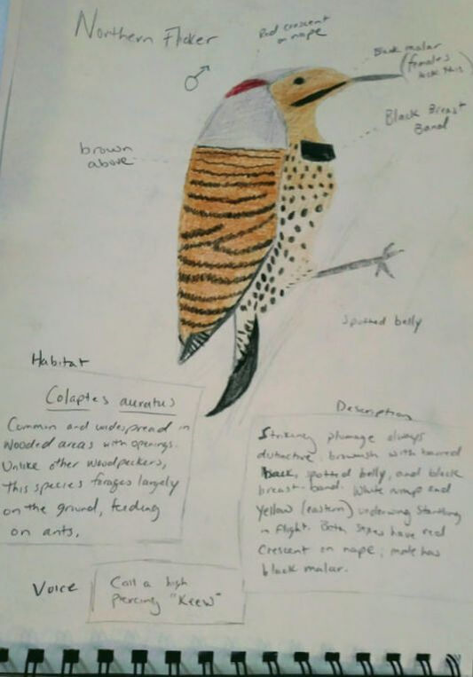
Ideas to get started
Choose one location and bring a chair or pillow to get comfortable there
Prompts:
What is the smallest thing you see?
How many colors do you see?
Sit by an open window with your eyes closed. Count to 30 in your mind. What sounds do you hear? Can you write down the sounds? Can you draw the sounds?
Can you write a story from the perspective of a bird? How does a bird see the world differently?
Weather-Watching: Record the weather at three different times of the day or the week. What did you notice? Can you draw it?
Think about your favorite place in nature. What makes it special? Can you draw or write about how you feel when you visit that special place? Is there something special, like a flower or leaf you can glue in your journal to remind you of that special feeling?
Draw a leaf that you find or make a leave rubbing. Now, try one with a different leaf. What is similar about the two leaves? What is different?
Can you find an ant and trace its path?
If you can go outside, draw any tracks you see. Record any other signs of animals you find, as well.
Take a walk around the block. How many tree species do you see? Can you make a map of your block or neighborhood, and include the different trees?

