Slide 1
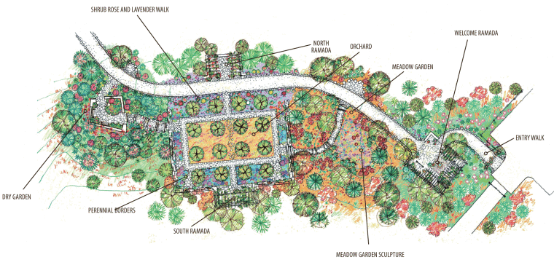

How do you draw a map of your local habitat? A habitat is where a plant or animal lives.

Slide 2
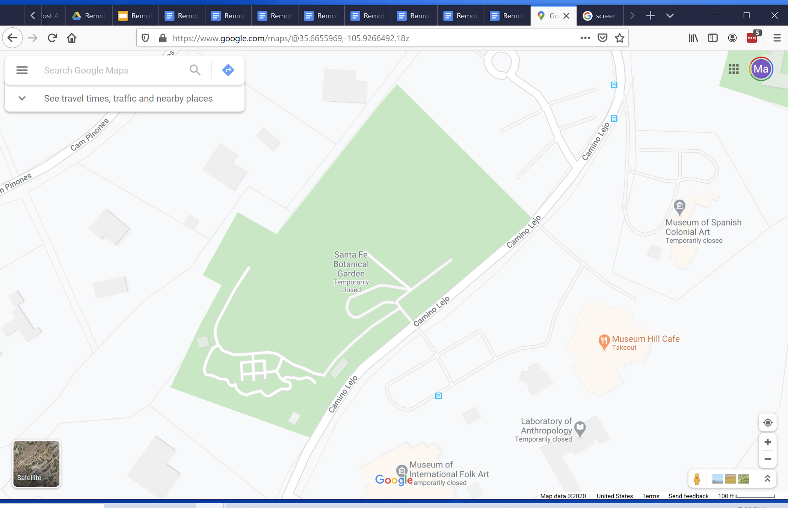
First, locate where you live on Google Maps

Slide 3
If you are looking out your front window, what direction are you looking?

Slide 4
I am looking to the Northwest

Slide 5
This is a map of the Botanical Garden

Slide 6
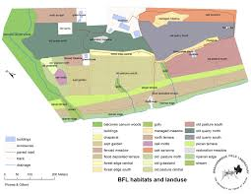
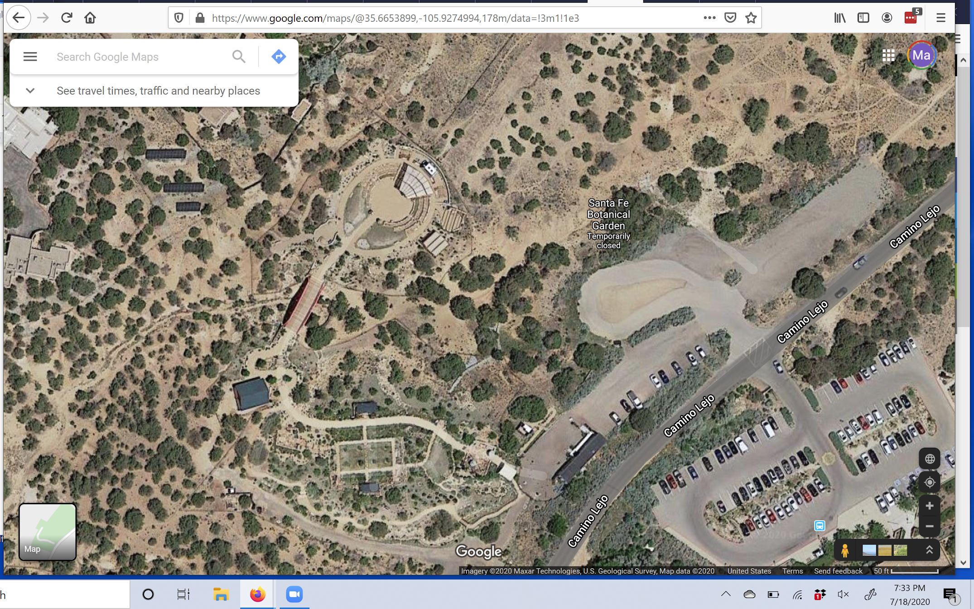
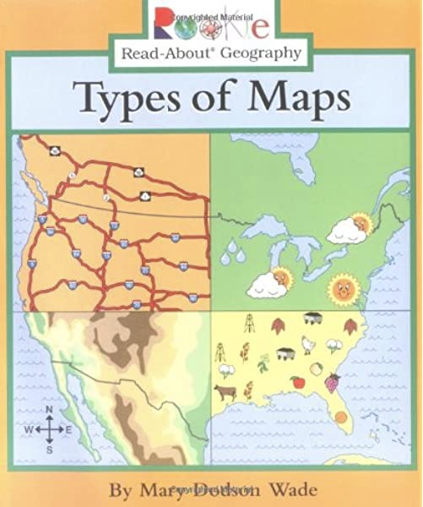
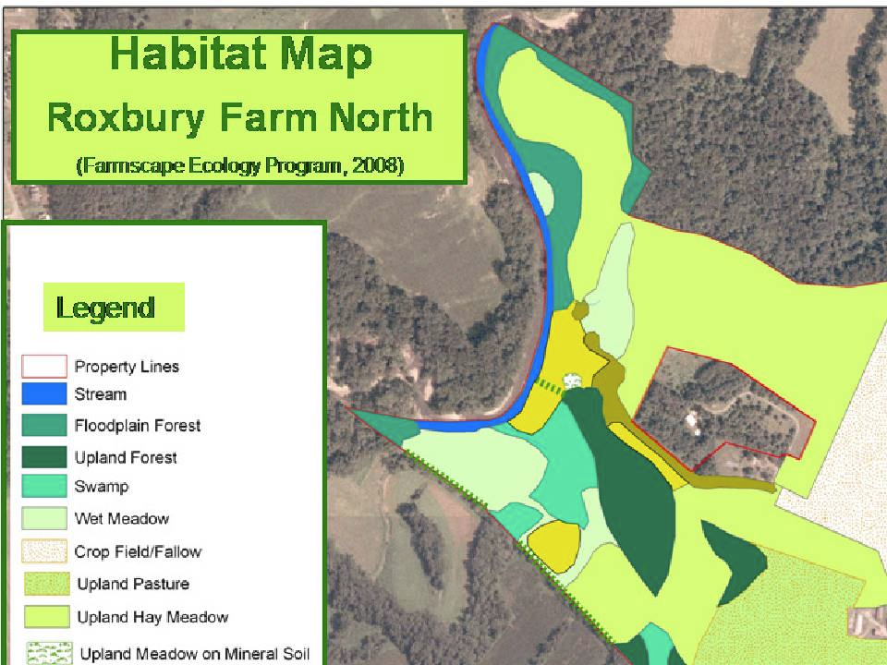
Decide what type of map you want to draw

Slide 7
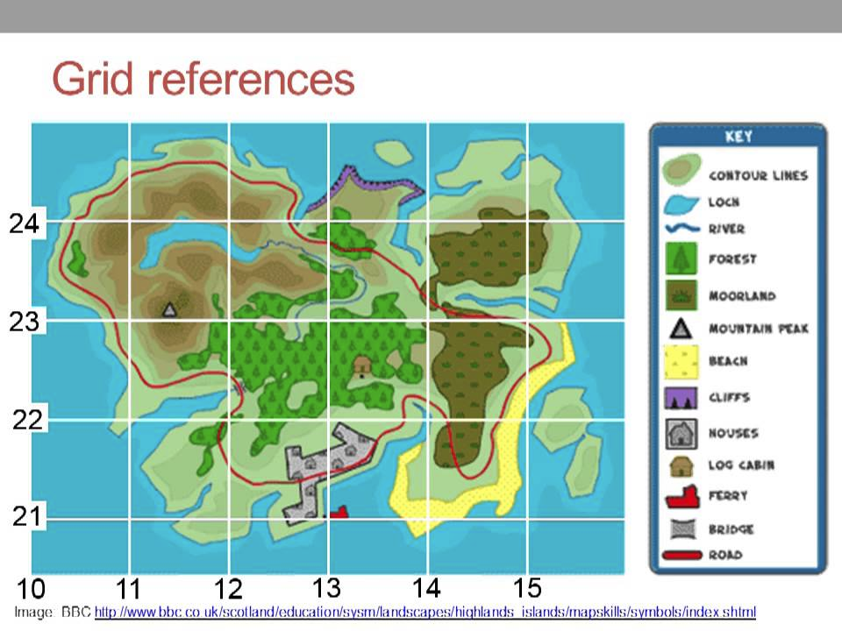
Do you want to use symbols? Make sure you use a key!

Slide 8
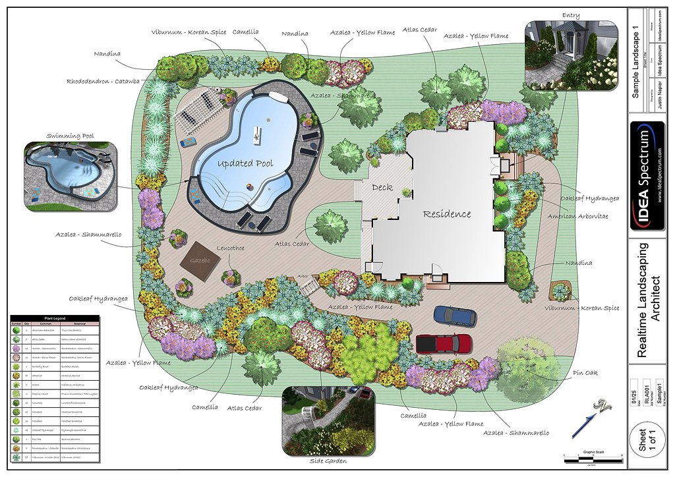
Do you want to use a birds eye view?

Slide 9
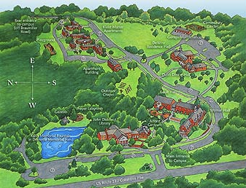
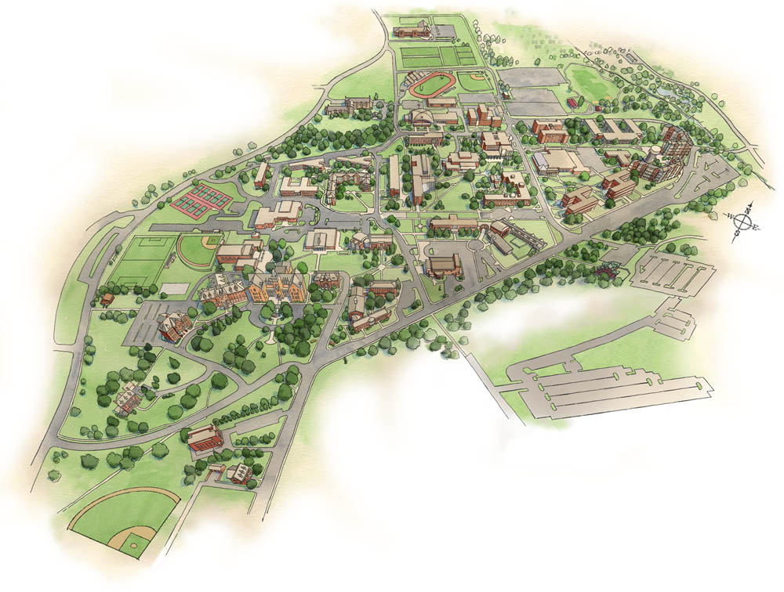
Do you want to use perspective?
Perspective is when a person looks from a specific place and draws what they see.
Notes:
Make sure you define perspective. Use the example of drawing a cube and it looks 3-d, rather than drawing a square.

Slide 10
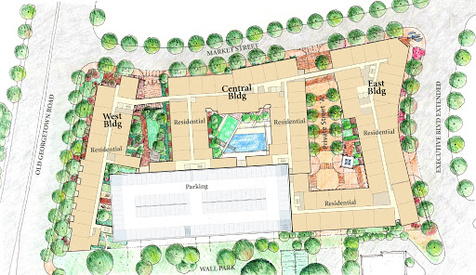
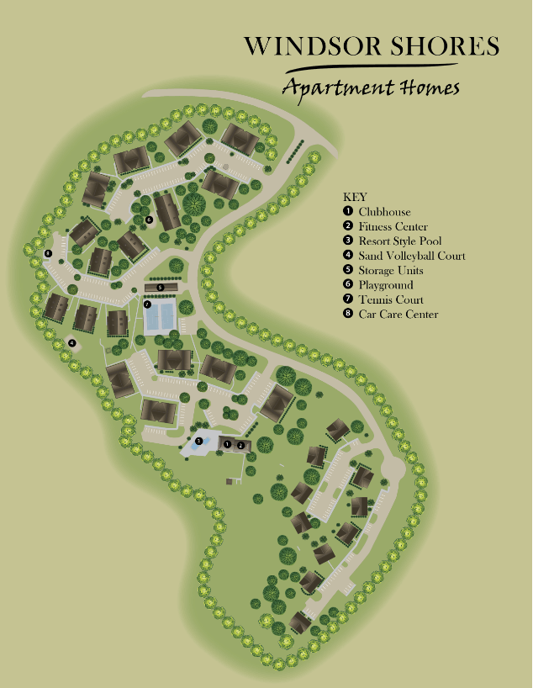
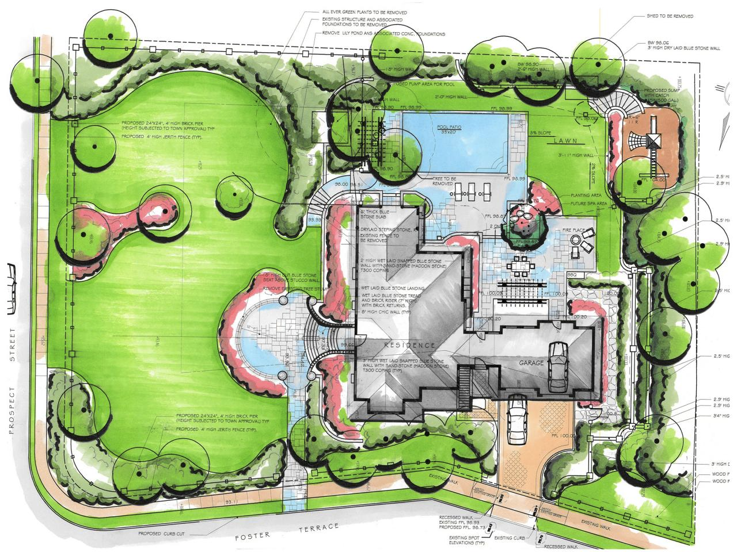
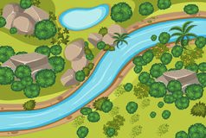
A few more examples...

Slide 11
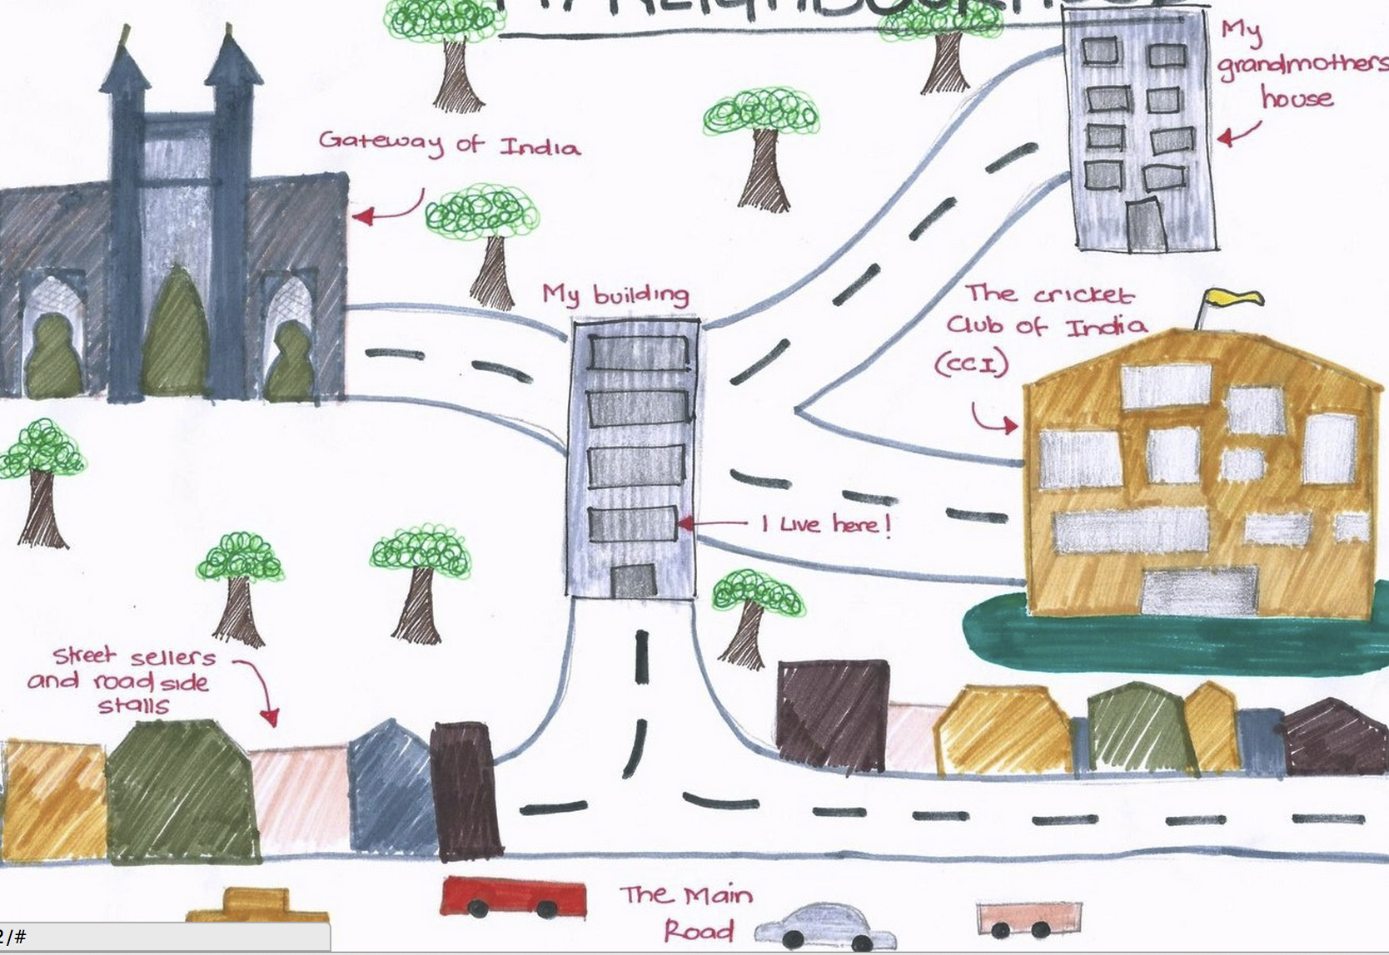
Whatever type of map you choose to draw, make sure that you include...
Map key
Compass rose, showing north
Trees and large plants
Buildings
Roads
Where water flows
Anything else that can help you understand how your neighborhood provides habitat to plants and animals
Notes:
Review habitat: Habitat is a place where a plant or animal lives

