Slide 1

Learning Types of Birds

Slide 2

How do we recognize someone?
How do we recognize the people in our lives?
How do you know I am me, and not someone else?
How would you be able to tell the difference between a child and an adult?
Make a list of clues that help us recognize someone:
____________
____________
____________
Now, try to sort the people in your class!

Slide 3



Silhouette:
the dark shape and outline of an object, similar to a shadow
Just like people, we can use body shapes and silhouettes
to recognize and sort birds into groups!

Slide 4

What kind of bird is this? How do you know?

Slide 5
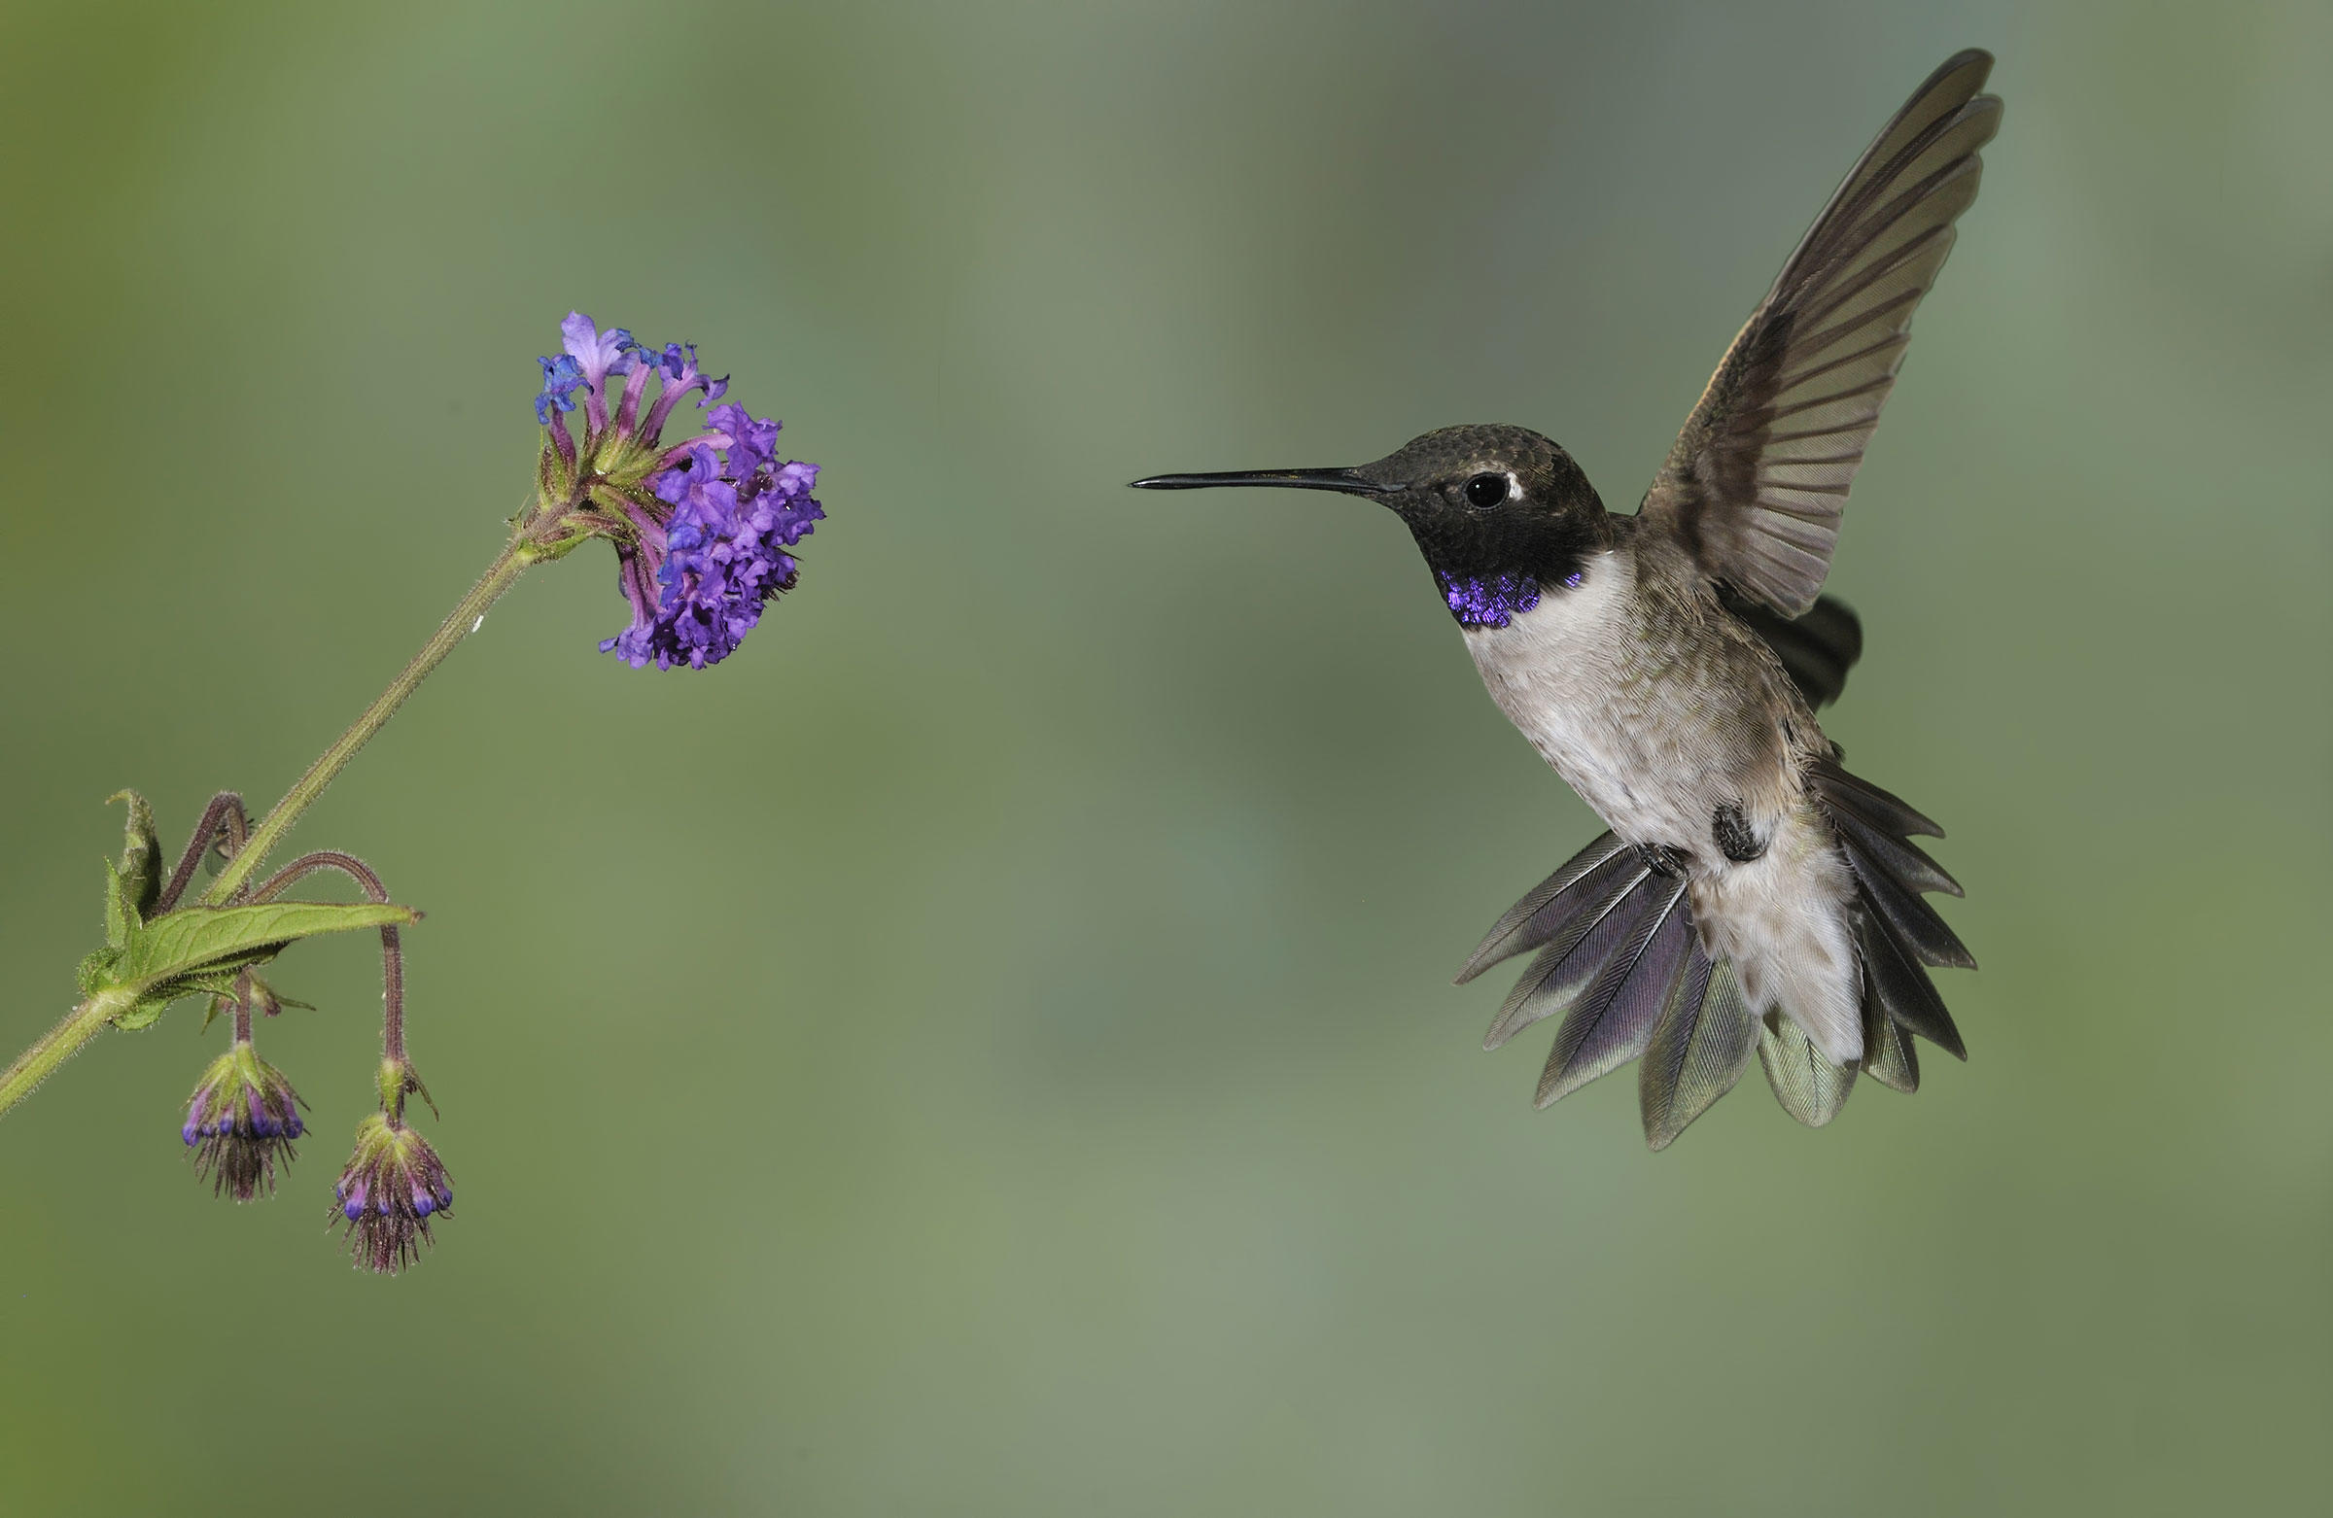
Black-chinned Hummingbird
hummingbird
Hummingbirds have a long skinny beak used for eating nectar from flowers.

Slide 6

What type of bird is this? How do you know?

Slide 7
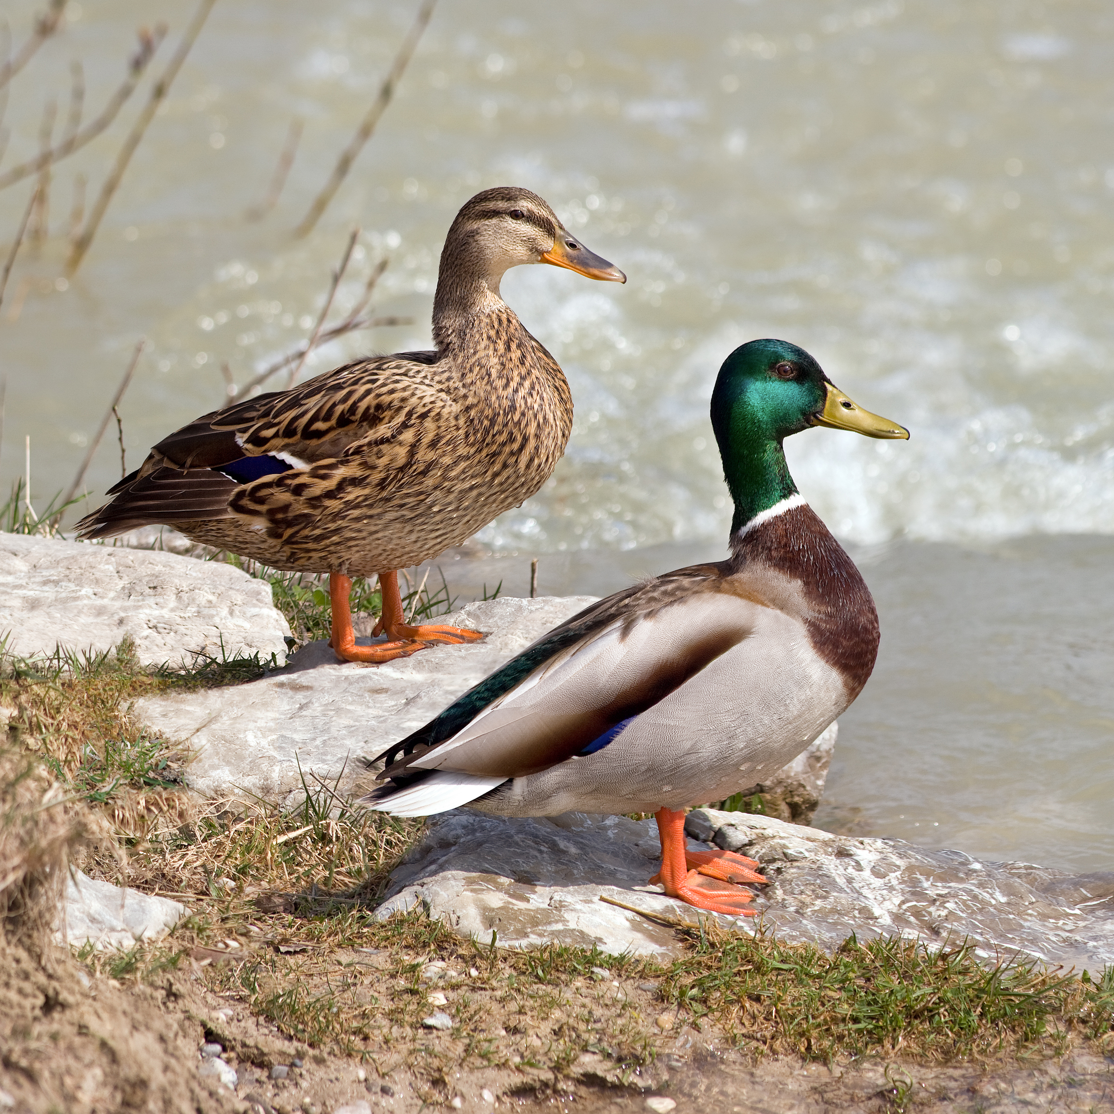
Mallard Duck
Has a rounded bill/beak used for filtering food out of water, and webbed feet for swimming in its watery habitat.

Slide 8
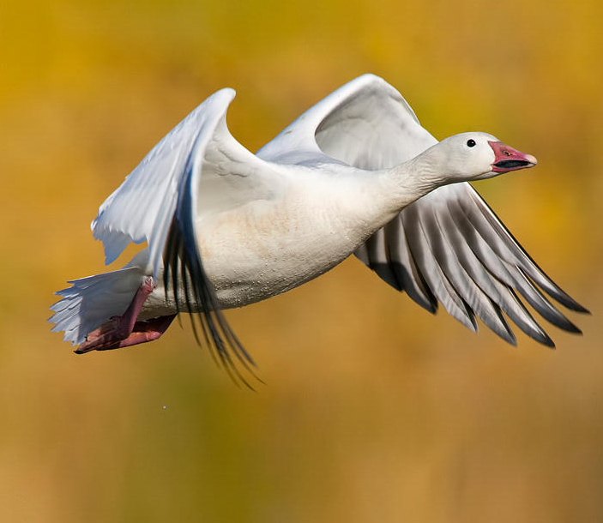
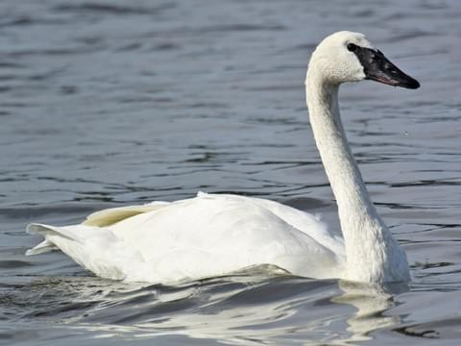
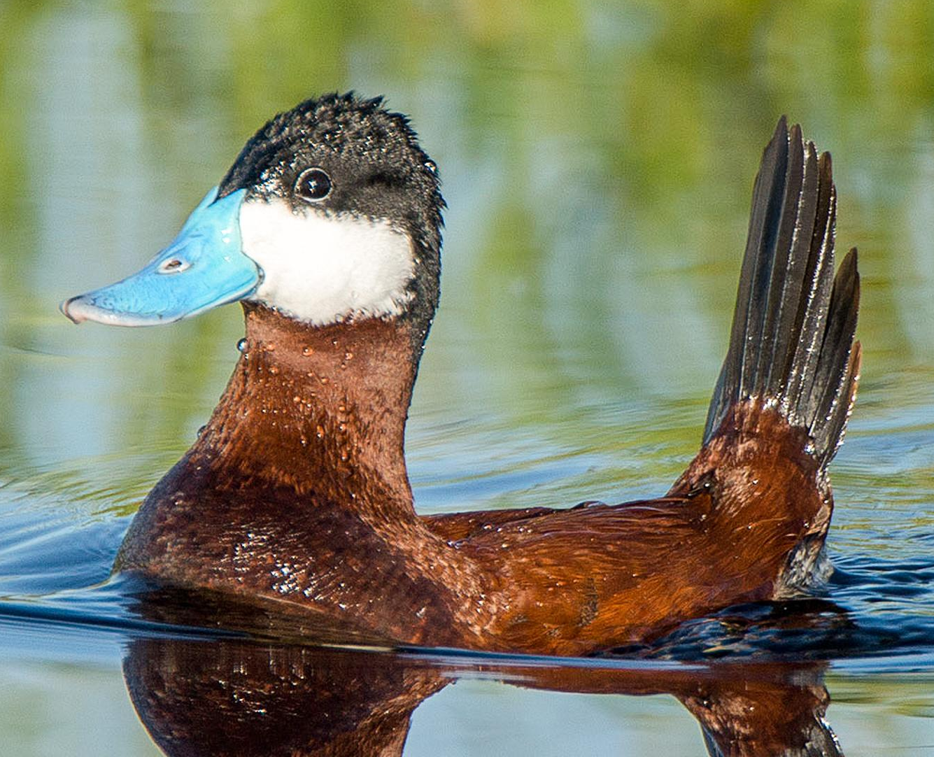
Mallard Duck
Snow Goose
Trumpeter Swan
Ruddy Duck
Similar Group: Ducks,
Geese, and Swans
Have rounded bill/beaks used for filtering food out of water, and webbed feet for swimming in watery habitats.
Notes:
Birds with shared characteristics can be put into larger groups. For instance, ducks have similar body shapes, feet, and beaks to other birds like geese and swans.

Slide 9
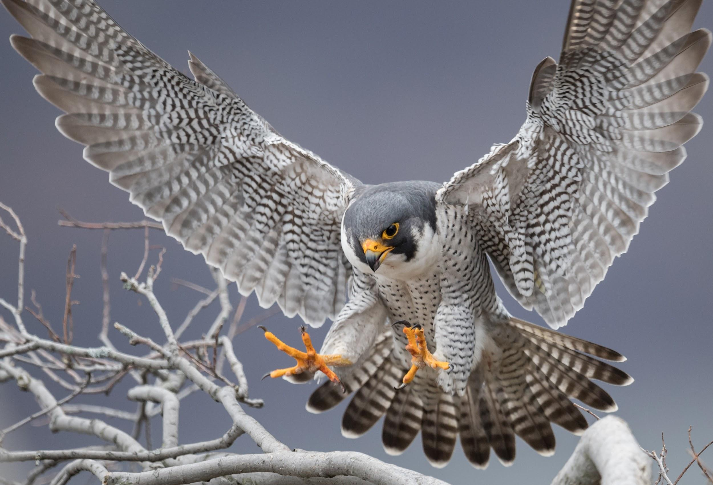
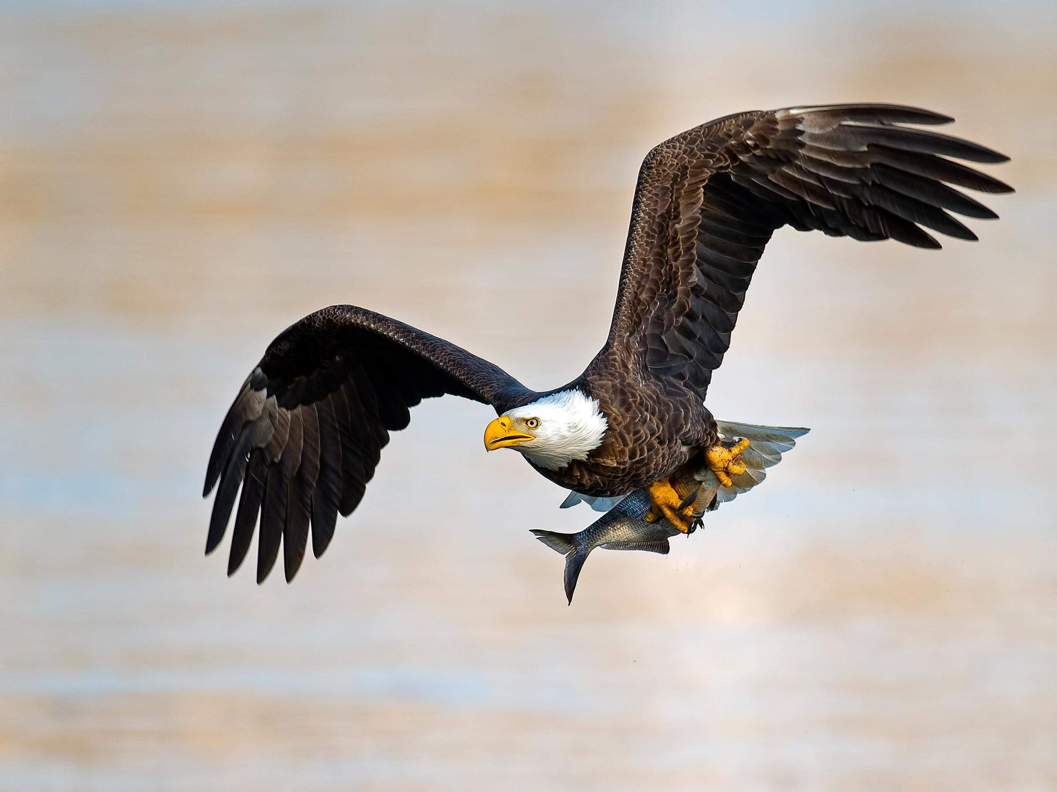
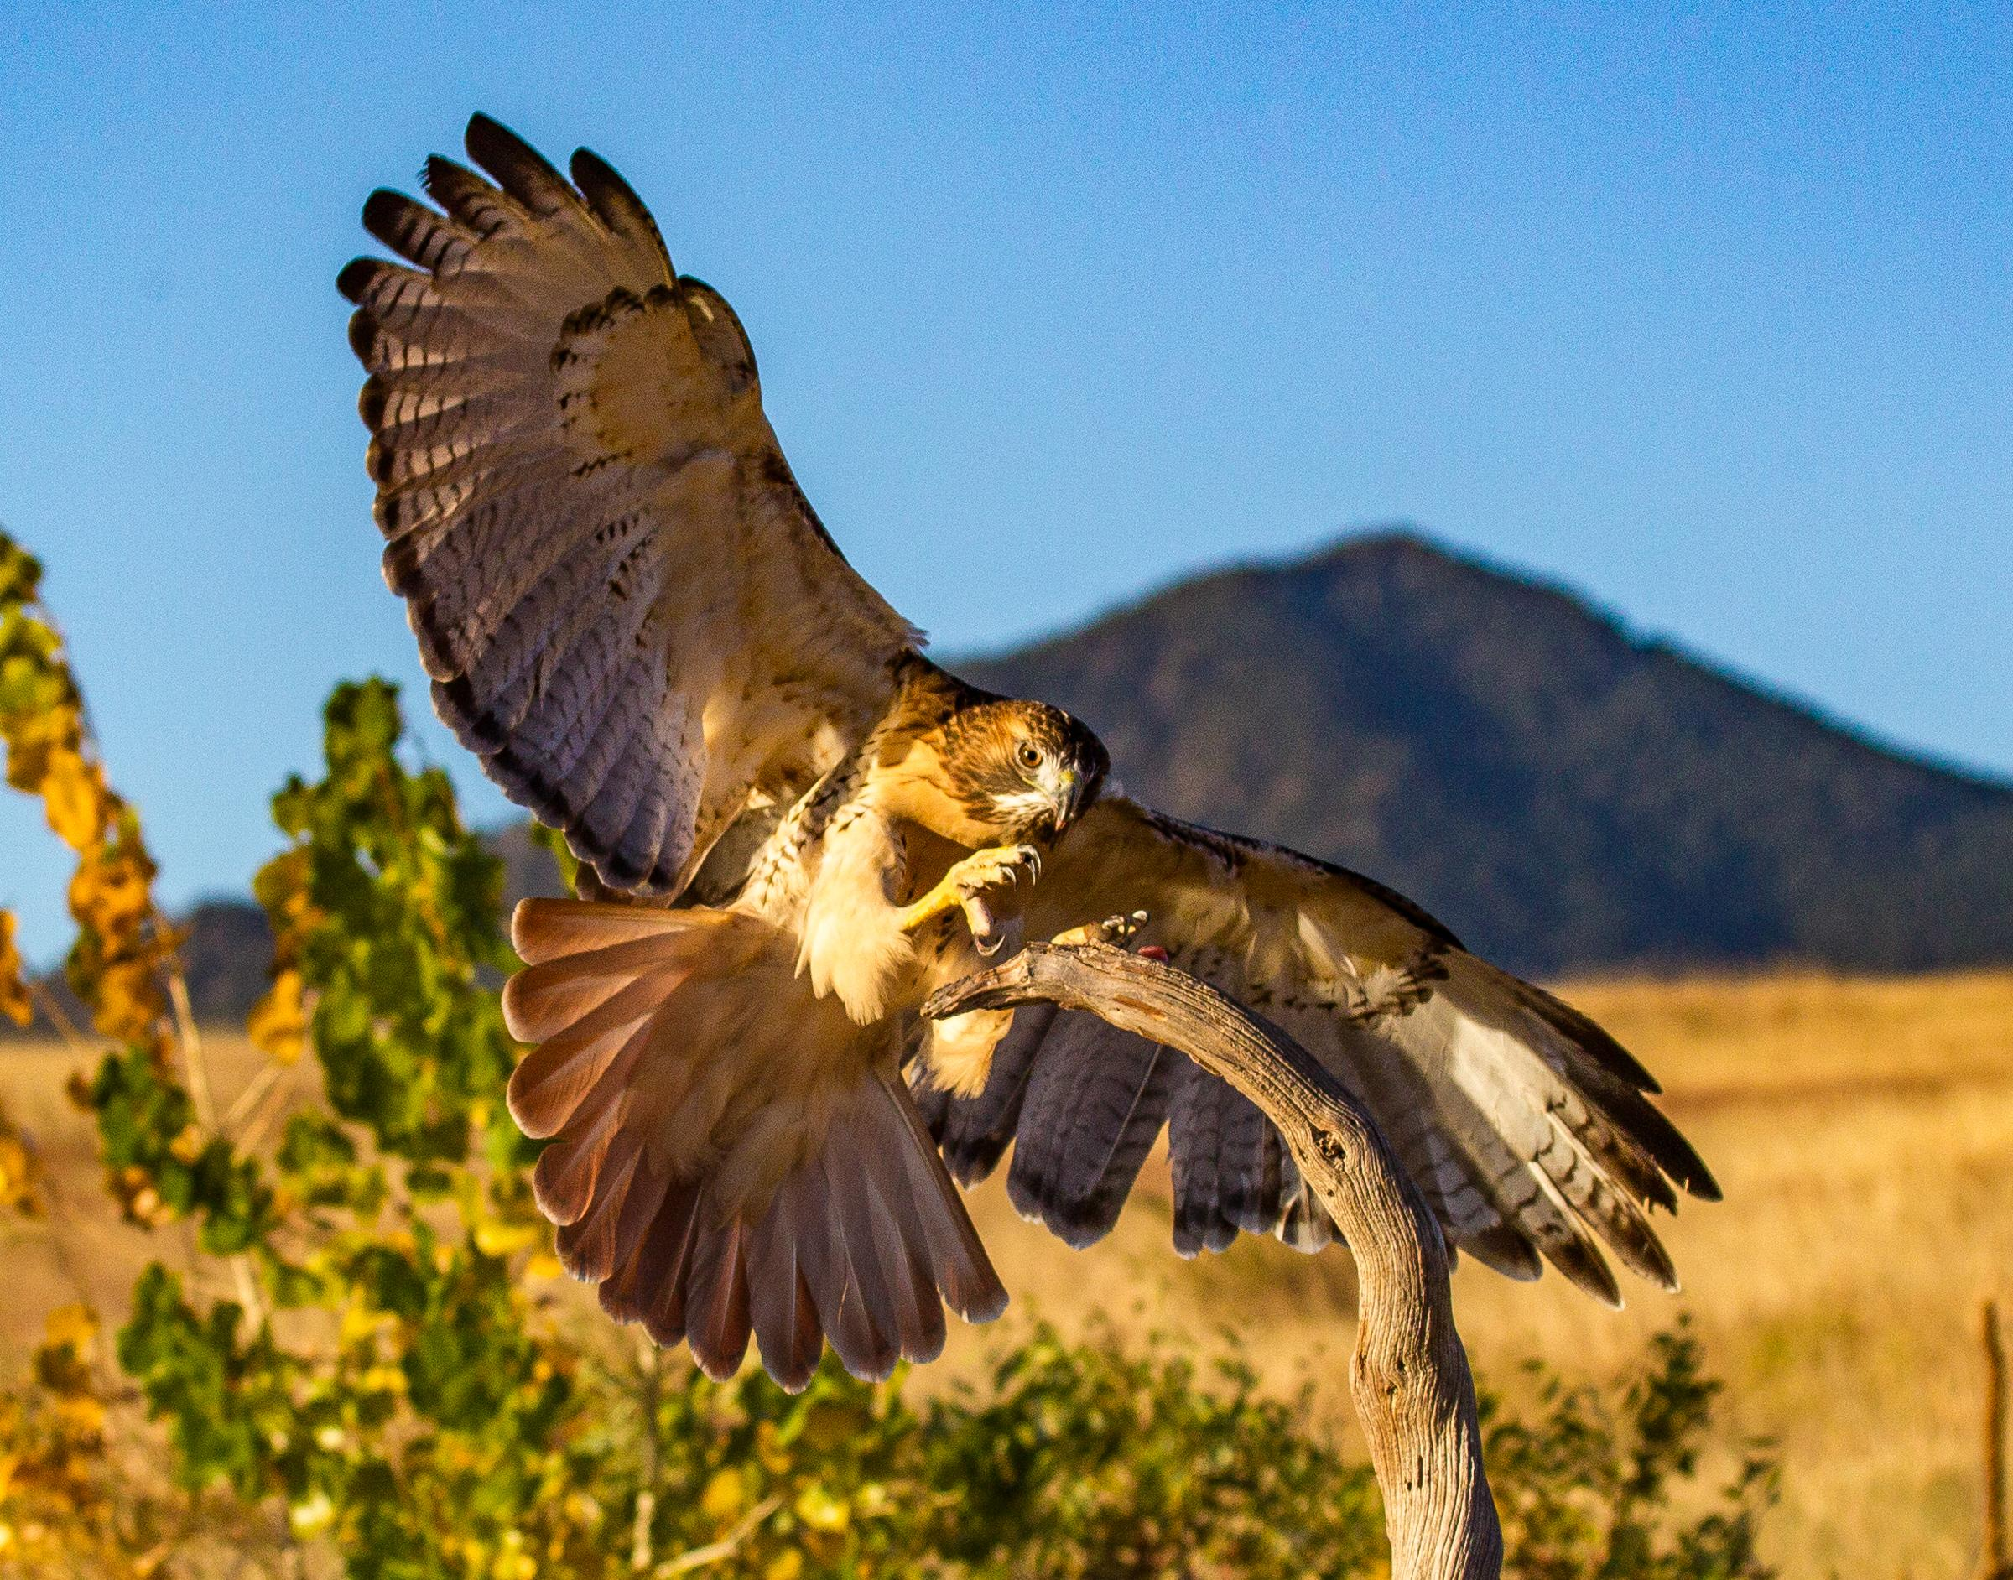
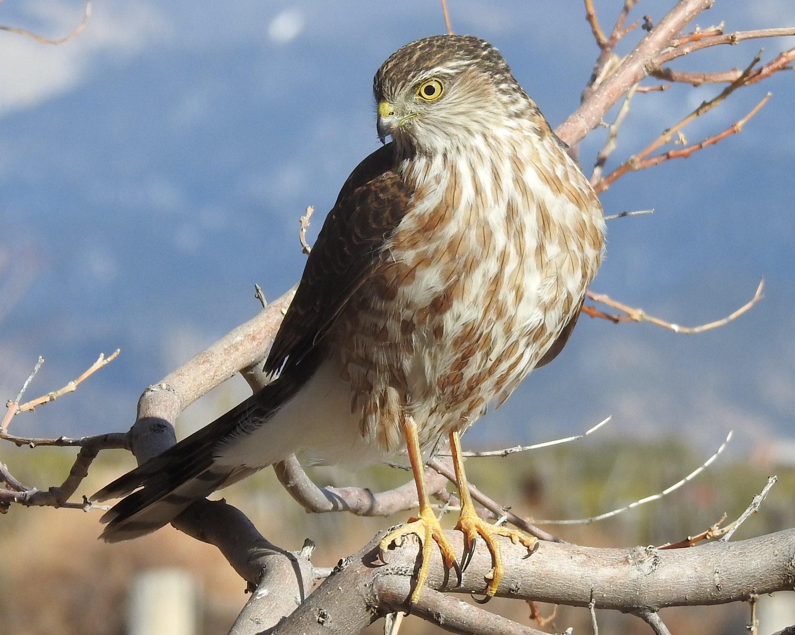
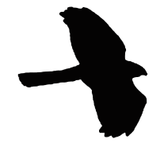
Hawks, Falcons, & Eagles
Peregrine Falcon
Bald Eagle
Also called, “birds-of-prey” or raptors
Includes vultures.
Predators who hunt and eat meat
Have strong, broad wings good for soaring, flying fast, or diving for prey, as well as a strong, sharply hooked beak for tearing into meat.
Red-tailed Hawk
Cooper’s Hawk
Notes:
Here are some other groups of birds that are helpful to learn.

Slide 10
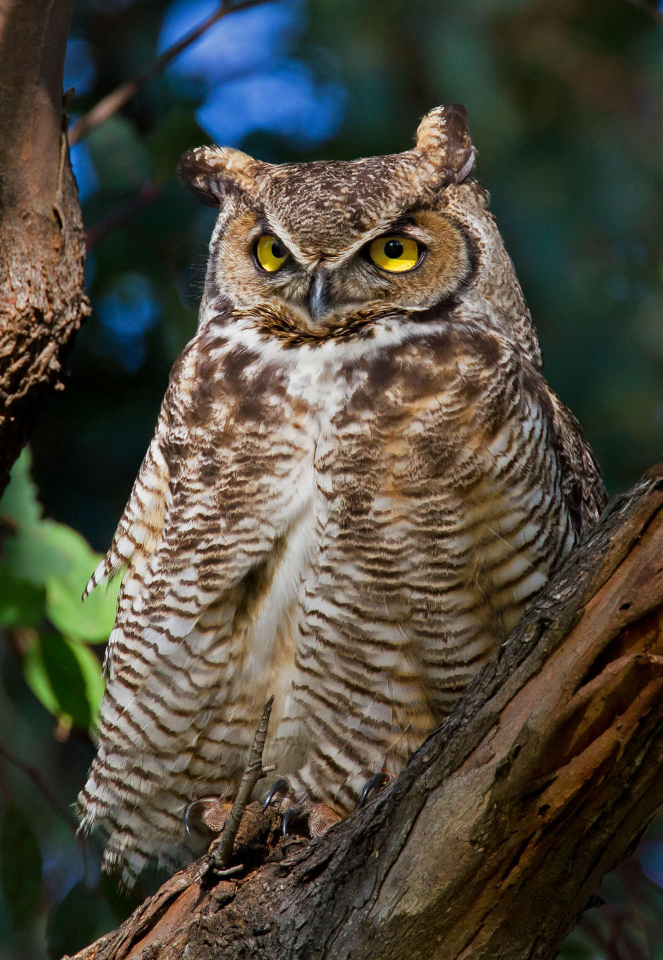
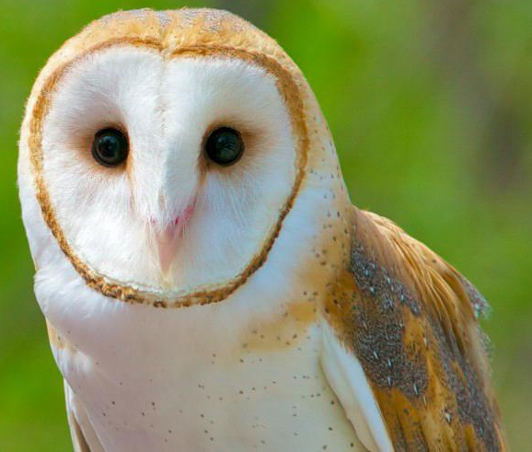

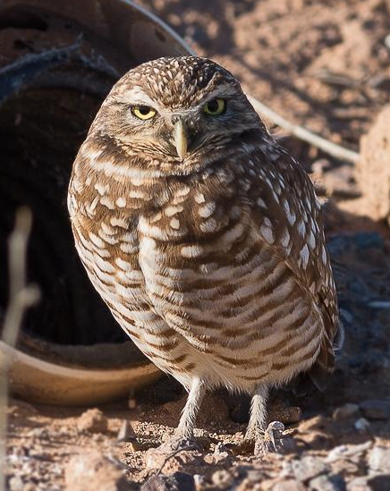
Owls
Peregrine Falcon
Great Horned Owl
Barn Owl
Predators who hunt at night
Thick feathers surround the face and neck of the bird, making its neck look short and thick in silhouette.
These feathers are actually a useful adaptation for nocturnal hunting, as the face “discs” amplify and direct sound to the owl’s ears.
The Great Horned Owl is the biggest owl in New Mexico (and doesn’t actually have horns, just special feathers on its head that look similar to horns).
Burrowing Owl
Notes:
**Note to teachers: owls are considered bad omens to some Native tribes/pueblos. You may want to skip this slide if you have any concerns.

Slide 11
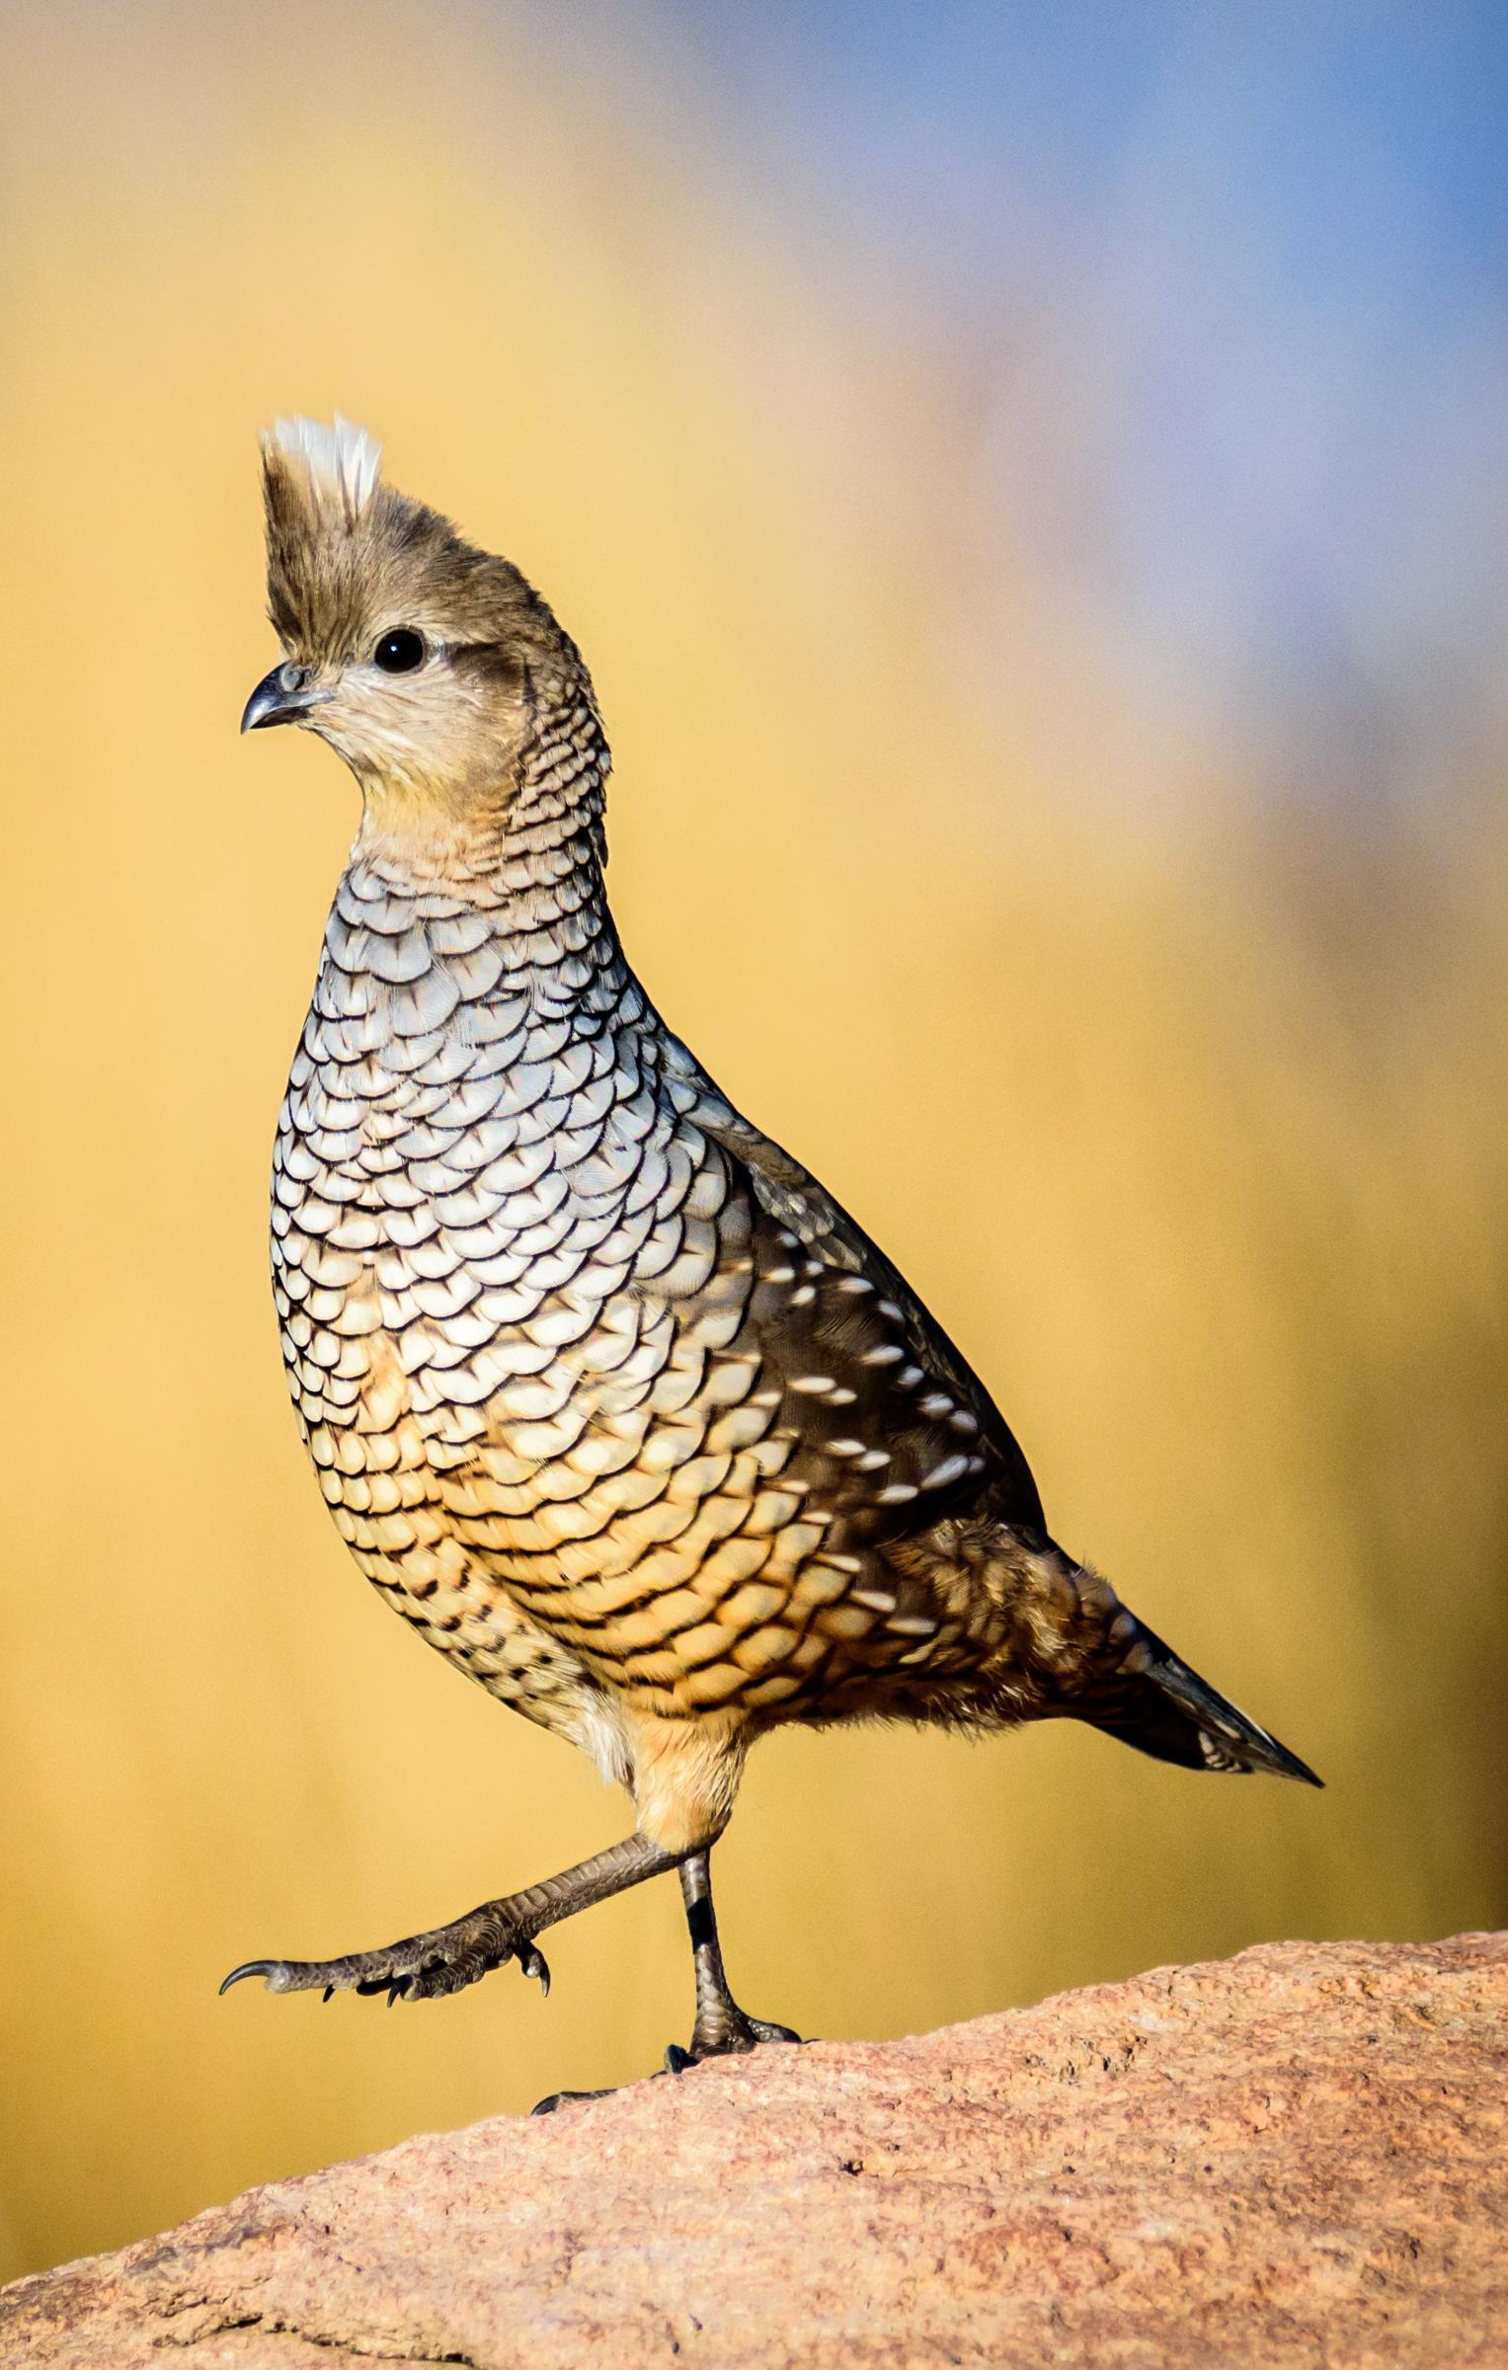
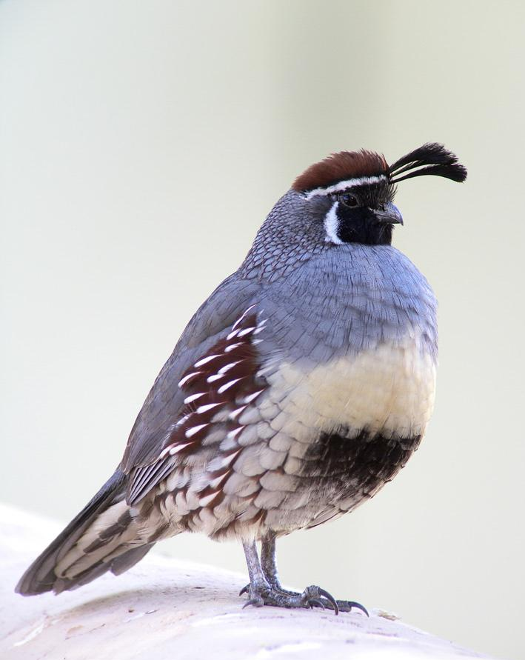
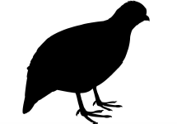
Game Birds
Scaled Quail
Gambel’s Quail
The birds people like to hunt and eat
Have rounded body shapes, and short, rounded wings that allow them to fly short distances to escape predators.

Slide 12
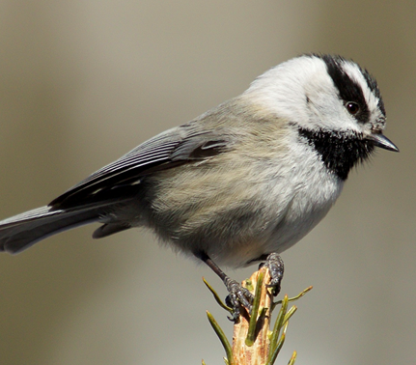
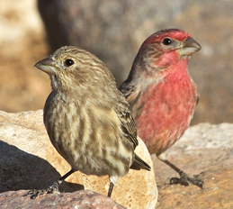
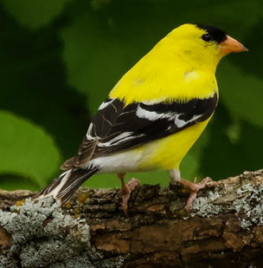
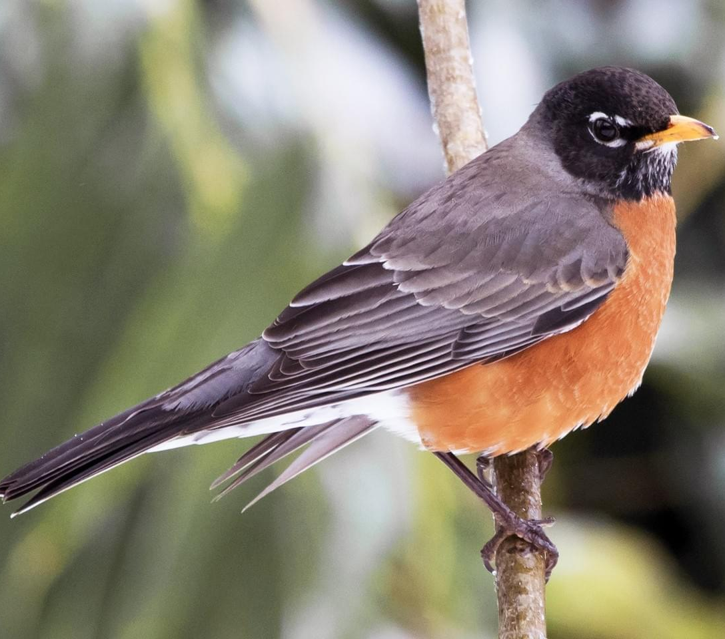
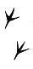
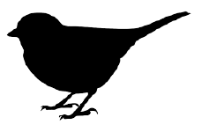
Peching Birds
Mountain Chickadee
House Finches
Largest group of birds in New Mexico (100’s of species)
Also called “song birds”
Usually small birds that have one toe in the back of the foot and three toes in the front of the foot, making landing and holding onto a branch or other surface easy for them.
American Goldfinch
American Robin
Notes:
These birds usually eat seeds, berries, or insects. Very large group with lots of different types of birds.

Slide 13
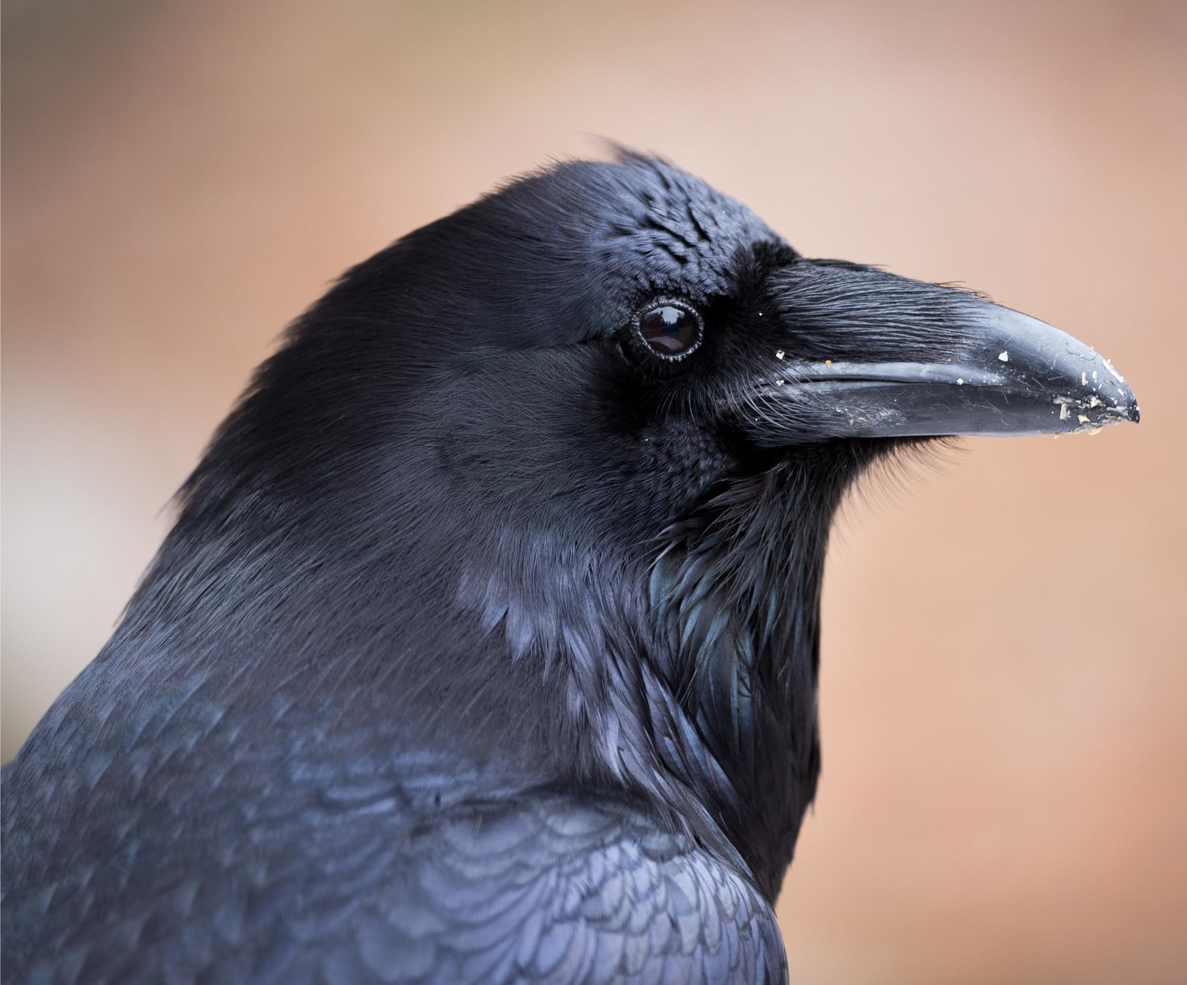
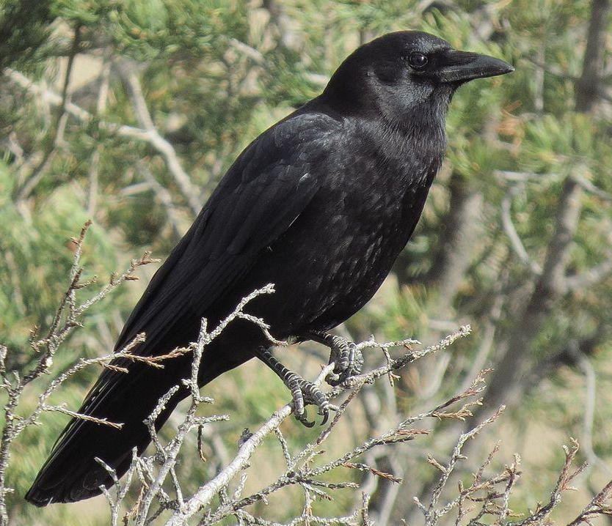
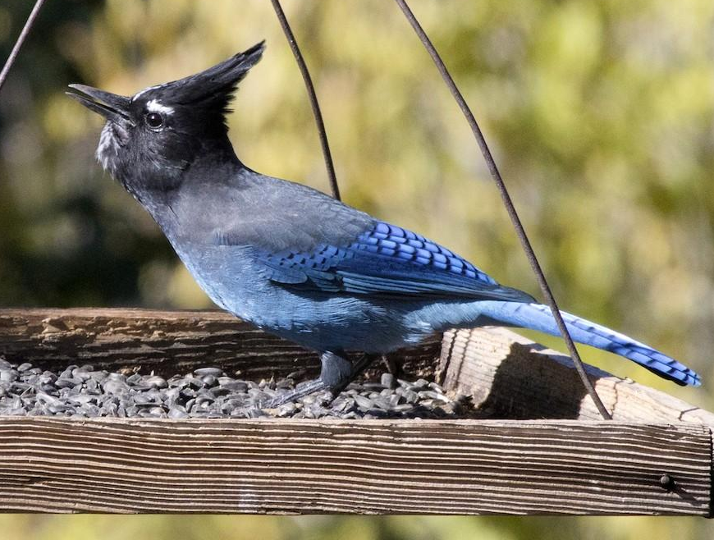

Jays, Crows, and ravens
Common Raven
American Crow
Also called “corvids” and technically belongs within the larger “perching birds” group.
Very intelligent
Able to live in many different habitats and eat different types of food due to the very general but strong shape of its beak.
Steller’s Jay
Notes:
Usually on the larger side, size-wise

Slide 14
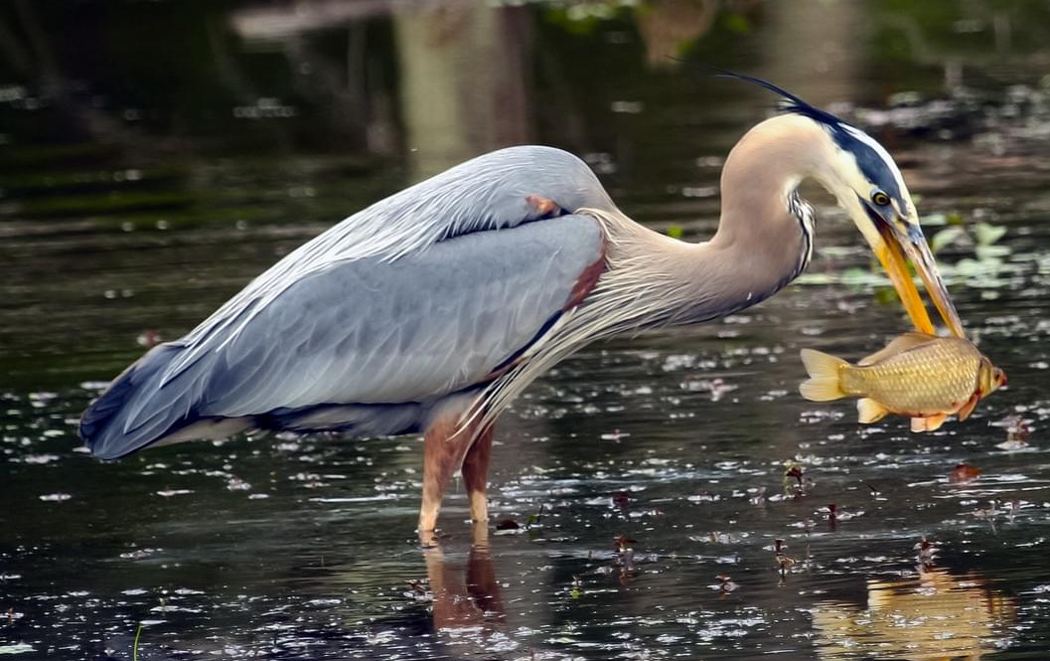
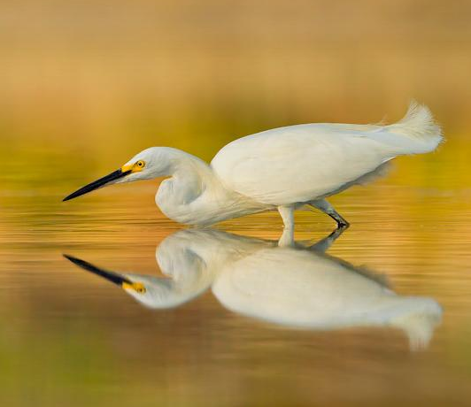
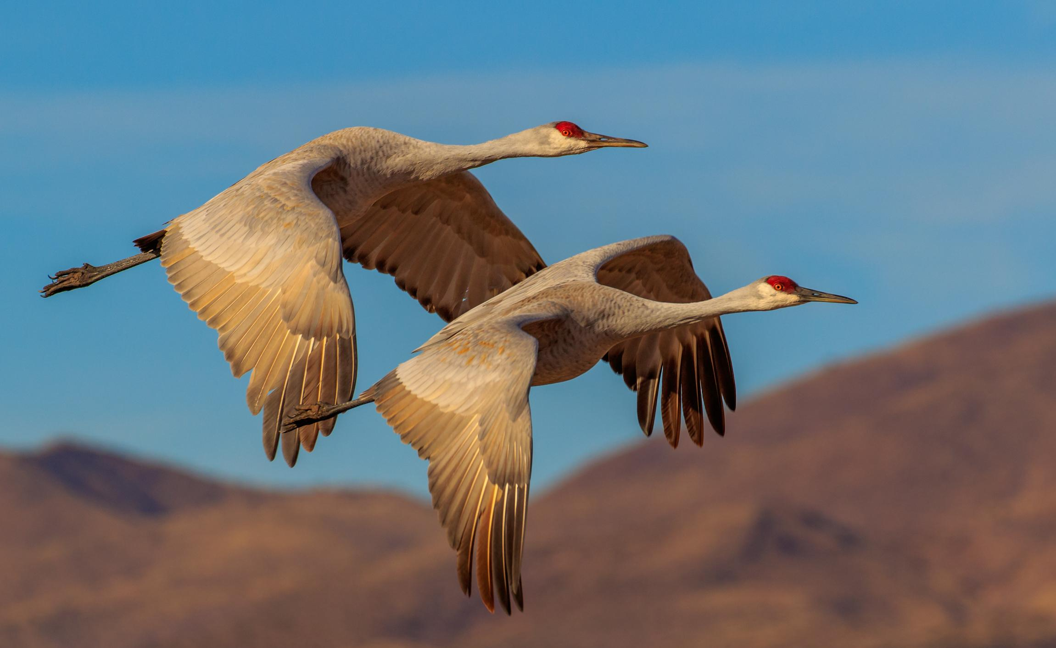
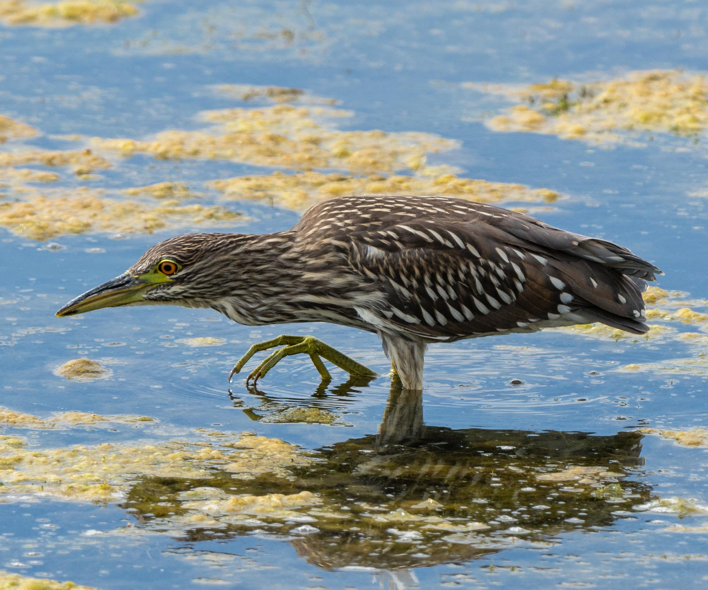
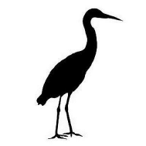
Wading birds
Great Blue Heron
Snowy Egret
Have long, straight, pointed beak, long legs, and long splayed toes used as they walk through water and over muddy shores while hunting/searching for food.
Sandhill Cranes
Black-crowned Night Heron
Notes:
Every winter, tens of thousands of Sandhill Cranes migrate to New Mexico. This is one of the largest populations of Sandhill Cranes in the world. You can see them along the Rio Grande, especially south of Albuquerque. In November, the annual International Crane Festival is held at Bosque Del Apache National Wildlife Refuge in Socorro.

Slide 15
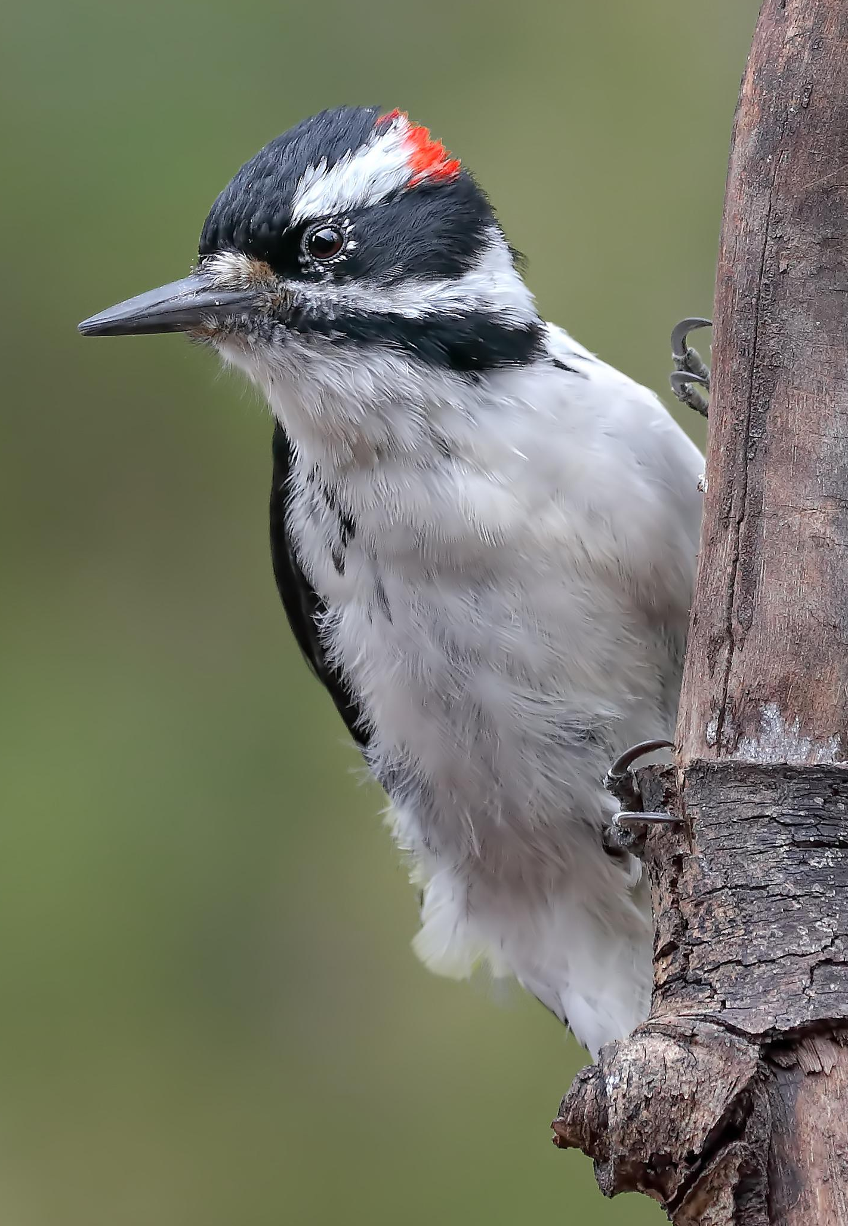
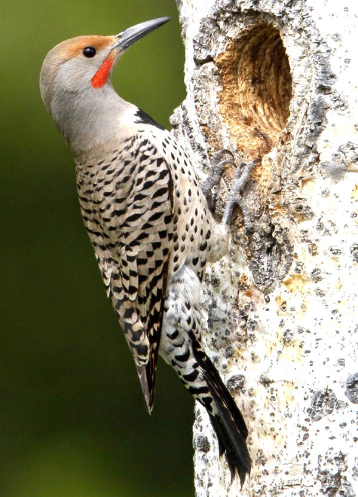

Woodpeckers
Have a strong pointed beak, a sturdy tail that helps the bird cling to a tree, and feet with two toes in front, and two toes facing backwards.
Hairy Woodpecker
Northern Flicker

Slide 16
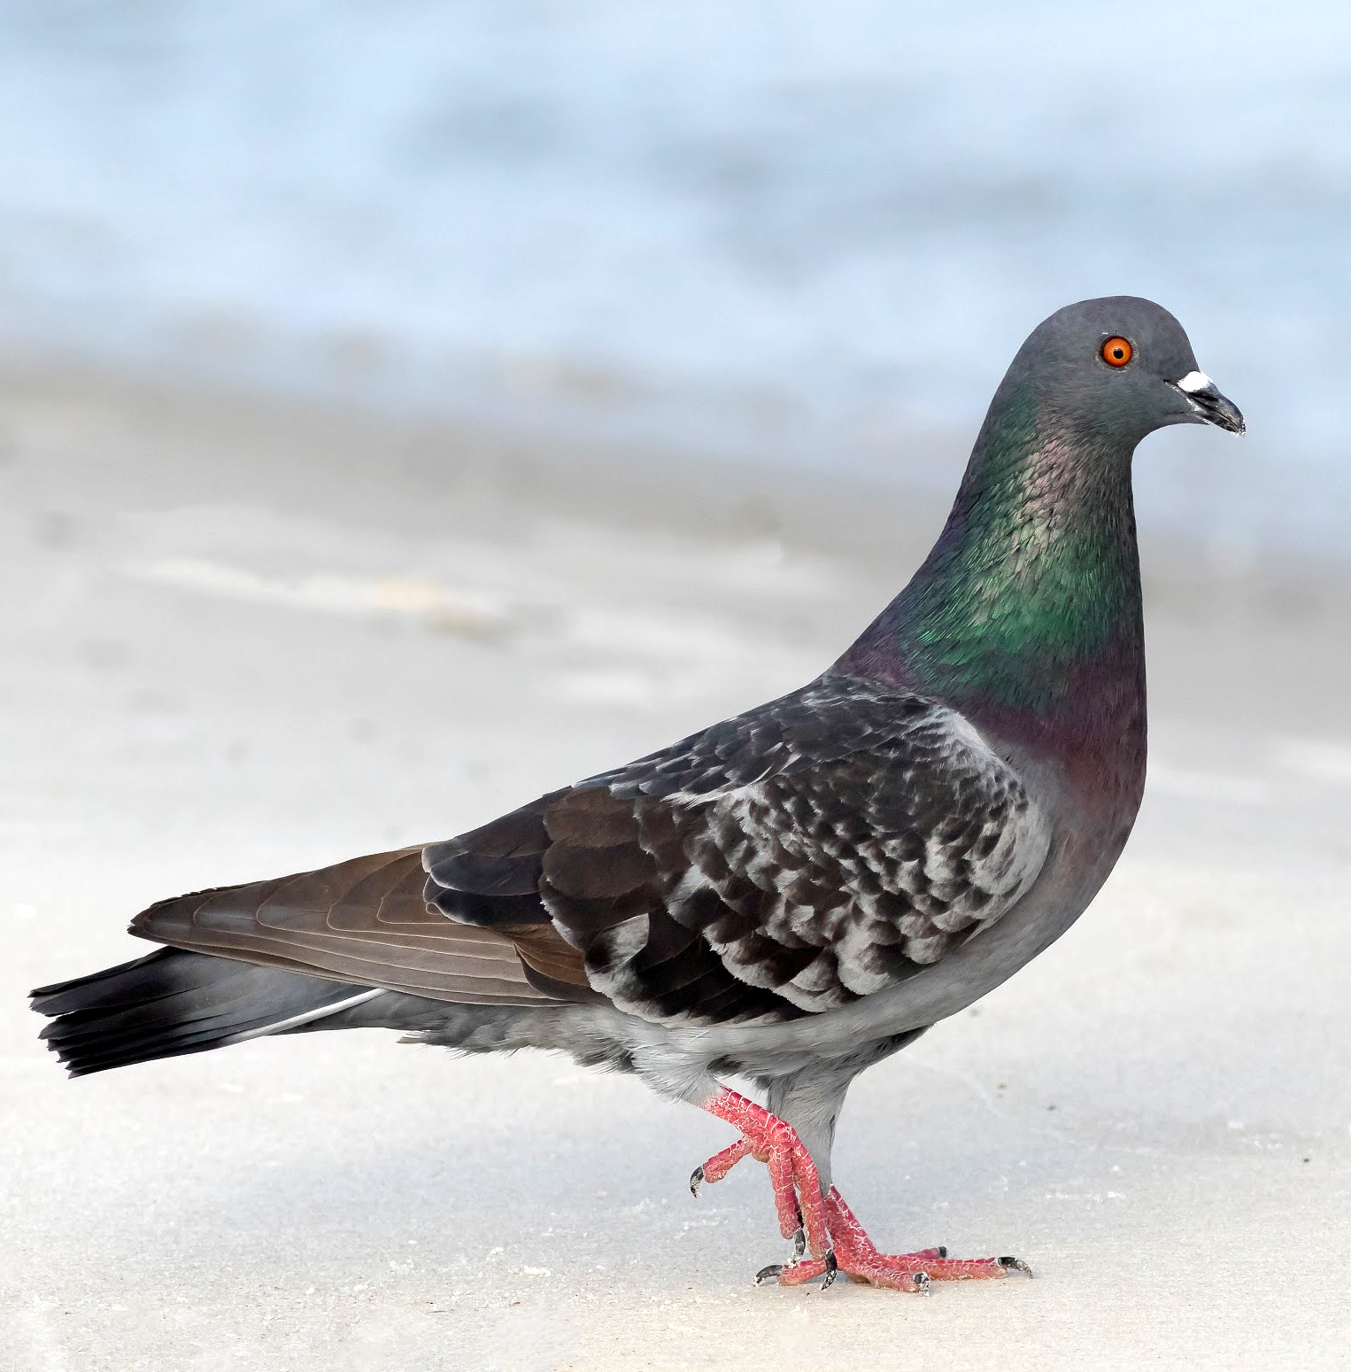
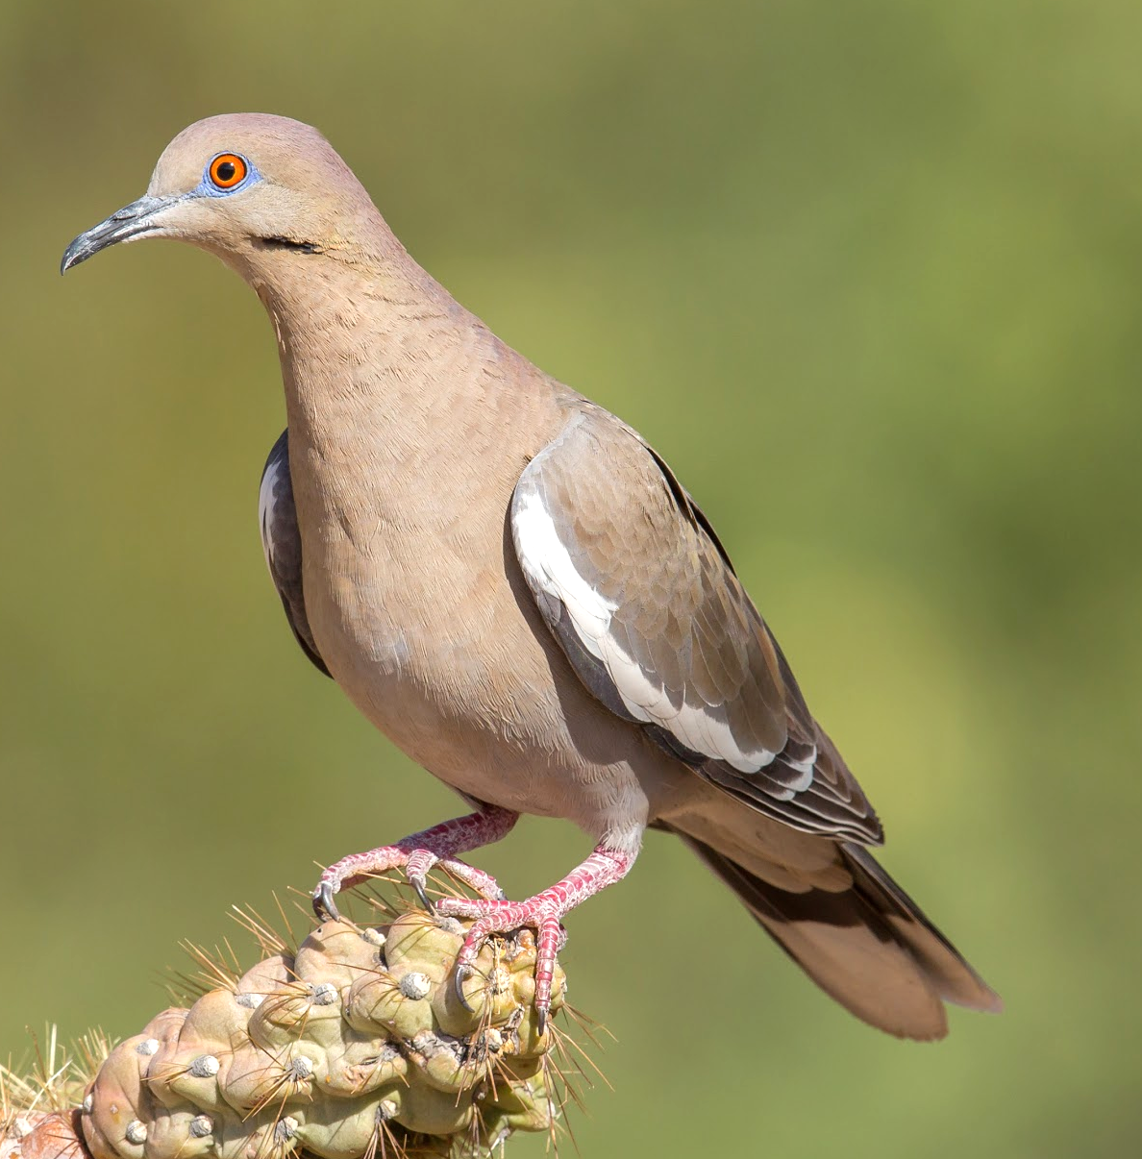
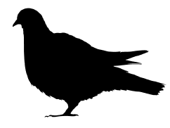
Pigeons & Doves
Rock Pigeon
White-winged Dove
Have chubby bodies, short legs, short necks and small heads.

Slide 17
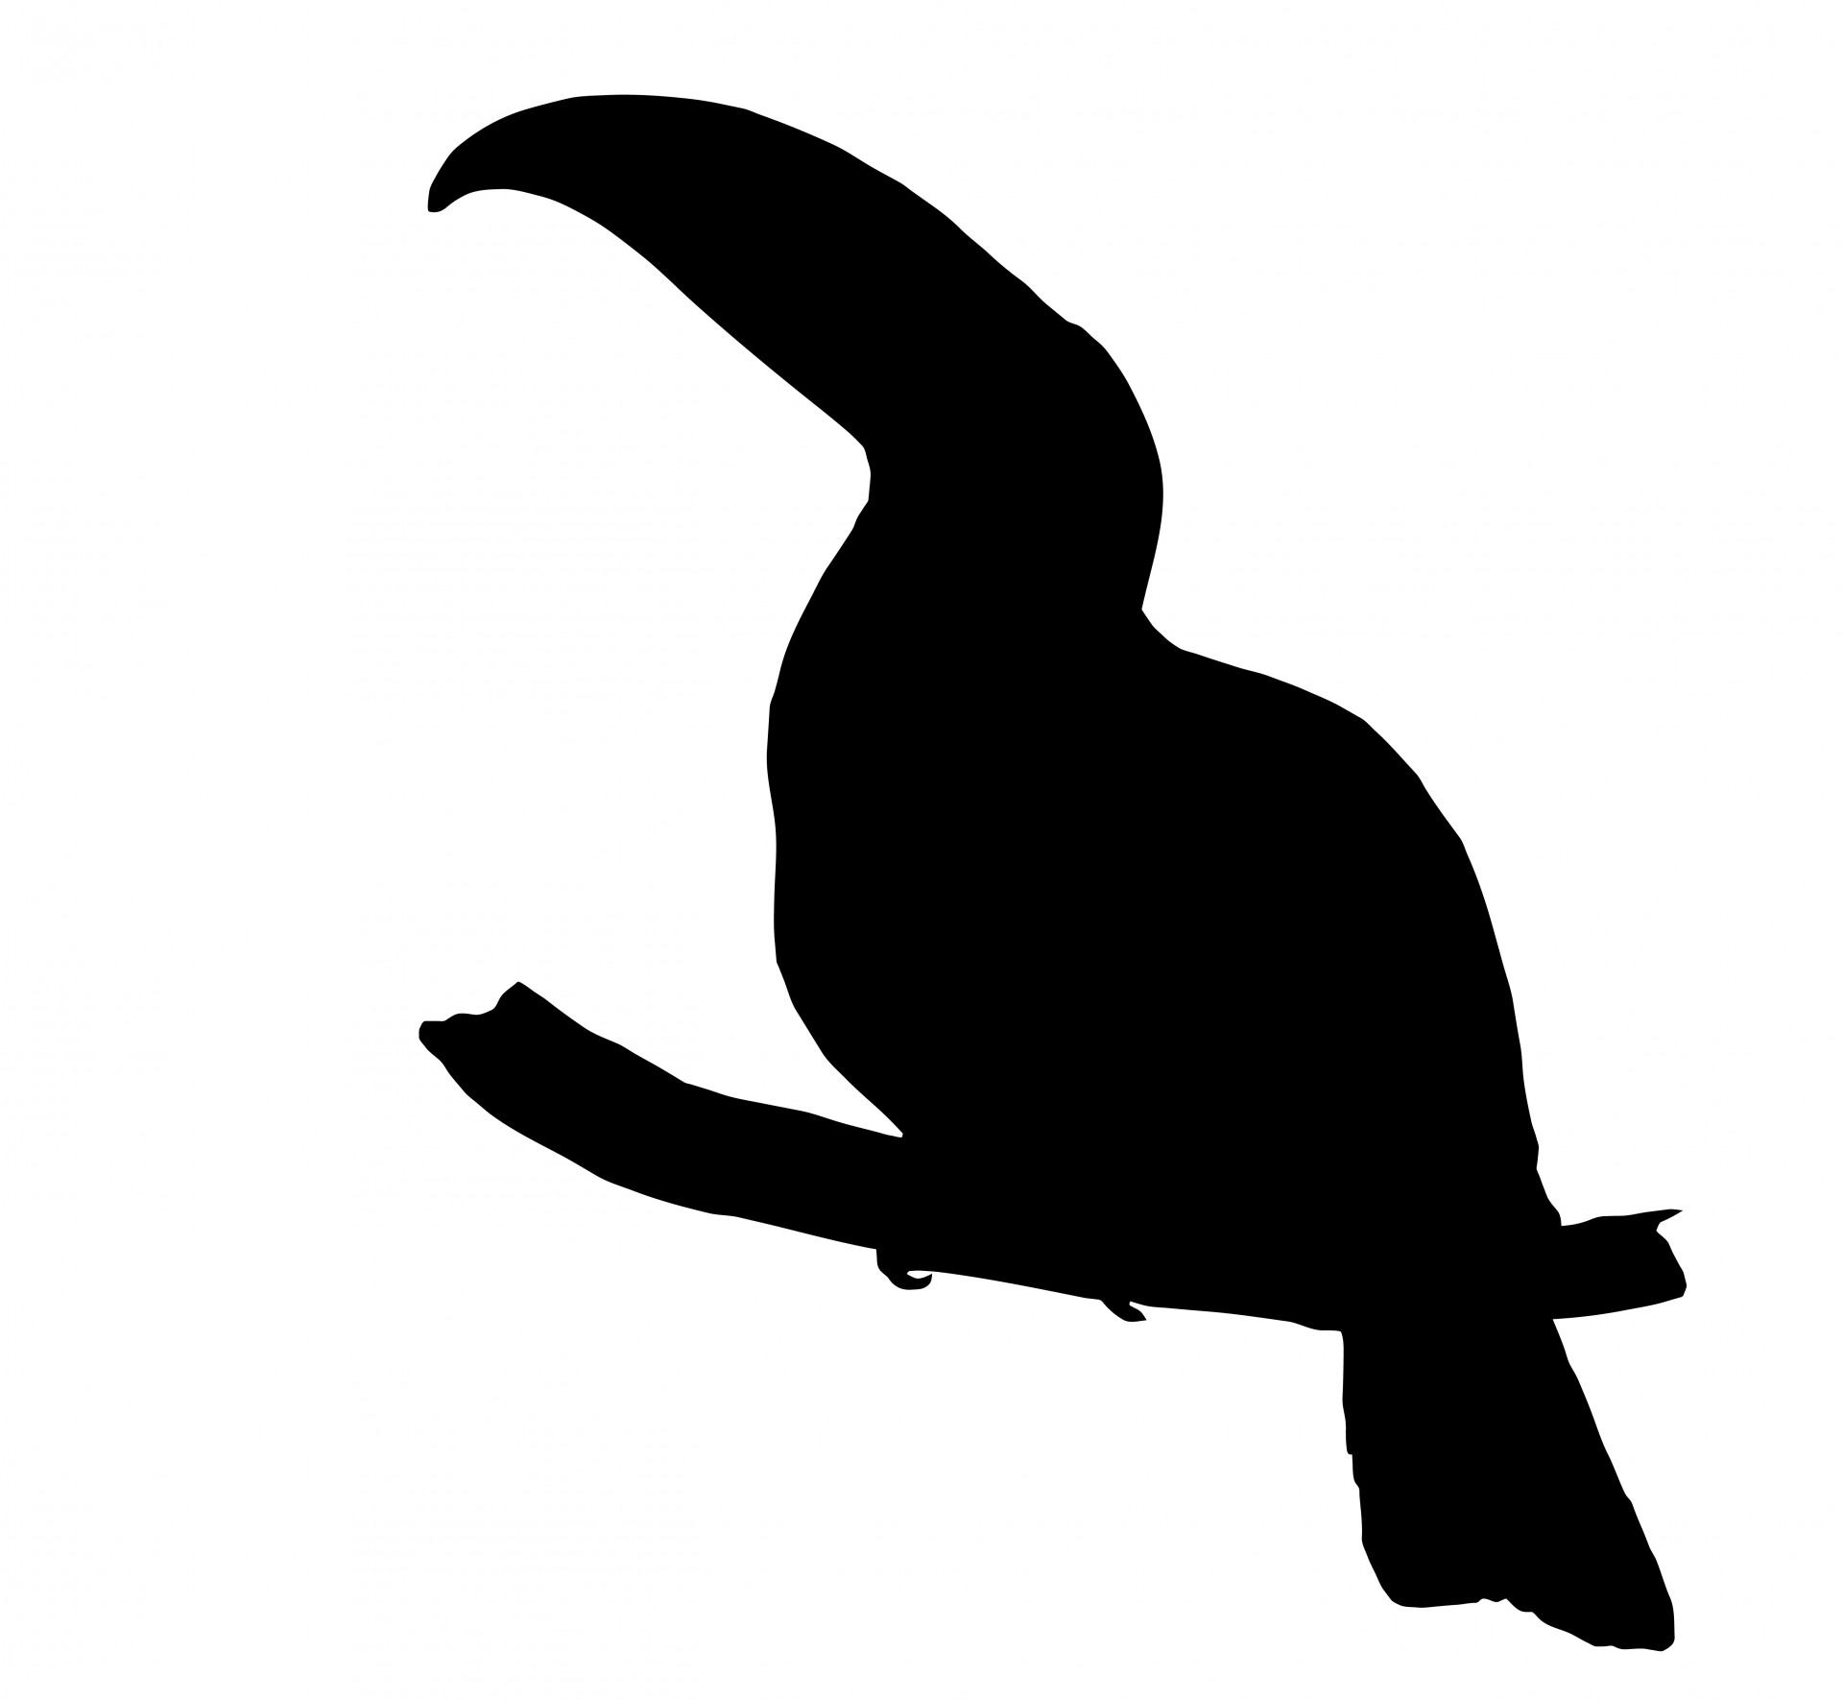


Other groups
There are lots of groups of birds around the world, but we don’t usually see them around New Mexico.
Can you recognize these silhouettes?
Notes:
Silhouette answers: left- penguin, top right- toucan, bottom center- cockatoo
Next: try to observe which types of birds are found in your yard/schoolyard

Slide 18
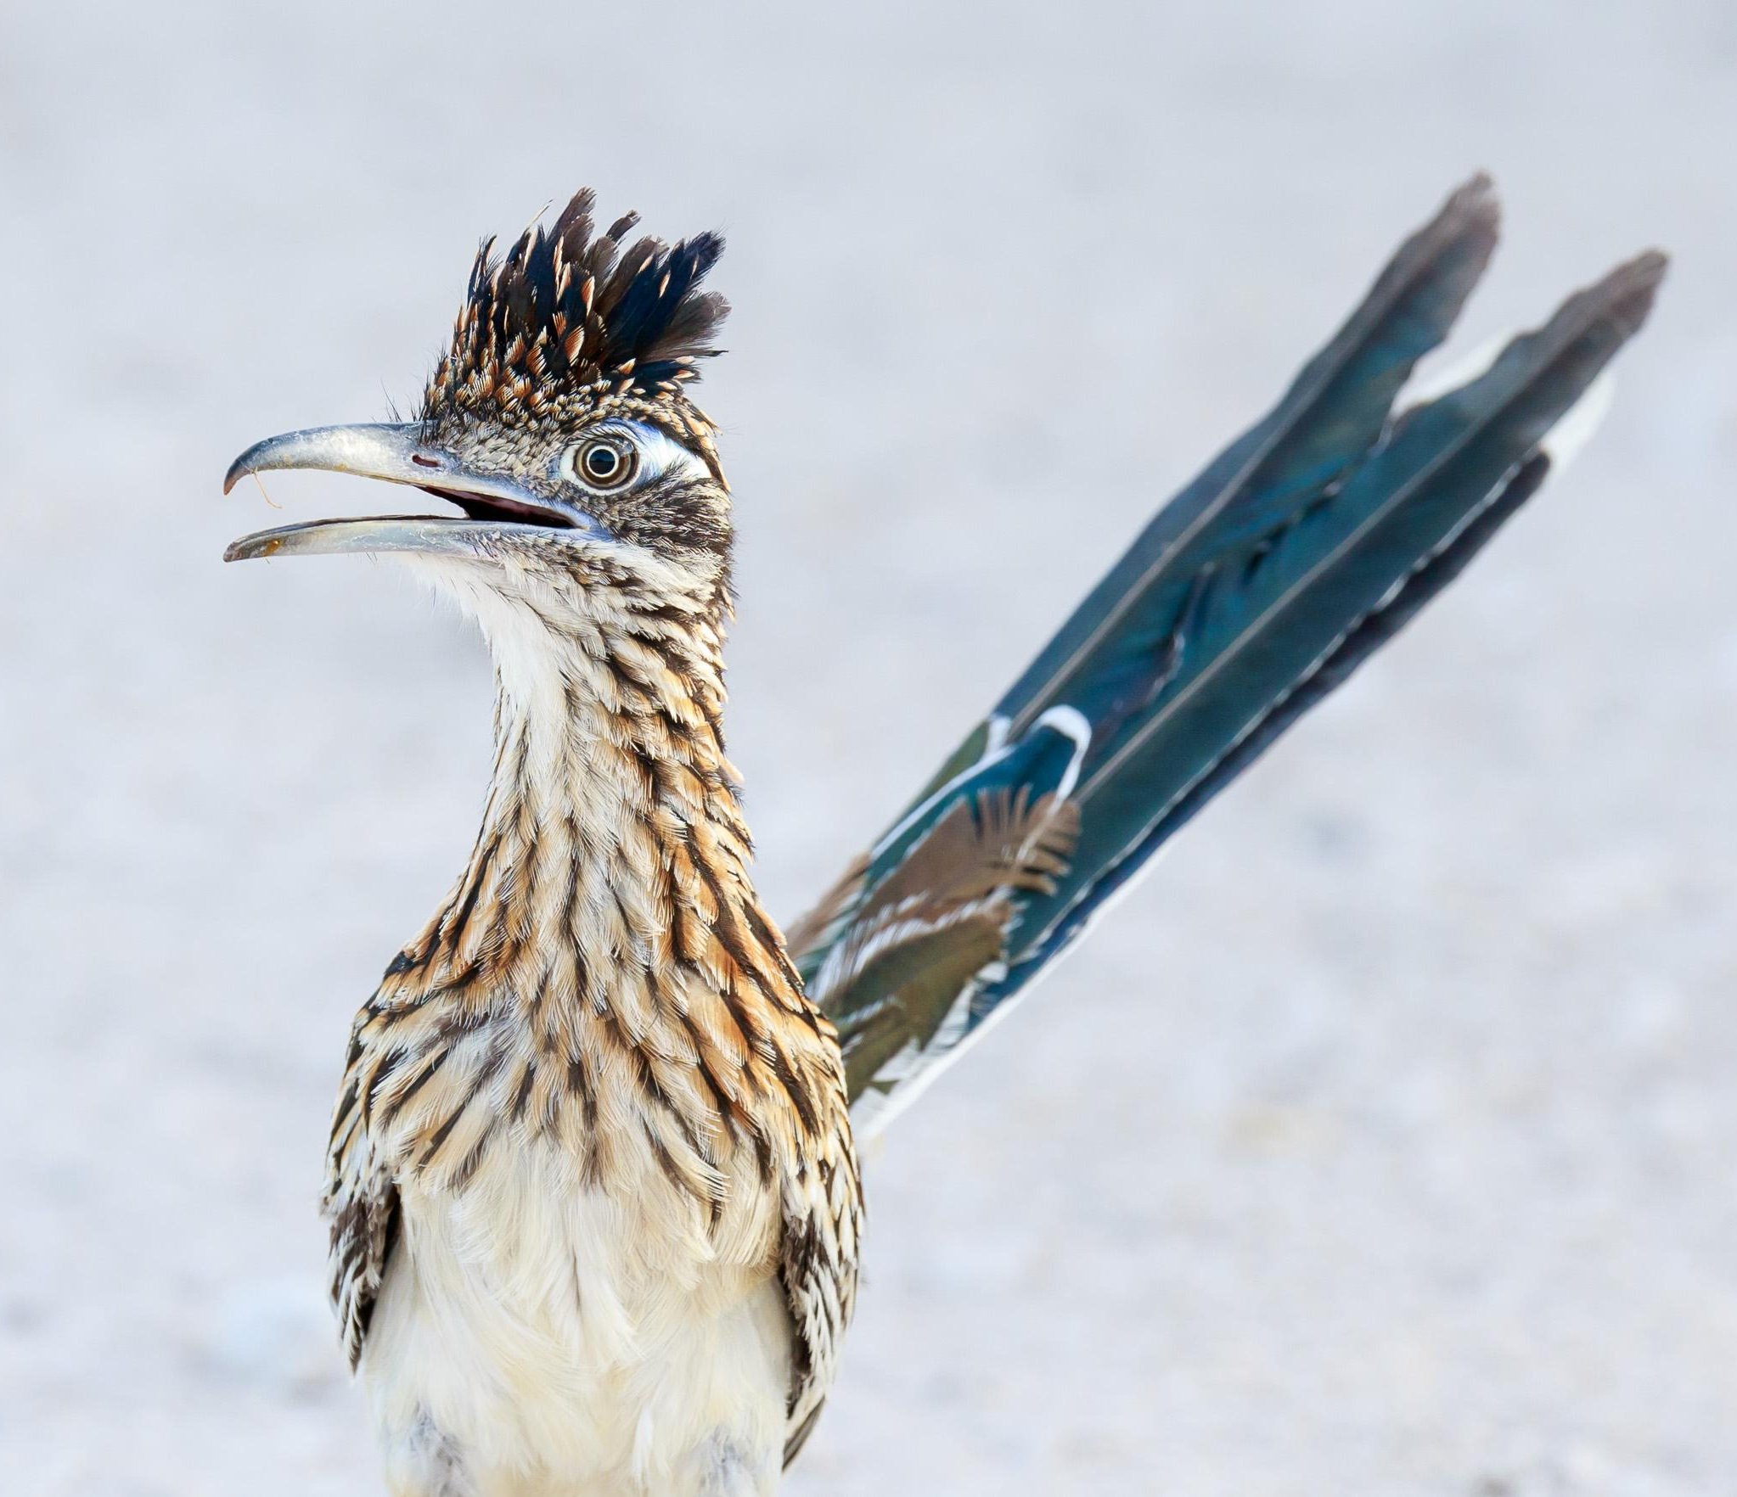

Learn more about birds:
Audubon’s Online Guide to North American Birds (English/Spanish)
Use the free Audubon Field Guide App
Try the free Merlin Bird ID App
Greater Roadrunner

