Slide 1
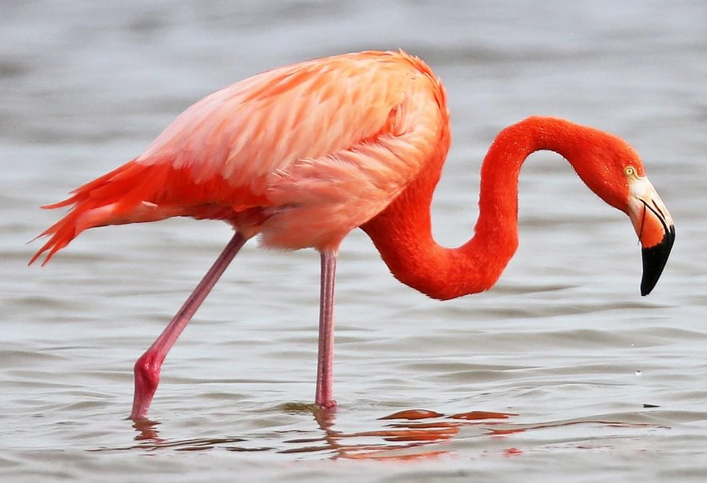
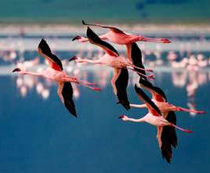
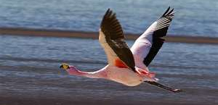

Flightless Bird? American Flamingo
Flamingo Facts:
Residents of along the Gulf and Eastern Coast.
Colonial birds that spend time in the coastal mudflats & estuaries.
Often mistaken as flightless due to captive populations

Slide 2
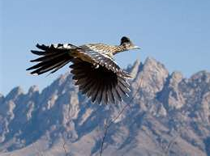
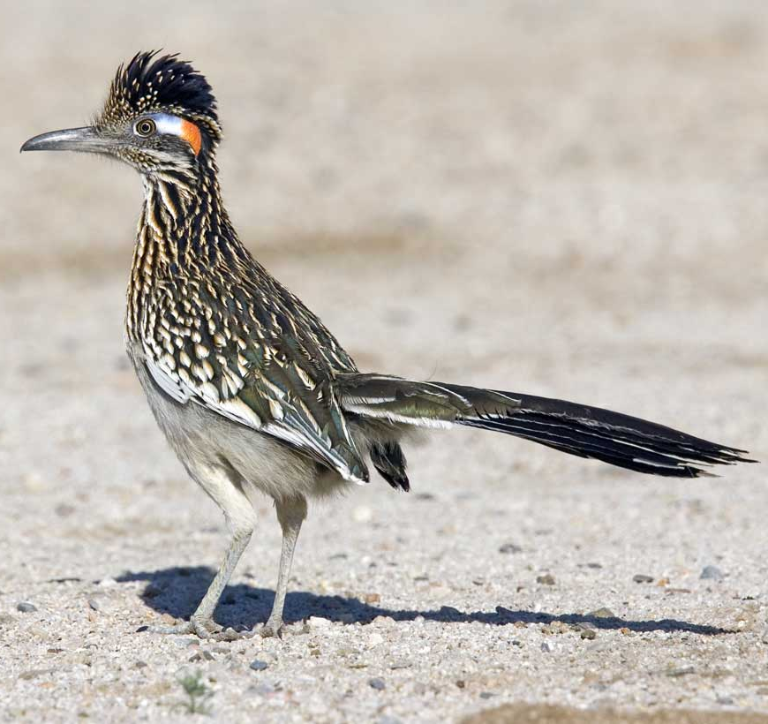
Flightless Bird? Greater Roadrunner
Greater Roadrunner:
Residents of Southwest US and
Mexico. State bird of NM.
Eats insects, snails, lizards,
scorpions, spiders, young birds, and rattlesnakes.
Not just great runners! Will fly up and perch on fences & telephone poles.

Slide 3
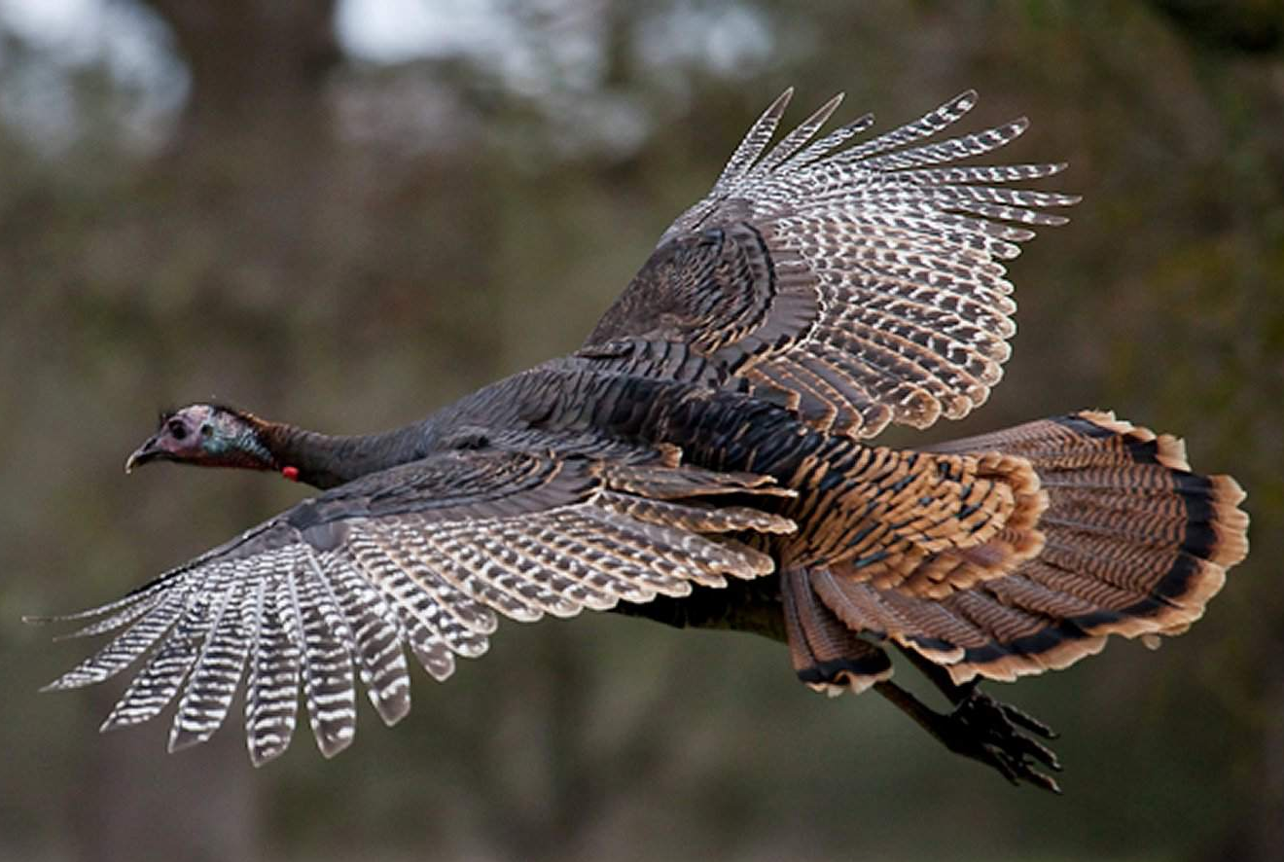
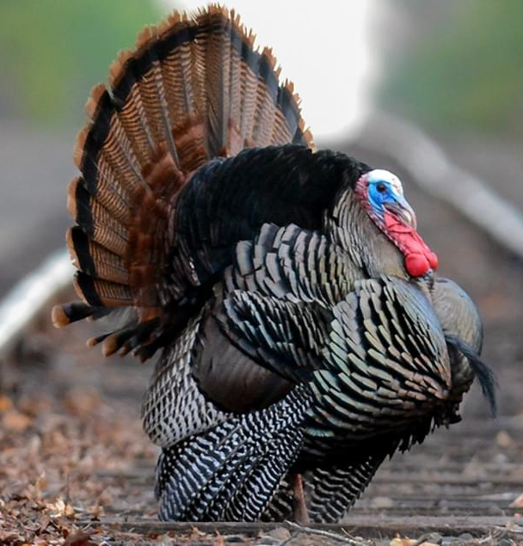
Flightless Bird? Wild Turkey
Wild Turkey:
Residents of North American including
Santa Fe, New Mexico
Non-migratory birds that feed in forests, grasslands, and open areas.
Actually fly up to roost in trees at night!

Slide 4
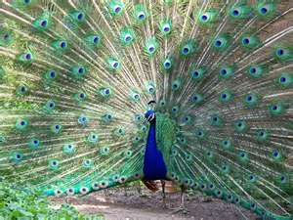
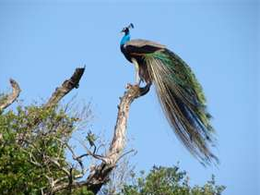
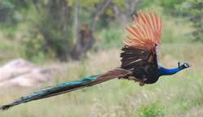
Flightless Bird? Common Peafowl (Peacock)
Common Peafowl:
Large pheasant native to southern India and Ceylon.
Non-migratory bird that feeds on grains, fruits,
insects and snakes.
Actually fly up to roost in trees at night!

Slide 5
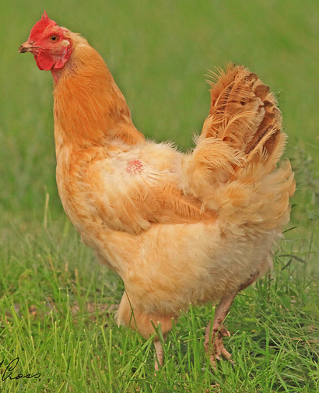
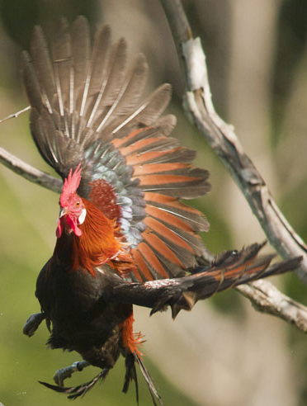
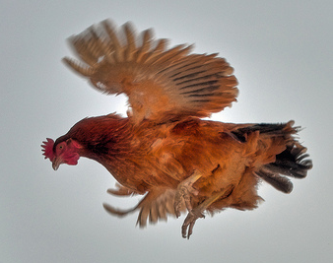
Flightless Bird? Chicken
Domestic Chicken:
Able to fly short distances to escape predators.

Slide 6
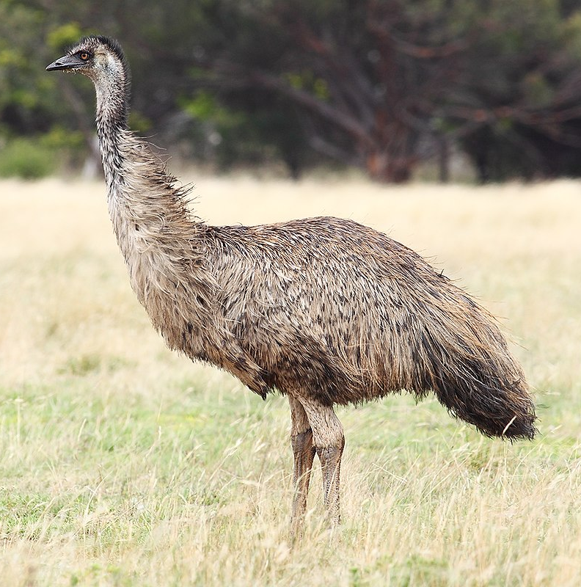
Flightless Bird!
EMU
True flightless bird!
Found in Australia
2nd tallest bird in the world
Smaller wings
Absent keel (anchors muscles needed for light).
Adapted for running (up to 30 mph!)

Slide 7
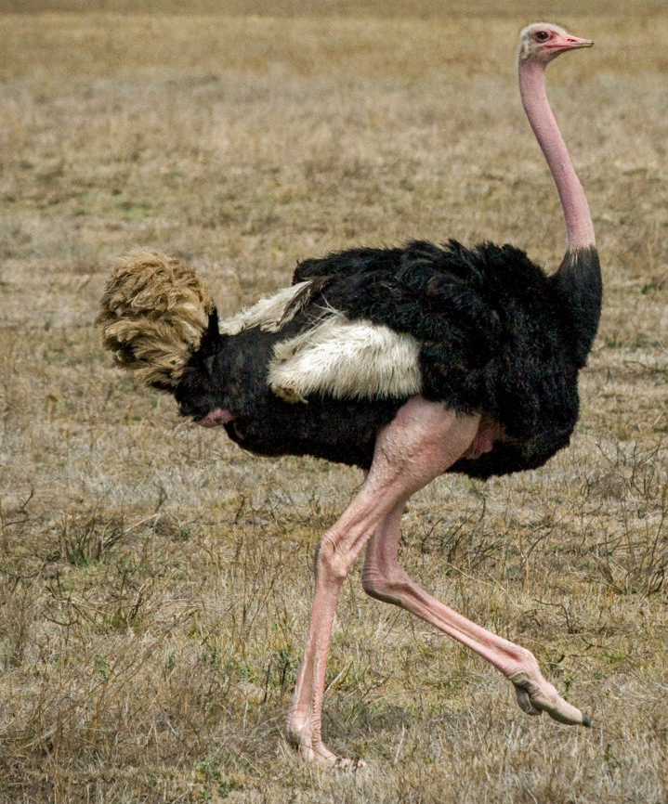
Flightless Bird!
Ostrich
True flightless bird!
Found in Africa
Tallest bird in the world
(6-9 feet)
Smaller wings
Absent keel (anchors muscles needed for light).
Adapted for running (up to 43 mph!)

Slide 8
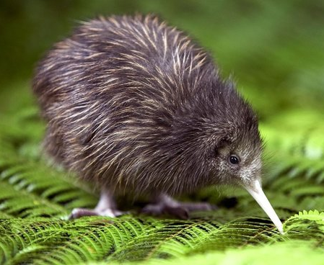
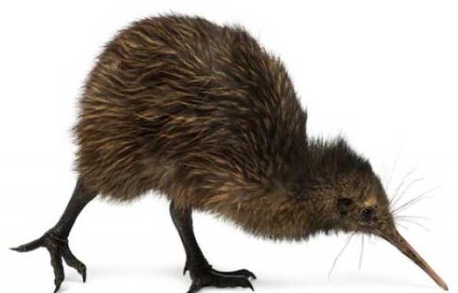
Flightless Bird!
Kiwi
True flightless bird!
Found in New Zealand
Tiny wings structures
No keel (anchors muscles needed for light).
Adapted to living on an island with no predators & no need to escape
Nocturnal (only out at night), practically blind

Slide 9
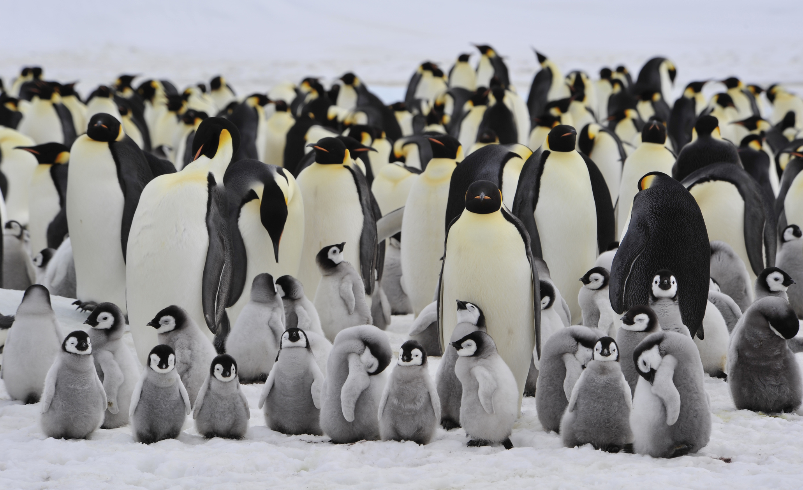
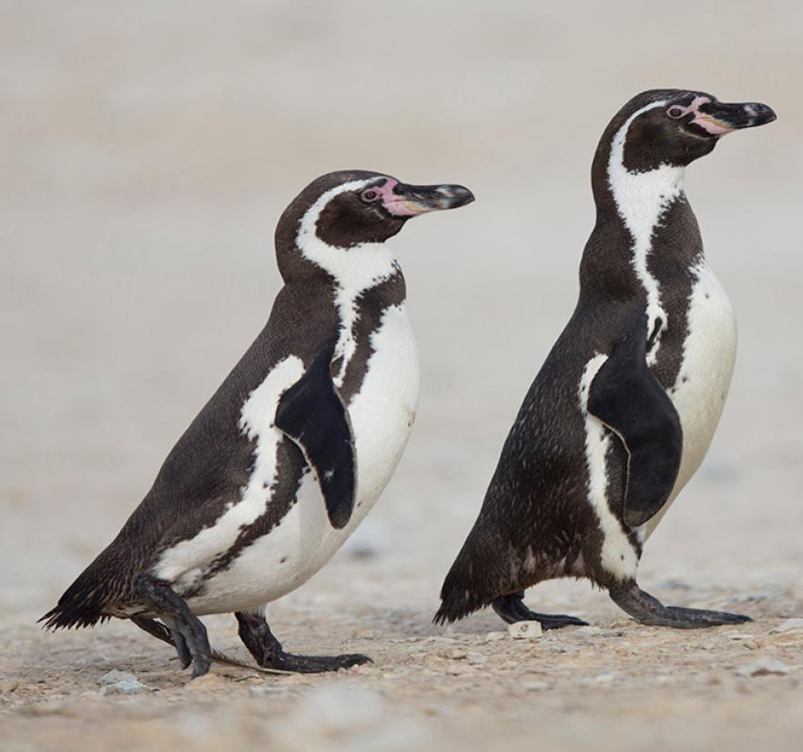
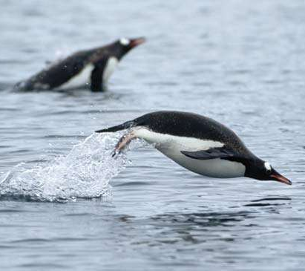
Flightless Bird!
Penguins
True flightless birds!
Found in Antarctica & other parts of the Southern Hemisphere
20 species worldwide
Smaller wings, reduced keel (muscles needed for flight)
Highly adapted to swimming and aquatic life.

